Slide 1
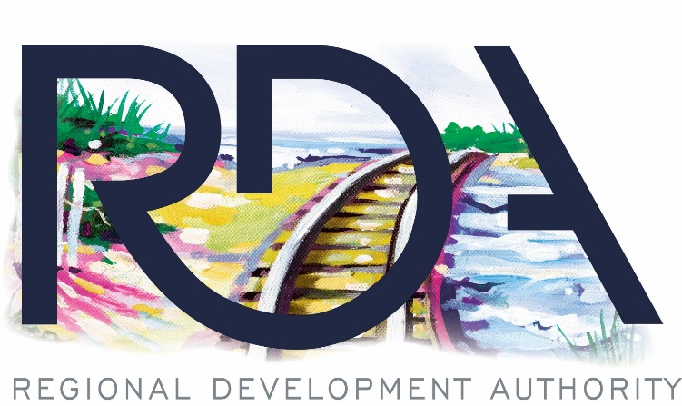
NW Indiana 2021 Business & Economic Outlook
Rail Projects and TOD: Return on Investment
Policy Analytics, LLC on behalf of the RDA
November 5, 2021

Slide 2
IMPACT OF THE RDA
RDA Created in 2005 to catalyze economic development across NW IN
Focus was to be: Airports, Shoreline, Bus Transit, Commuter rail
Since 2006 the RDA has invested more than $364 M in the economy of NW IN
RDA’s focus now is in financing the rail projects, and in TOD
Combining the Rail Projects buildout, and the projected TOD following, this is the largest economic development project ever in the State of Indiana
Northwest Indiana RDA

Slide 3
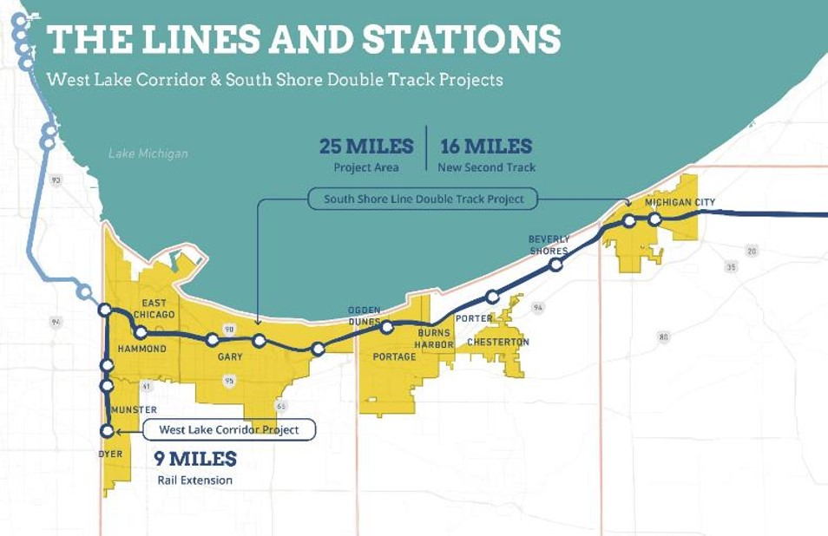
GETTING THE PROJECT STARTED
Legislature mandated an RDA Strategic Plan in 2015
RDA asked Policy Analytics and Structurepoint to do it
Plan was presented to the State Budget Committee in the Fall of 2016

Slide 4
Predicted Results: POPULATION IMPACT
Lake, Porter County Population Changes Above Baseline
Increased accessibility encourages migration from Chicago and other regions to Northwest Indiana.
Modern urban design concepts help Northwest Indiana communities compete with Chicago and other regional locations for newer generations of workers.
Transit access provides a key tool for local communities to leverage for redevelopment.

Slide 5
Predicted Results: ONGOING EMPLOYMENT IMPACT
Lake and Porter County Employment Impacts
Approximately 1,000 annual jobs are supported during the construction period from 2021 to 2025.
The West Lake Corridor project produces an estimated 2,500 ongoing jobs in Lake and Porter Counties by 2047.
Double Track adds another 2,900 jobs, mostly stemming from redevelopment in Northern Lake County communities.
The Total with all station areas included is 6,000 jobs.
Double-tracking catalyzes redevelopment in north Lake and Porter Counties.
West Lake + Double Tracking
West Lake Only

Slide 6
Predicted Results: STATION AREA EMPLOYMENT
Composition of Employment at Station Areas
The illustrative station area development plans include retail and office space.
An emerging trend is for professionals, particularly Millennials, to live within walking distance of their workplace, or to have pedestrian access to transit.
Employment impacts will develop from investments in commercial and residential growth around the station areas.

Slide 7
Predicted Results: COMMUNITY DEVELOPMENT
TOD Construction Cost Estimates – Phase I and II Projects
Improved rail connectivity increases demand for office, retail and residential uses across the region.
Projected station area plans were developed for ten stations along the West Lake and South Shore rail lines.
These plans estimate more than $2.7B in capital investment over a 20-year timeframe.

Slide 8
Predicted Results: FISCAL IMPACT
State and Local Fiscal Impact of Rail Projects and TOD
The rail transit and station area investment produces a marginal State Sales Tax increase of $310M in Lake and Porter Counties over a 20 year period.
The rail transit and station area investment produces a marginal State Income Tax increase of $192M in Lake and Porter Counties over a 20 year period.
For local income taxes, the total is $69M over the same period.
Property Tax impact is $451.8M

Slide 9
KICK STARTING THE PROJECTS
The Indiana General Assembly began funding both of the rail projects in earnest in the 2017 Legislative Session with appropriations to both the West Lake and Double Track projects 1144-2017 (IC 36-7.5-4.5).
The state also provided a mechanism for development and redevelopment to occur around the transit station areas.
These districts [TDD’s] function like a TIF district, however the incremental revenues go to the NWI RDA, for project investment within that station area.
Incremental revenues in LaPorte or St. Joseph Counties go to the local Redevelopment Commission.
TDD’s are established by resolution of the RDA Board, with approval by the State Budget Committee.
TDD’s collect both incremental property taxes and local income taxes, and revenues must be used within the district where collected.

Slide 10
TDD PLANNING PROCESS
12 Station Areas
RDA Planning Team is meeting with every community
7 Station Area Boundary plans are ready for approval

Slide 11
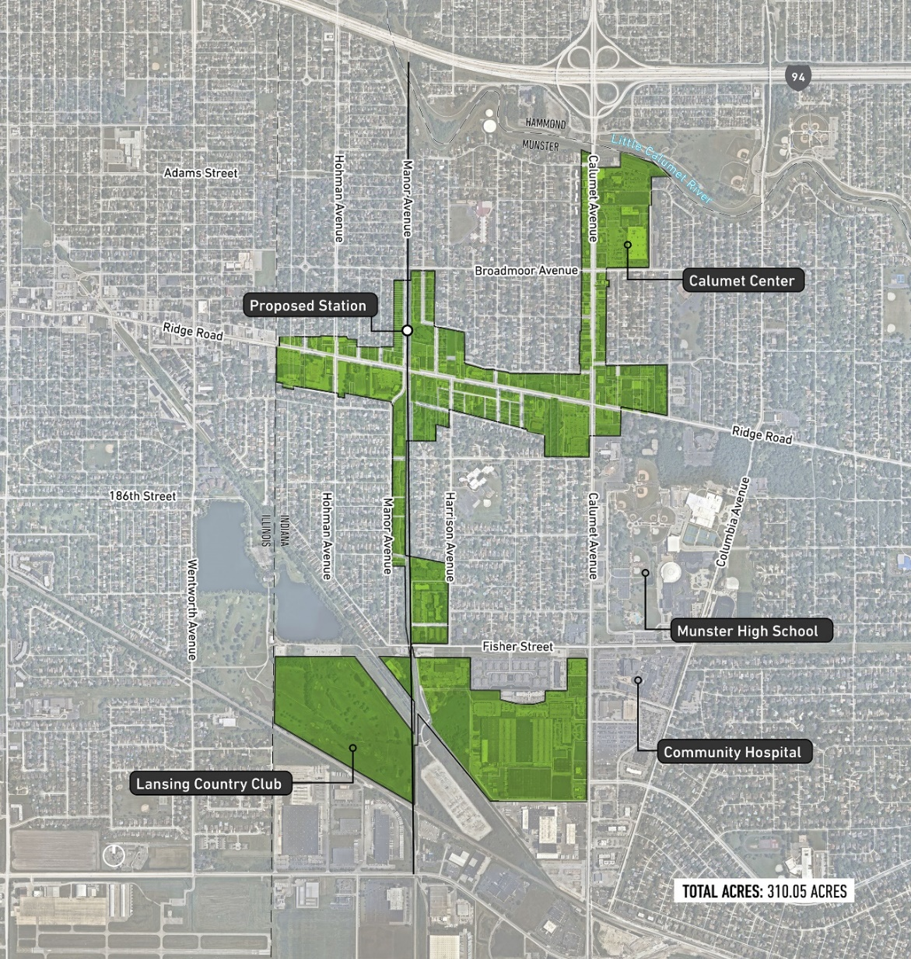
TRANSIT DEVELOPMENT DISTRICTS
Each TDD per statute may only encompass 320 acres, [expandable to 640 acres]
RDA and the communities are working together to set the boundaries
Strategy is to include areas ripe for redevelopment
Areas to be included should provide incremental revenues to fund infrastructure
The process is designed to show immediate results

Slide 12
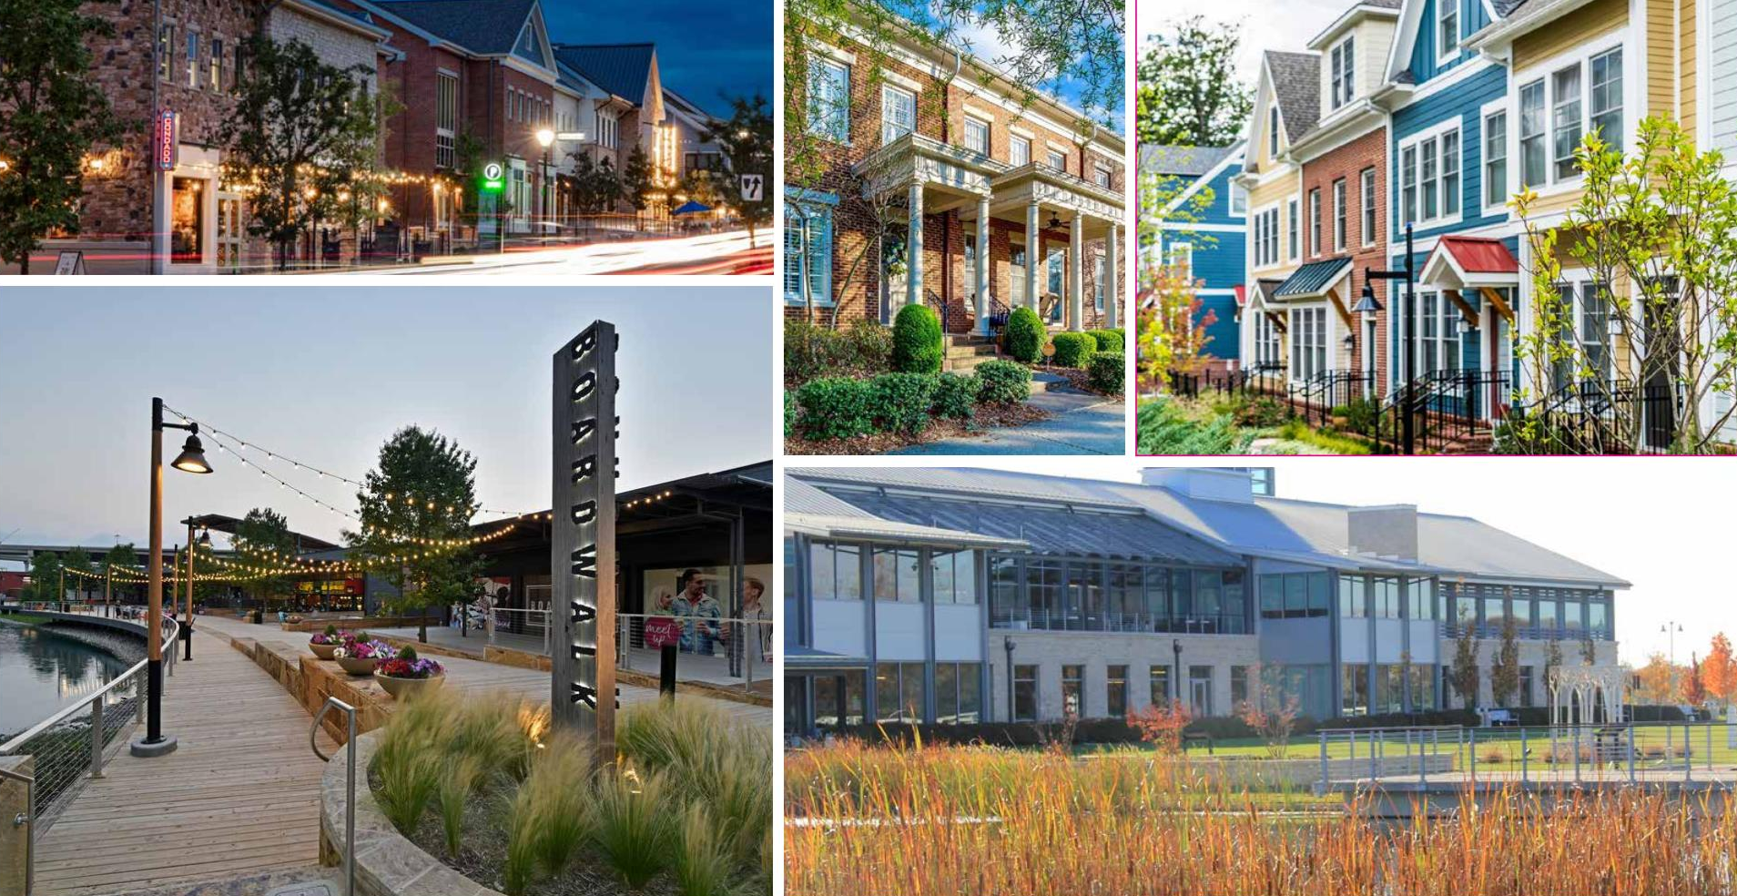
COMMUNITY ASPIRATIONS BEING MET

Slide 13
CONCLUSION
The rail projects with the associated transit oriented development are the largest economic development project in the history of Indiana. Together approaching $4.7 billion.
As Mike Noland has shown you, the train projects are, in fact, being built – it’s not just hopes and dreams.
The station area, and more broadly community developments, are being put in place with funding available from the beginning.
The RDA has sponsored 2 industry days with more to come, bringing developers and community leaders together, with more than 12 development firms attending at this point.
Communities, their planners, and their leadership are excited about the opportunity that this process is creating within their geography. They are responding with thoughtful, collaborative ideas and strategies.
Developers and bankers are meeting with communities right now to pitch projects in an attempt to find common ground and get started right away.

Slide 14
QUESTIONS AND DISCUSSION
For more information visit: http://www.nwitdd.com

