Slide 1
PARDON OUR DUST
PARDON OUR DUST

Slide 3
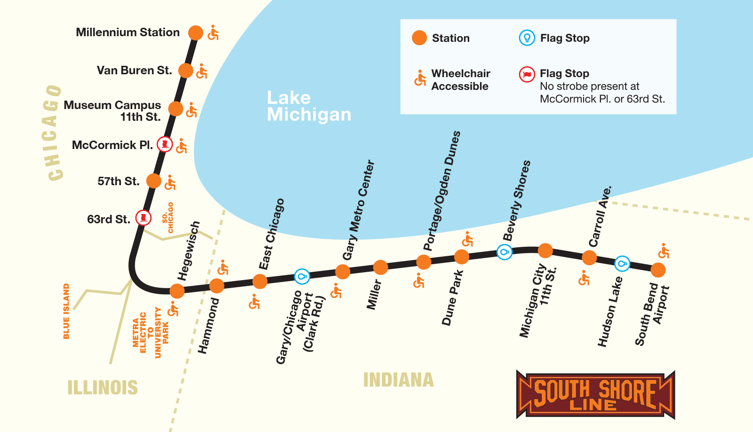

South Shore Line System
South Shore Line System
West Lake Extension
Notes:
Train Schedule, Travel Times, WL Extension intro into overview map

Slide 4
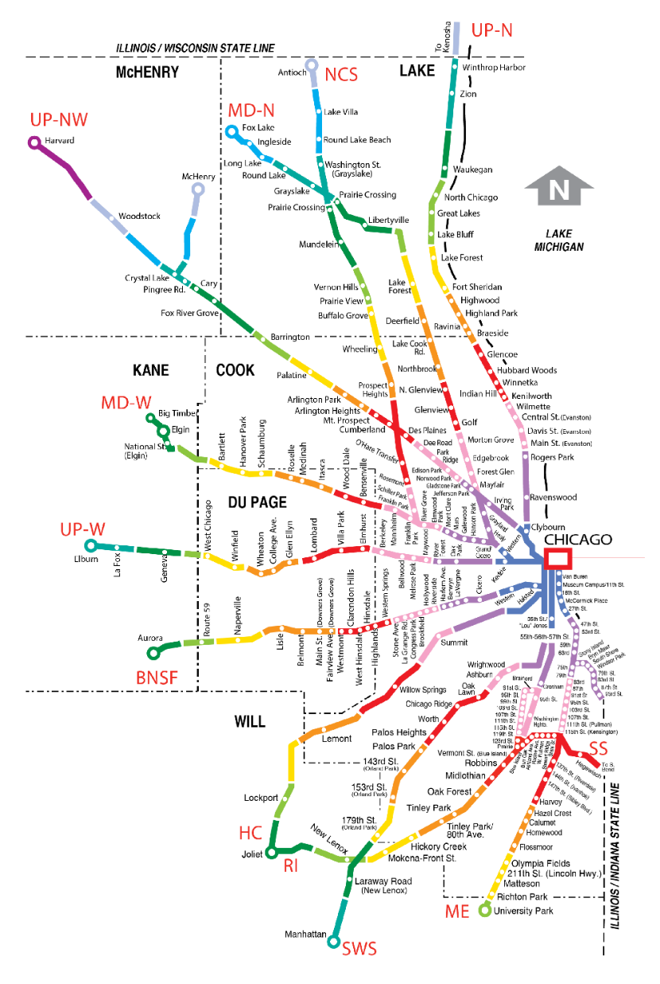
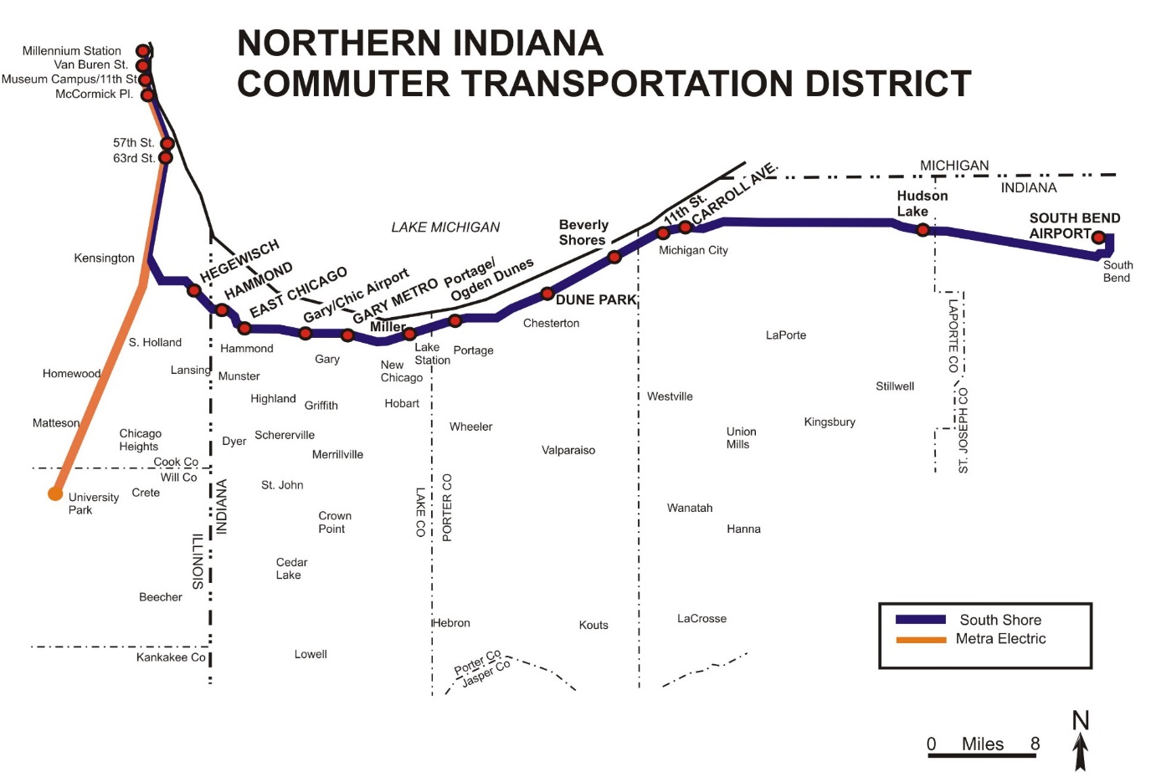



Slide 5

West Lake COST
$944
MILLION*
Additional $43.8M from ARP
*Subject to continuing review by Federal Transit Administraton

Slide 6
Double Track COST
$495
MILLION*
Additional $24.5M from ARP
*Subject to continuing review by Federal Transit Administration

Slide 7
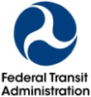


Slide 8
Why Do These Projects
In excess of $2B in private investment from the projects
Creation of more than 7,000 new jobs
Generation of a ROI on the State of Indiana investment of at least $2 for every $1 invested.
SSL average income is nearly $90K/year
Jobs in Chicago pay a 40% premium, on average than jobs in NWI
Ridership Double-More riders to Chicago, more local investment
Transit Oriented Development
Transit Development Districts

Slide 9
INCREASED RIDERSHIP
With Double Track NWI, ridership increases from 12,000 daily boardings to over 27,600 on the system with the addition of the West Lake Corridor (20,500 on the South Shore Line) by 2040 as compared to no investment
With Project
No Project
Today
Today
No Project
With Project
Source: RSG, January 2016

Slide 12
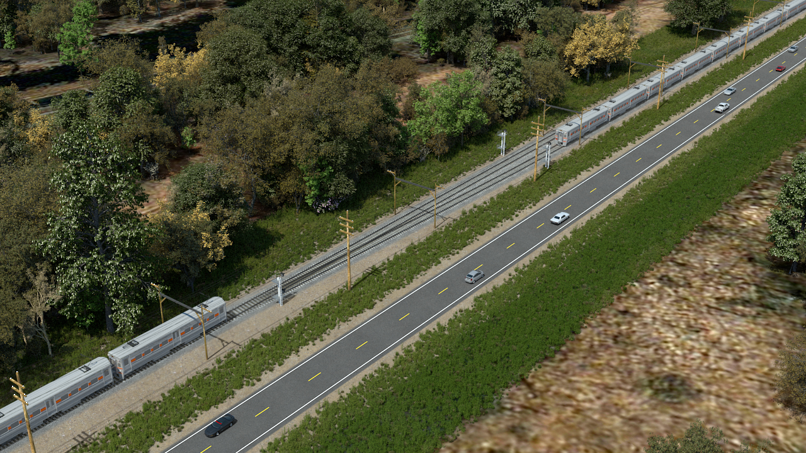
SINGLE TRACK CHALLENGES

Slide 13
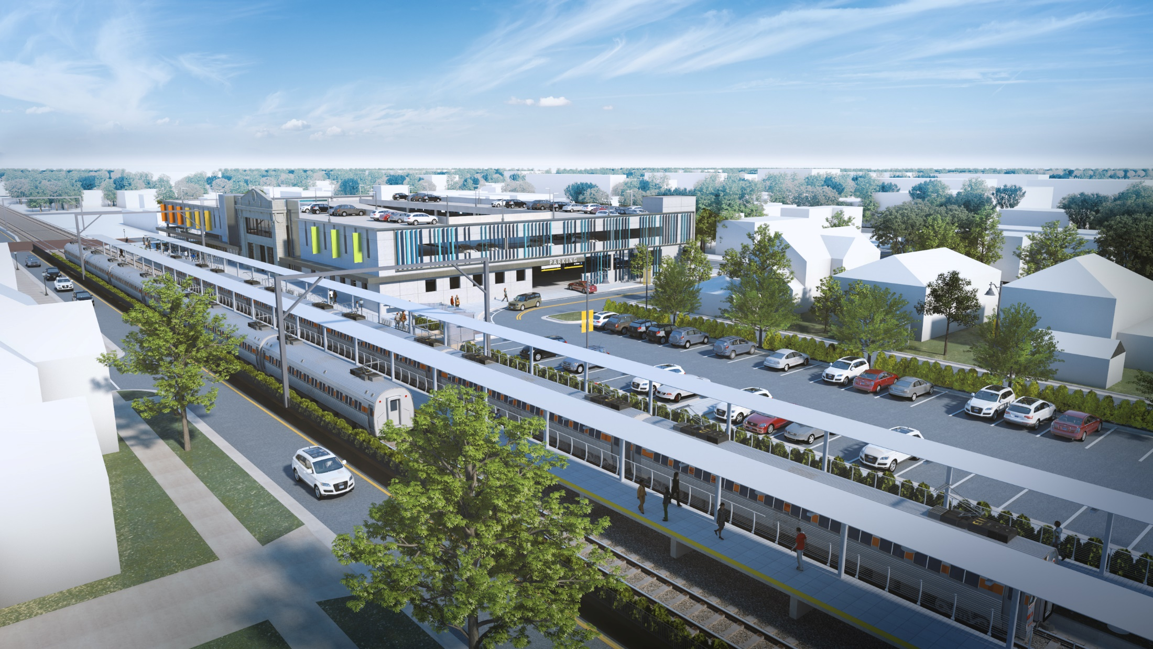
View: From above looking northwest south of 11th near Spring Street
DRAFT APRIL 2020 AT 60% DESIGN;
NOT FINAL DESIGN

Slide 14
Notes:
Photo curtesy of Norman Carlson

Slide 15
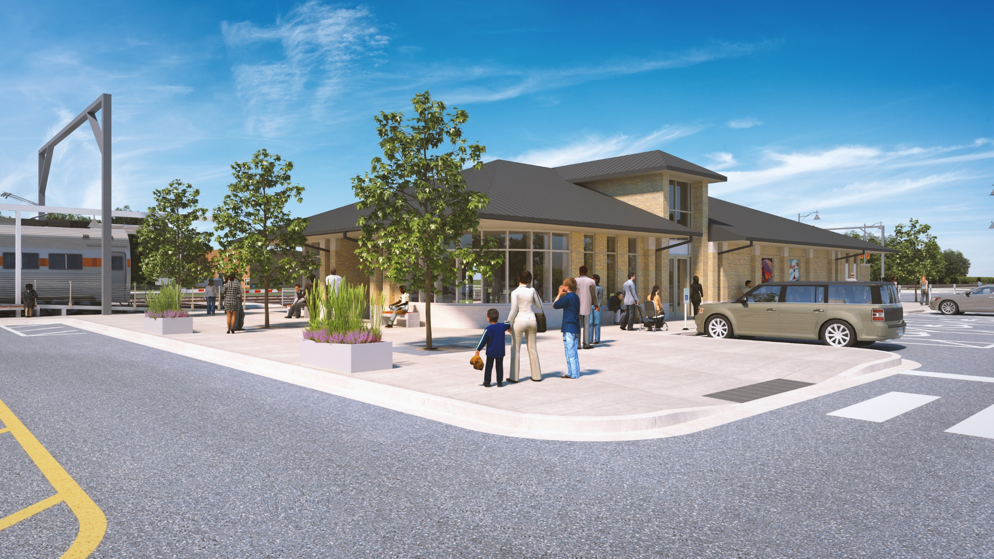
Miller Station (60% Design)
VIEW: Looking Northeast at southwest corner of station
DRAFT APRIL 2020 AT 60% DESIGN;
NOT FINAL DESIGN

Slide 16
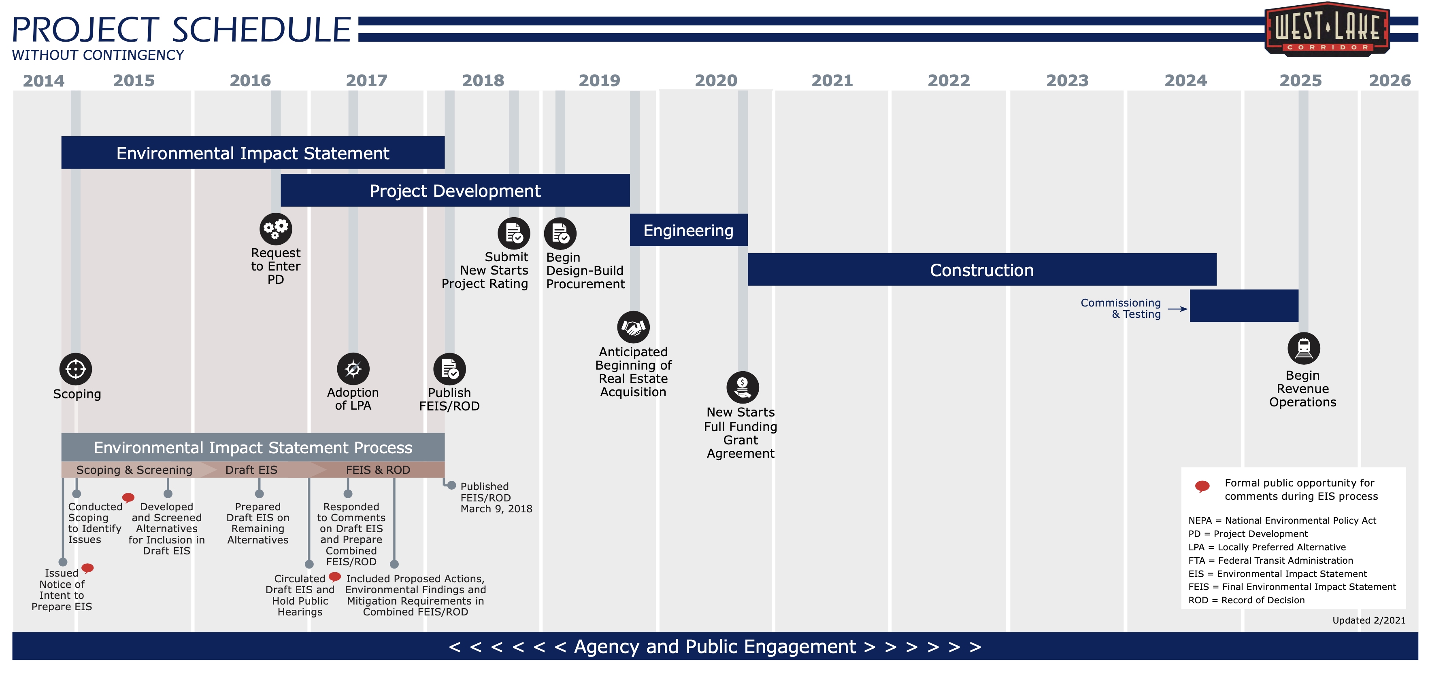

Slide 18
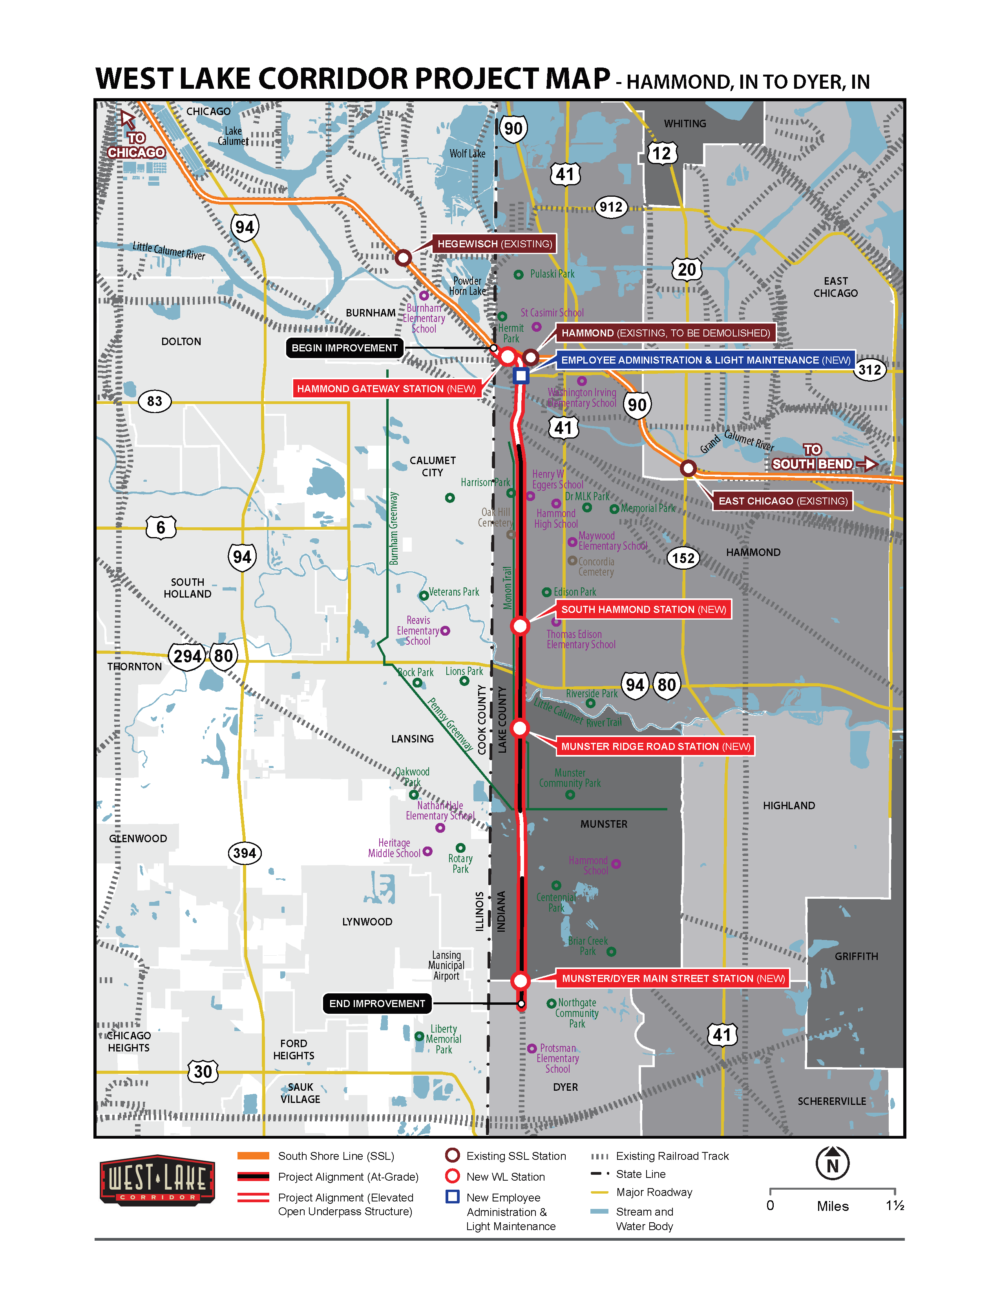
Project Corridor

Slide 19
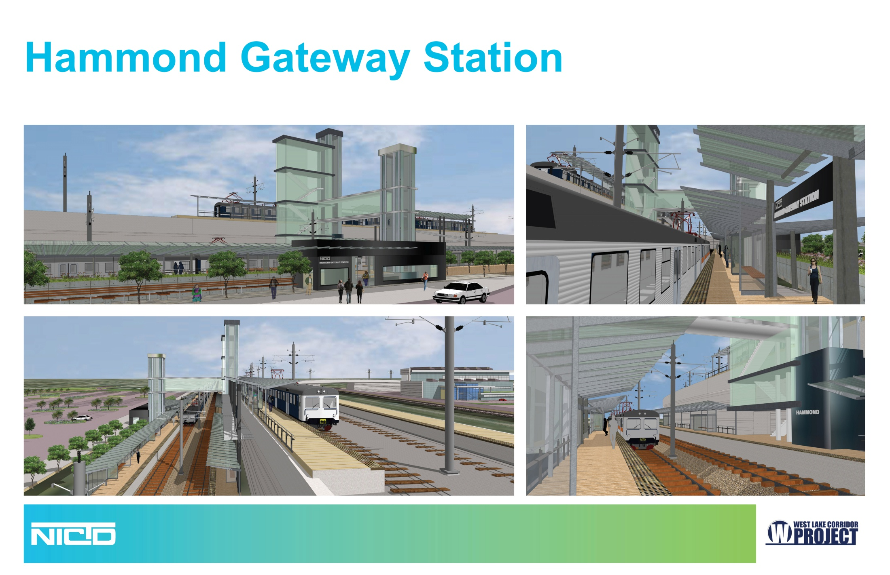
ILLUSTRATIVE PURPOSES ONLY

Slide 20
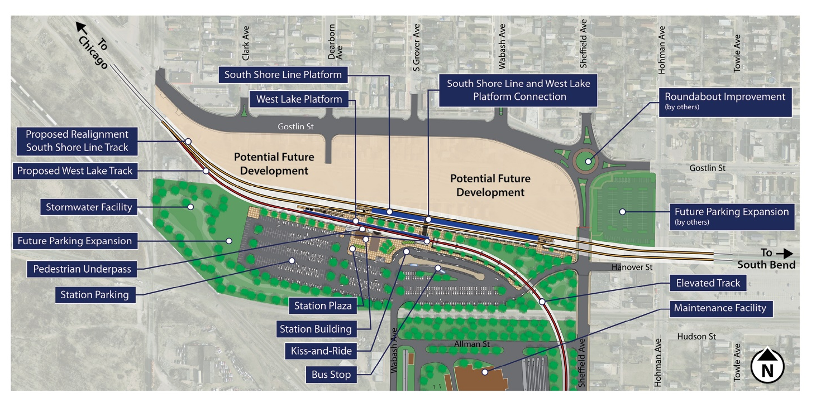

Slide 21
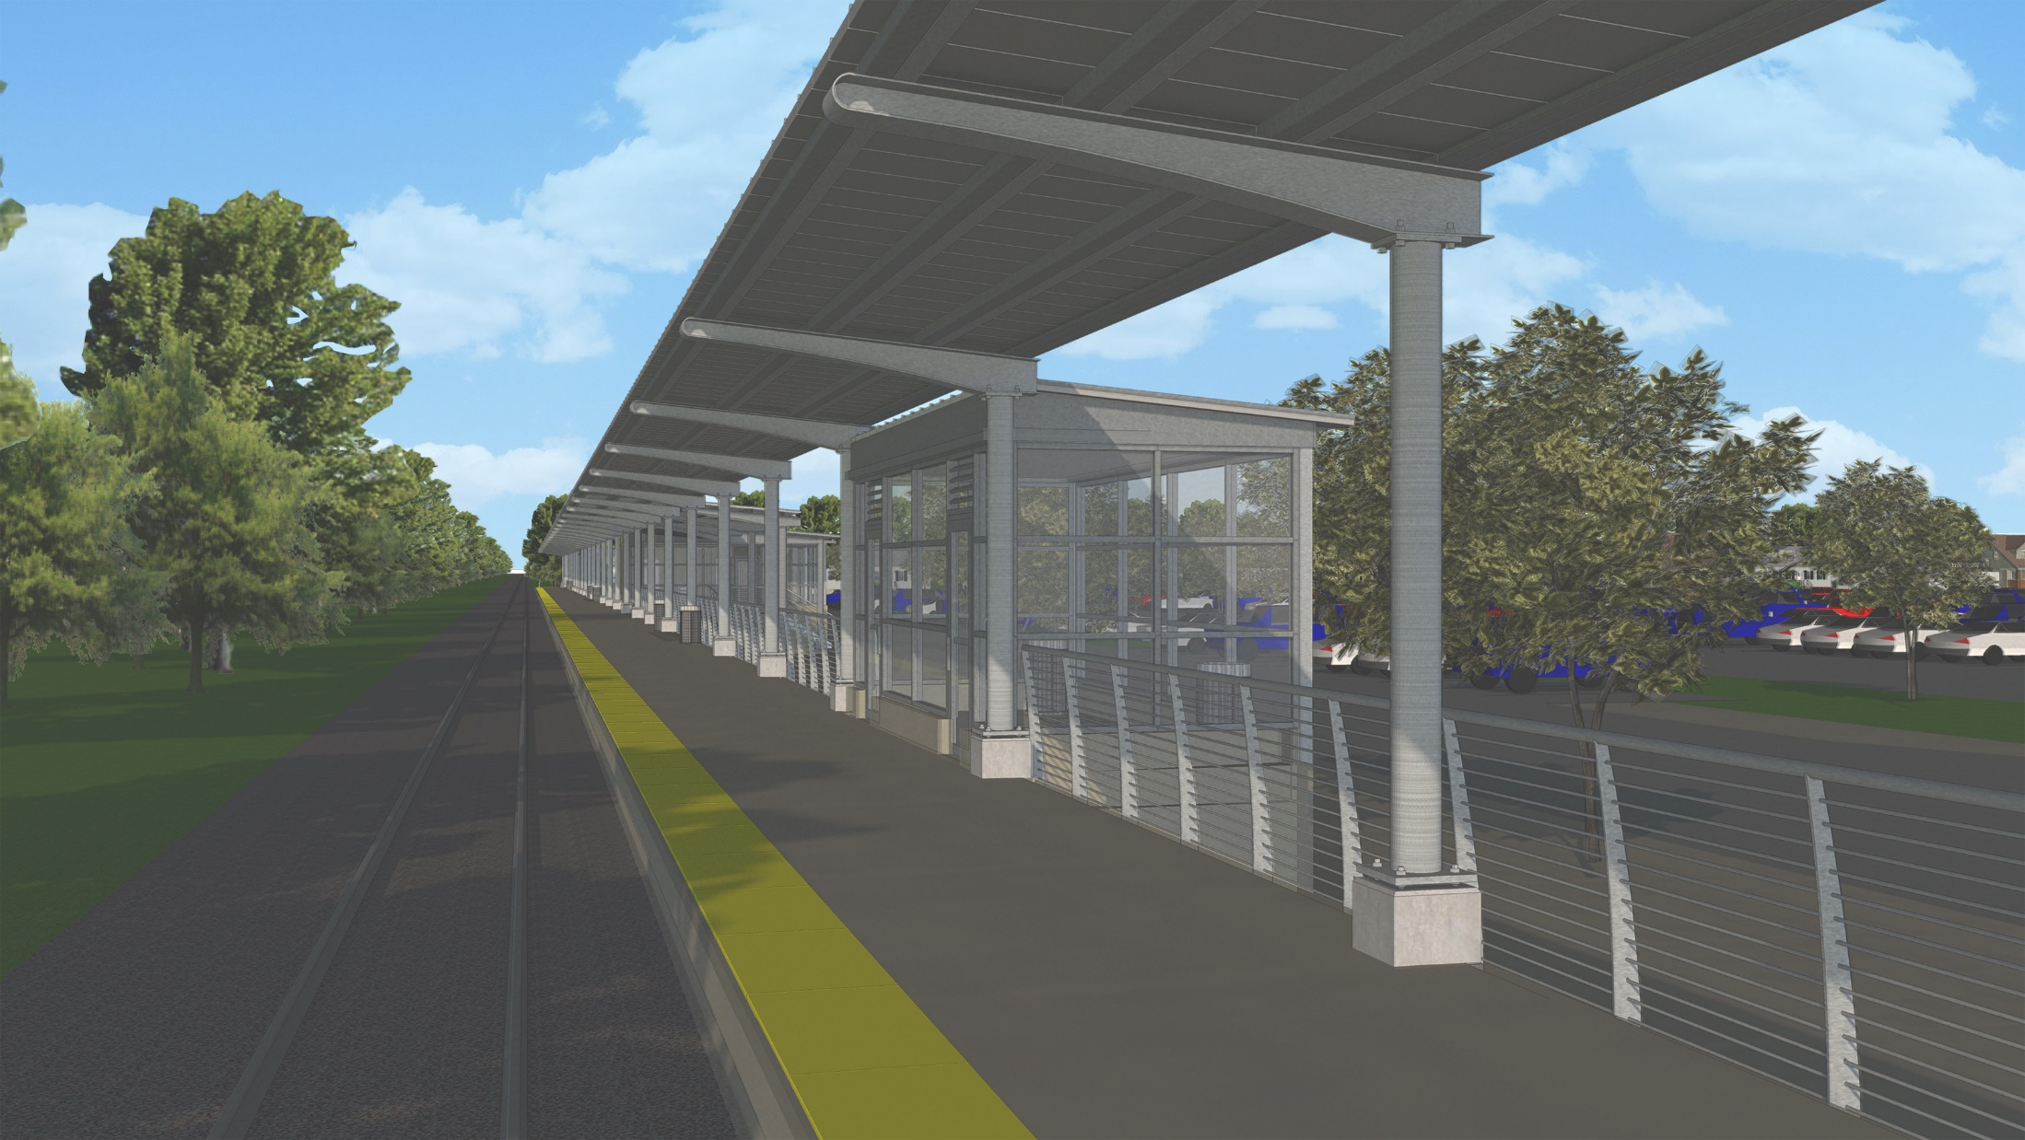
Typical High-Level Platform

Slide 22
PARDON OUR DUST
STARTING IN EARLY SPRING 2022
PLEASE
PARDON OUR DUST

Slide 23
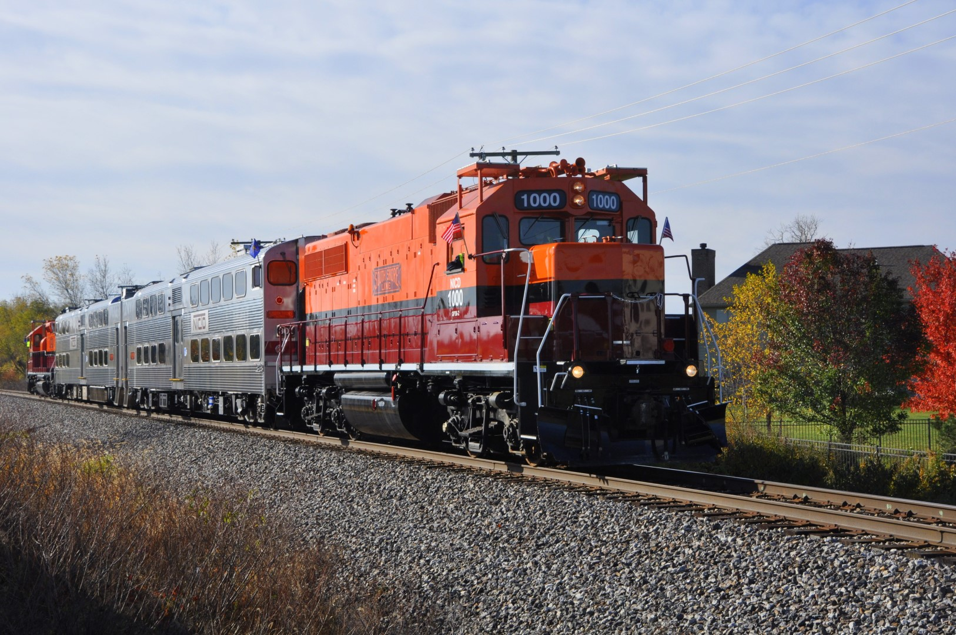
Notes:
Photo arranged by Norman Carlson and taken by Mark Llanuza

Slide 24
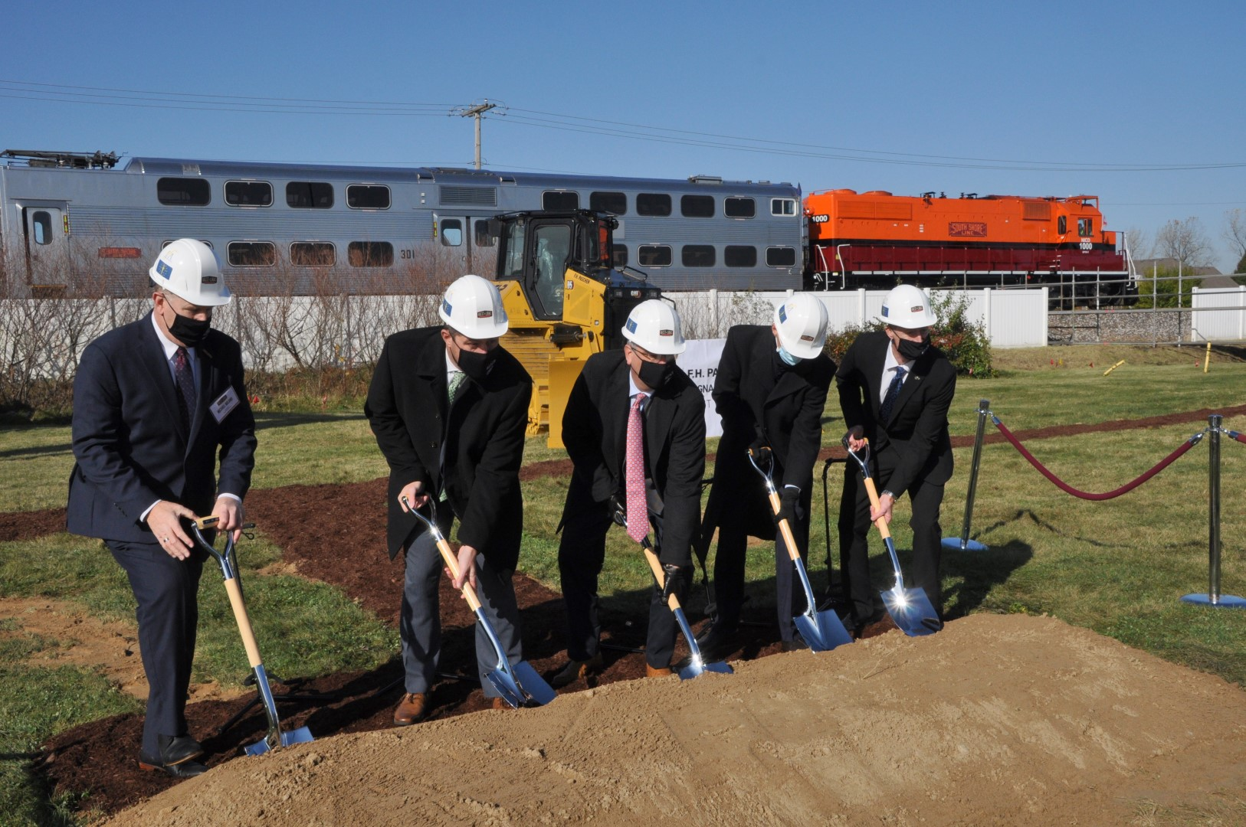

Slide 25
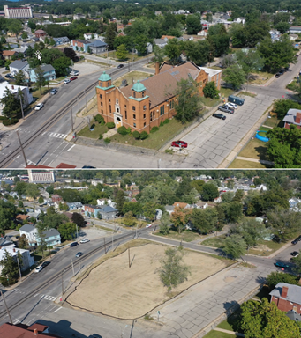
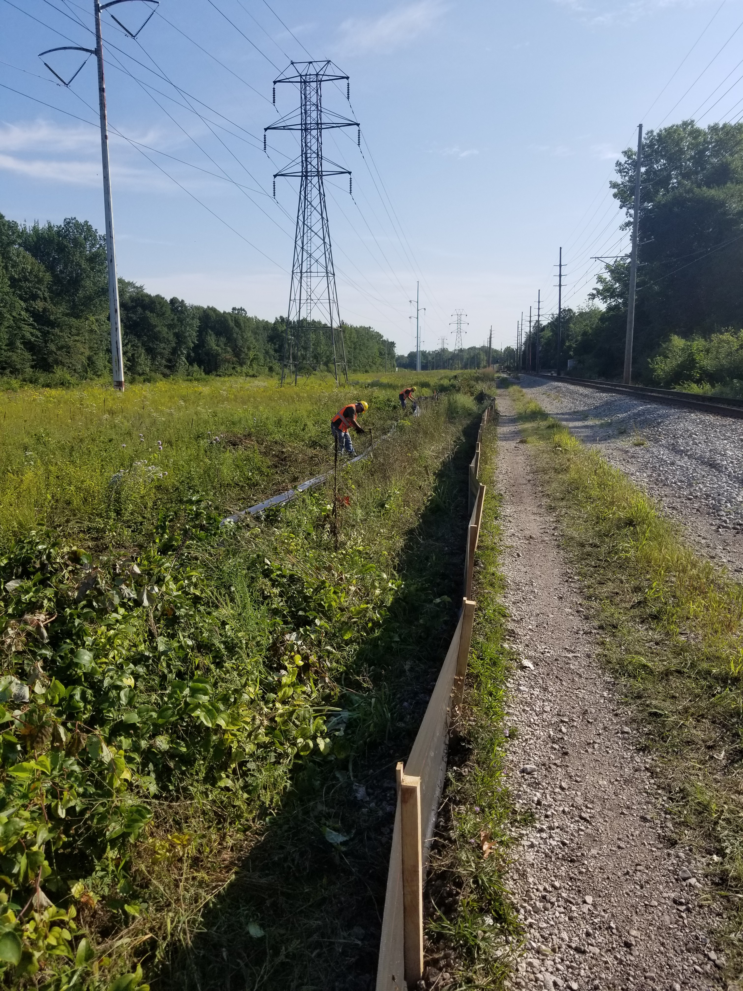

Slide 27
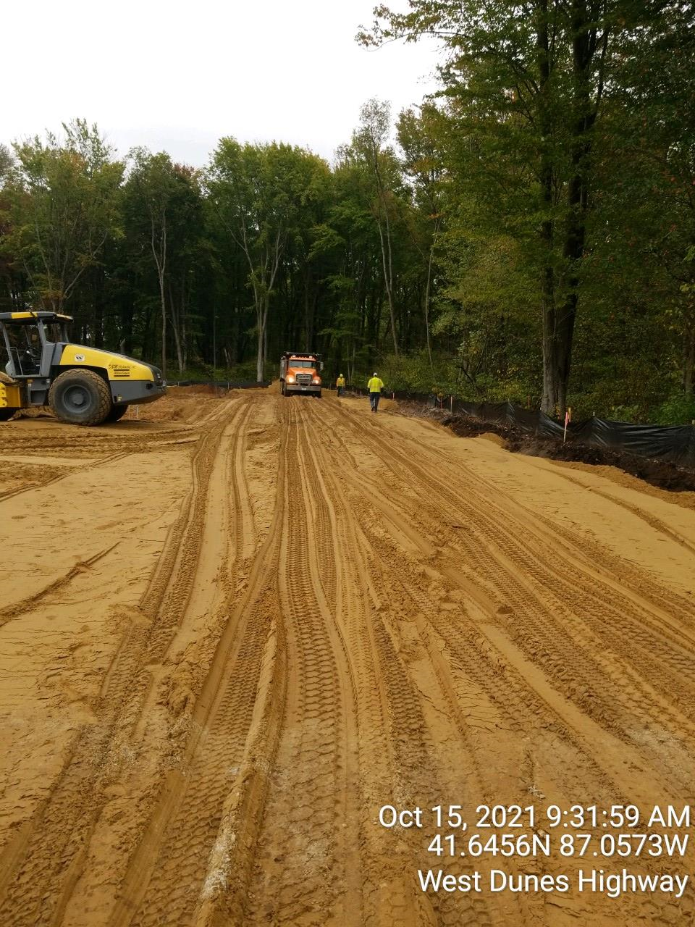

Slide 28
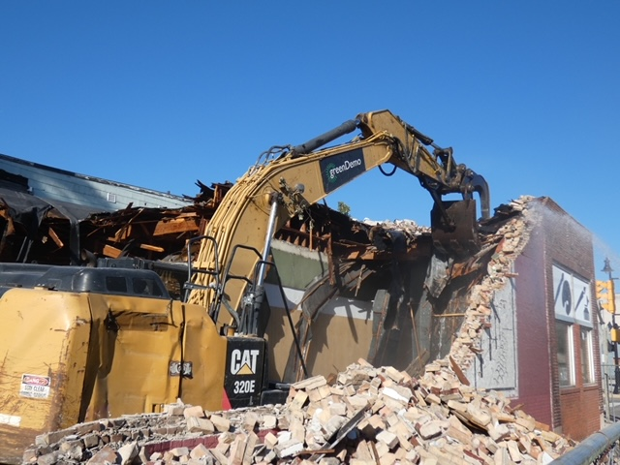

Slide 29
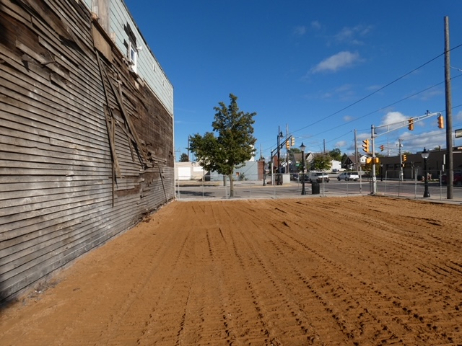

Slide 31
Marketing collateral including the draft schedule to help sell NWI

Slide 32
Marketing Campaigns Designed to market NWI, including those considering the Chicago suburbs

Slide 33


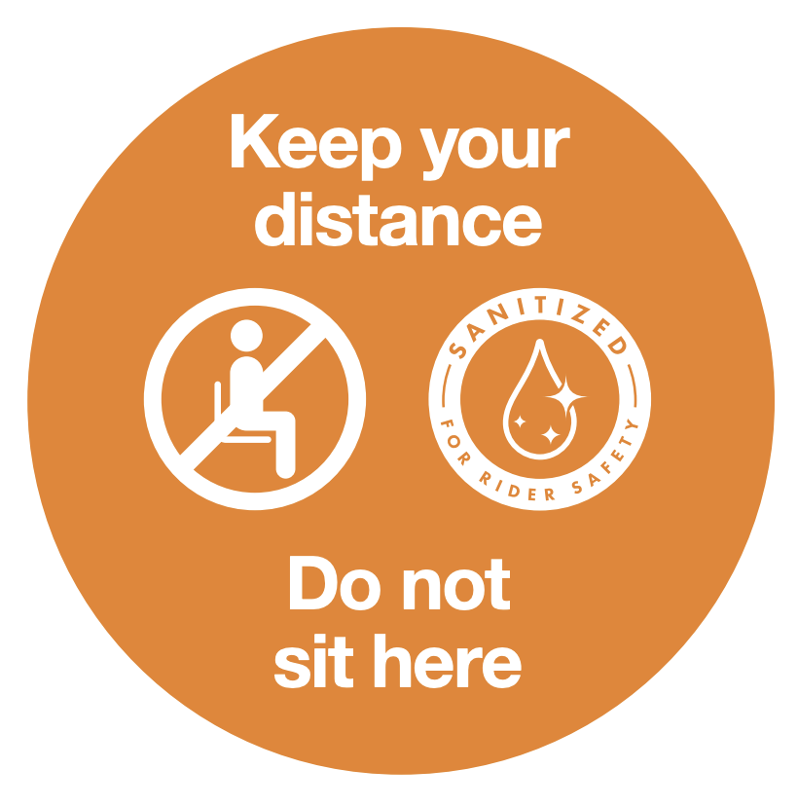
Sanitized For Rider Safety.
A comprehensive cleaning and health & safety program.

Slide 34


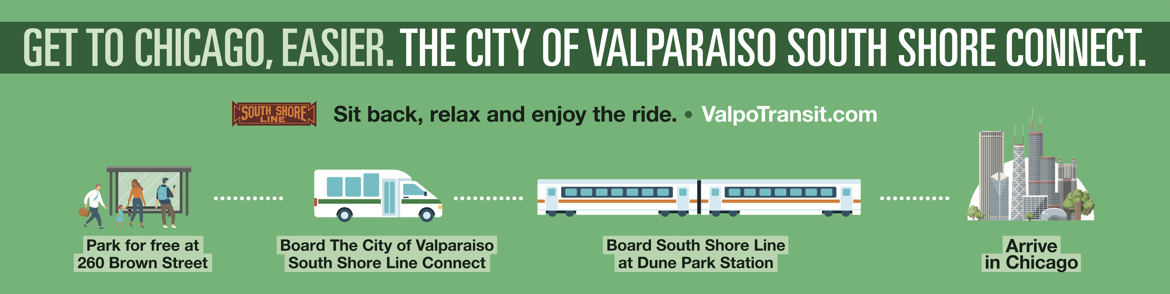
Express bus service from downtown Valparaiso to Dune Park South Shore Line train station .

