Slide 1
Dropped Objects
A presentation to help you understand the hazards of dropped objects and how to approach the situation
By: Andrew Smith, Nina Cotton, Patrick Espinosa, Kyle Horlacher, Dara Hutchison, Nelson Novales, Miguel Rodriguez, Nenad Vasiljevic

Slide 2
Objectives
· Inform
· Share Knowledge
· Prevention
Notes:
“The objectives of training are to provide program awareness training. It is to provide knowledge training, and awareness by training workers on hazard identifications and controls”(OSHA.gov).

Slide 3
Inform
· Safety and health policies procedures and goals
· Functions for the safety program
· Who to contact with questions/concerns
· How to report a hazard, an injury or illness
· What to do in an emergency
· The responsibilities of the employer
· Workers’ rights under the OSHA act
Notes:
“Provide program awareness training to all managers, supervisor and employees on the programs plans and procedures. Giving this knowledge helps to ensures that everyone will be able to participate in developing, implementing, and improving the program”(OSHA.gov).

Slide 4
Knowledge
· Reinforce
· Train
· Instruct
Notes:
“Reinforce employers, managers, and supervisors' knowledge of their responsibilities under the Occupational Safety and Health Act and the workers' rights guaranteed by the Act. Train employers, managers, and supervisors on procedures for responding to workers' reports of injuries, illnesses, and incidents, including ways to avoid discouraging reporting by employees”(OSHA.gov).
“Instruct employers, managers, and supervisors on fundamental concepts and techniques for recognizing hazards and methods of controlling them, including the hierarchy of controls”(OSHA.gov).
“Instruct employers, managers, and supervisors on incident investigation techniques, including root cause analysis”(OSHA.gov).

Slide 5
Awareness
Instruct on how to prevent dropping situations from occurring
Instruct workers with assigned roles
Most common results of dropping include
Broken bones
Spinal cord injuries
Brain injuries
Death
Equipment or tools once dropped could be
Damaged
Lost
broken

Slide 6
Goals of Training
Train workers on techniques and strategies to avoid injuries due to dropping.
Train workers on how to limit the chances of damaging or losing company equipment
Train workers to understand and recognize several hazards that can lead to dropping to take place.
Instruct workers on ways to control hazards
Train workers on when why, and how to wear the proper equipment

Slide 7
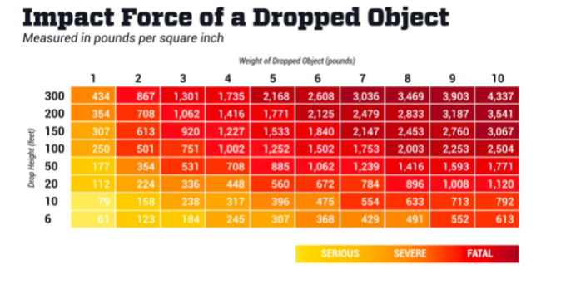
Why is it Important?
Figure 1: impact chart
Dropped objects account for 9.4% of fatal injuries in the construction industry according to OSHA findings
Over 50,000 reported cases of injuries, a year are sustained by dropped objects in the U.S (2019 )
A study shows that fewer than 25 percent of workers believe that dropping is an avoidable and preventable accident. (ehstoday.com, 2020)
Know what hazards cause dropping will prevent many injuries loss of property, and most importantly save lives

Slide 8
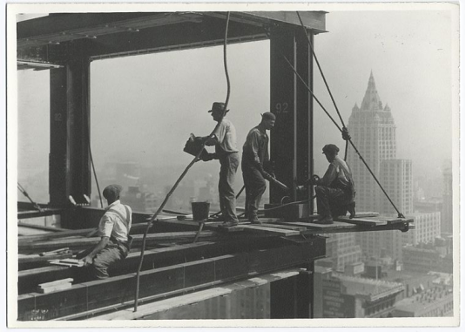
Common Hazards
1) Unsecured objects on the floor
Smaller objects are more commonly left unattended but can do as much damage as heavier objects.
A 2 once object dropped from 230 feet has the potential to penetrate through a hard hat.
Loose equipment by workers side has a greater chance of being mishandled and dropped.
To calculate the maximum damage of the object use the formula (force = gravity * mass of an object).
Figure 2: men working on hoisted platform
Figure 3: hard hat demo video
Notes:
Figure 1 demonstrates how equipment and private material were left out in the open causing tripping hazards that could lead to objects falling or even an employee falling.

Slide 9
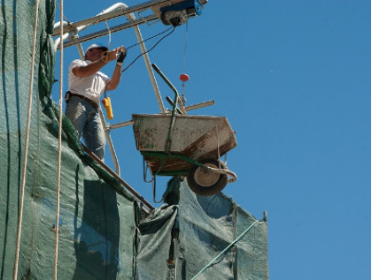
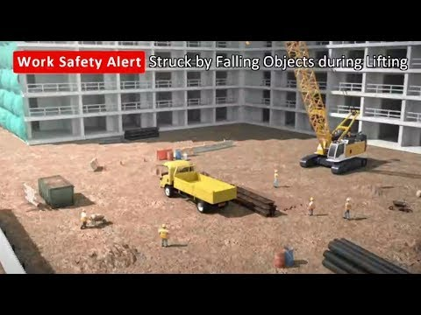
Common Hazards
2) Not securing objects well when lifting material
A heavy item dropped at any height will lead to severe injury or worse
equipment damage is certain either to the equipment securing the load (when it breaks or malfunctions} or to the load itself (when it hits the ground)
Has the capability of injuring multiple people or worse with a single incident
Has the capability of causing an avalanche of debris causing multiple lives to be in danger not only causing major damage to equipment
Figure 4: wheelbarrow being hoisted up
Figure 5: falling object example video
Notes:
Figure 2 demonstrates a wheel barrel being lowered by thin wire attached to the wheel barrel handle. the wire could easily snap or the handle on the wheel barrel could break off.

Slide 10
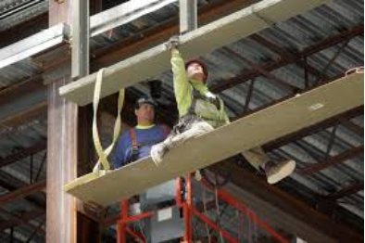
Common Hazards
3) Non-secure platform
Loss of balance increases the chances of dropping equipment and other objects.
Equipment could easily slide off an unbalance area.
An unstable area increases the chances of a worker falling.
An uneven or tilted structure will lead to an increase in the risk of creating falling debris.
Figure 6: unstable work area example
Figure 7: additional unstable work area example

Slide 11
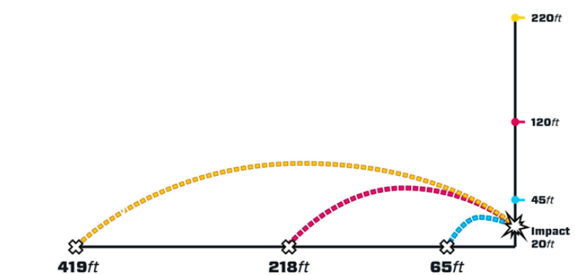
Common Hazards
4) Tool Deflection
Can lead dropped equipment to be damaged or become broken.
Can lead to the equipment to be lost.
Could lead to serious injury of an employee.
Could lead to the death of an employee.
Figure 8 demonstrates how far a 8.3 lb wrench can be deflected after hitting a bar 20 ft.
Figure 8: wrench deflection at 20 ft impact

Slide 12
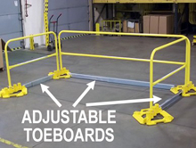
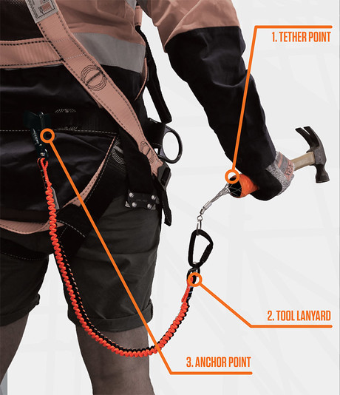
Prevention
Ensure a clean and stable work environment.
Use properly tested equipment with the required strength to lift the properly designated weight.
Always wear a helmet.
Restrictions to civilians from entering the area.
Tool tethers are a great tool to prevent objects such as hand-held tools from falling ( as a general rule all tools 5 pounds or above should be tethered).
Harnesses to prevent workers from falling.
“Toe board” to prevent objects from slipping through railings.
Figure 9: toeboard example
Figure 10: tool tether

Slide 13
Prevention (continued)
Use pedestrian walkways and exercise caution when working near heavy equipment
Never work under a load, especially during lifting.
Tether smaller tools to work belts to prevent dropped objects.
Wear appropriate protective gear (safety glasses, hardhat, face shields, etc.).
Check condition of hard hat (patting or the shell itself could be worn or damaged)
Net to catch falling debris.
Notes:
According to the CDC these simple things can be done to help with prevention

Slide 14
OSHA requirements
When there is a risk of falling objects:
Employees must wear proper head protection, such as hard hats.
Your employer must implement at least one of the following:
Toeboards, screens, or guard rail systems
Canopy structures
Sectioning off the area where objects may fall
Secure tools and materials to prevent them from falling on people below.
Barricade hazard areas and post warning signs.
Use toe boards, screens on guardrails, or scaffolds to prevent falling objects.
Use debris nets, catch platforms or canopies to catch, or deflect falling objects.

Slide 15
OSHA prevention standards
Falling object protection - Standard number : 1926.759
“All materials, equipment, and tools, which are not in use while aloft, shall be secured against accidental displacement”
“The controlling contractor shall bar other construction processes below steel erection unless overhead protection for the employees below is provided.”
Head protection. - Standard number : 1926.759
“Employees working in areas where there is a possible danger of head injury from impact, or from falling or flying objects, or from electrical shock and burns, shall be protected by protective helmets.”

Slide 16
Hard hat
An important measure in protecting the workers from the .
Hard hats must be replaced if they show signs of damage (dents, cracks, penetration, or fatigue due to rough treatment).
There are two components of the hard hat the suspension and the shell.
Both components must be maintained and replaced when recommended.
The suspension is recommended to be replaced yearly.
The shell is recommended to be replaced every two to five years.
It important to use a hard hat with that meets ANSI standards and is classified as “ANSI Z89.1-2009”.
Must be adjustable to accommodate the size of the workers head size.
Must meet requirement for visibility ( when adjusted properly does it hinder vision in anyway).
Must withstand at least a 8 pound ball dropped from five feet according to ANSI standards.
Must prove to have a maximum peak force of 1000 pounds.

Slide 17
What to Do When Objects Do Fall?
Report any injuries (and call an ambulance if necessary).
File a report on how the incident took place.
Report to the safety manager.
Make sure there are no injured workers and that everyone is accounted for.
If workers are confirmed to be accounted for and not injured account for what was dropped and where it was dropped incidents that may have occurred is as follows:
Was equipment dropped
Was person property dropped (lunch box, case, ect.)
Was it falling debris from the construction site
Was it dropped on tools or equipment

Slide 18
Resources
Brown, B. (2016, December 7). 5 Benefits of Promoting Employee Participation. Workology. https://workology.com/5-benefits-of-promoting-employee-participation/.
Construction Hazard Slides: ladder, fall, trench, scaffold, collapse, trash, roof , electrical, traffic - Robert Carr. Robert Carr Construction Hazard Slides ladder fall trench scaffold collapse trash roof electrical traffic Gallery RSS. https://myconstructionphotos.smugmug.com/Construction-Collections/Construction-Hazard-Slides/i-PTvTbcG/.
Department of Labor logo UNITED STATESDEPARTMENT OF LABOR. 1910.28 - Duty to have fall protection and falling object protection. | Occupational Safety and Health Administration. https://www.osha.gov/laws-regs/regulations/standardnumber/1910/1910.28.
Kaczynski, A. (2013, June 30). 24 Jaw-Dropping Photos Of The Construction Of The Empire State Building. BuzzFeed News. https://www.buzzfeednews.com/article/andrewkaczynski/photos-from-the-construction-of-the-empire-state.

Slide 19
Resources (cont.)
RailGuard 200 Short Adjustable Toe Board - Fits 4'-6' Rails. Cisco. https://www.cisco-eagle.com/catalog/product/182446/railguard-200-short-adjustable-toe-board-fits-4-6-rails.
Socias-Morales, C., Earnest, S., Echt, A., Garza, E., & Breloff, S. (2020, October 1). Preventing Struck-by Injuries in Construction. Centers for Disease Control and Prevention. https://blogs.cdc.gov/niosh-science-blog/2020/10/01/struck-by-injuries/.
UNITED STATES DEPARTMENT OF LABOR. Education and Training | Occupational Safety and Health Administration. https://www.osha.gov/shpguidelines/education-training.html.
victory electric cooperative. (2019). Hard Hat Safety Demonstration. youtube.com. https://www.youtube.com/watch?v=MziZesbb32Q.

