Slide 1

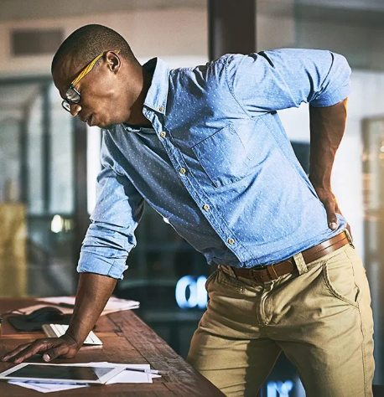
Sprains and Strains
How I respected by body and helped avoid injury.
Notes:
For picture Citation: Nall, Rachel. “Lower Back Pain”. Healthline, July 3, 2019. https://www.healthline.com/health/cancer/lower-back-pain-cancer

Slide 2

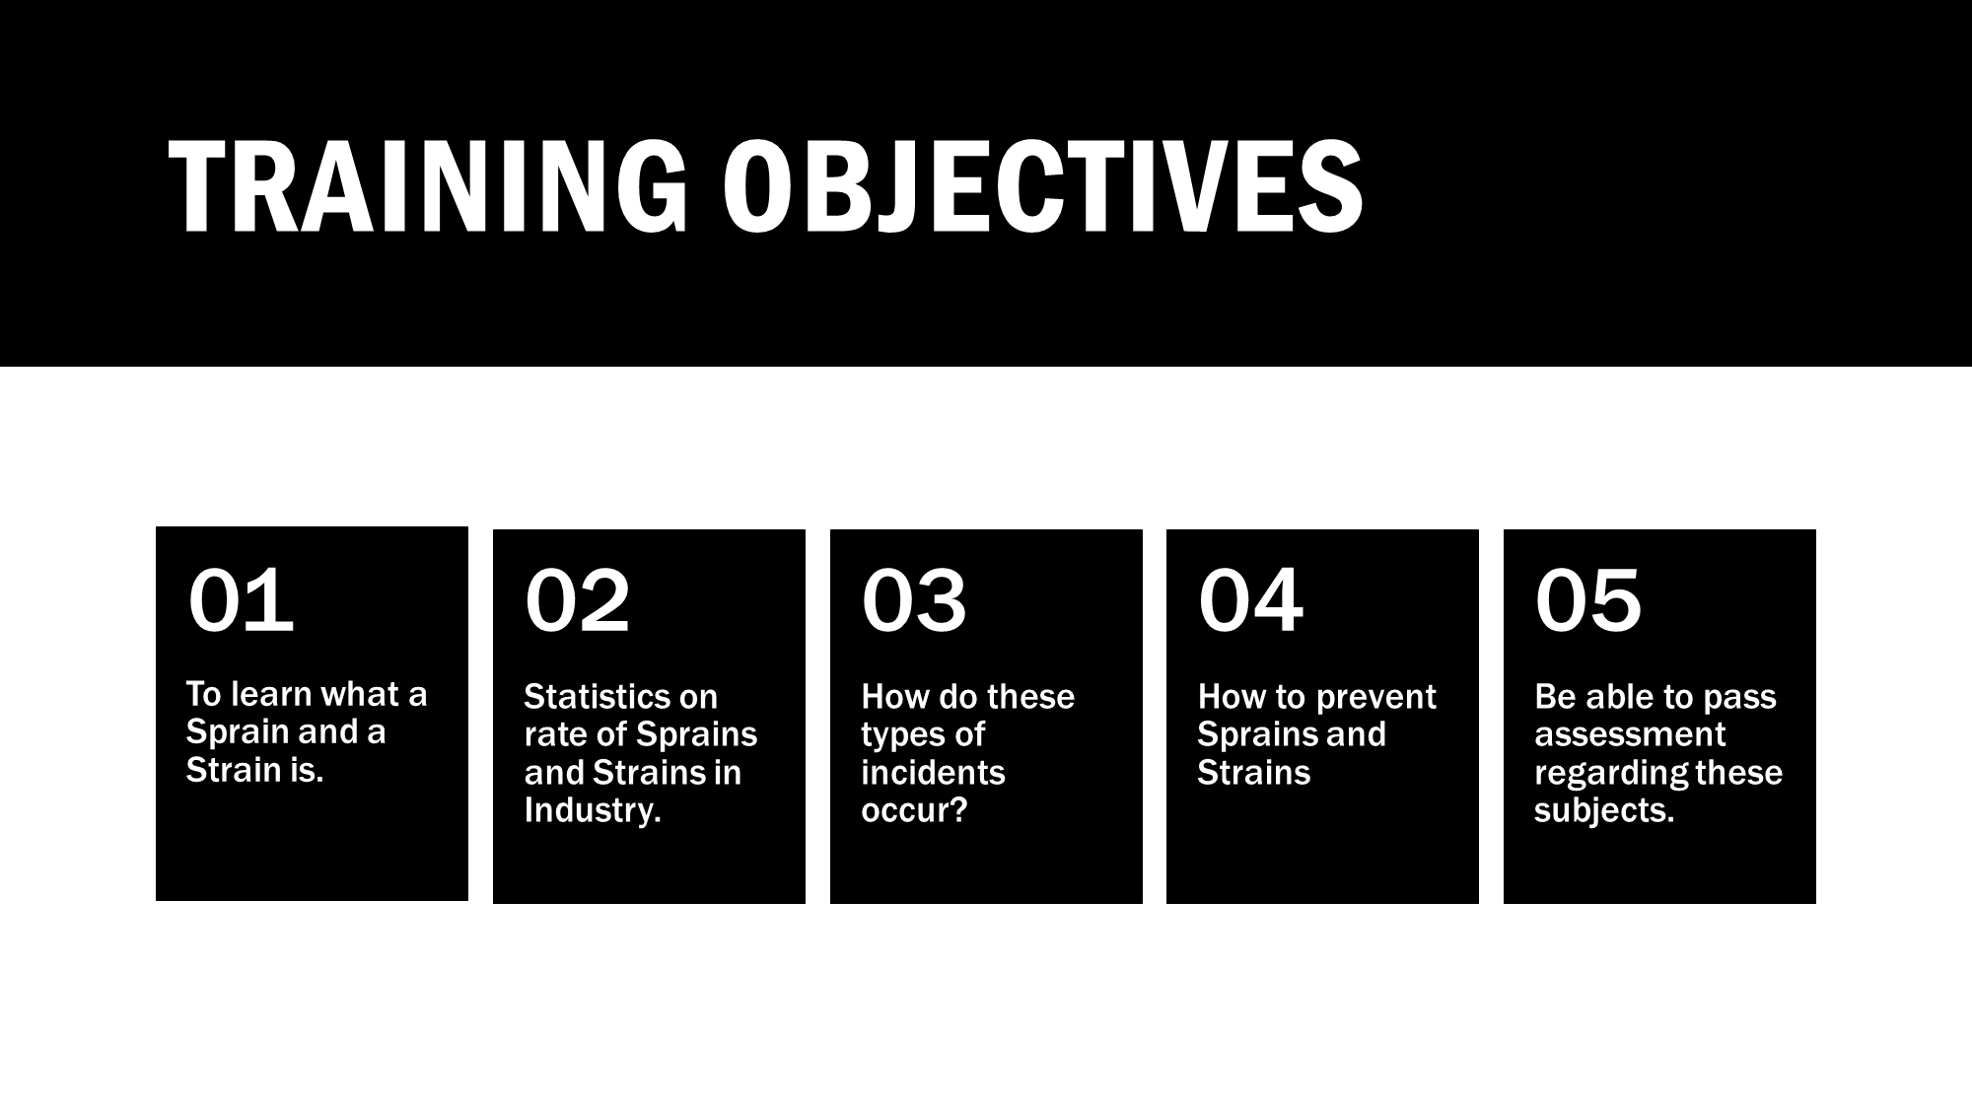

Slide 3
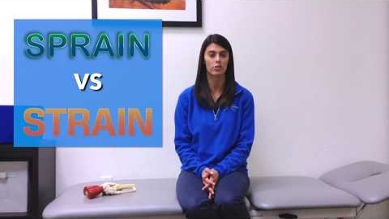
What is a sprain or strain?
According to the Mayo Clinic, “A sprain is a stretching or tearing of ligaments- the tough bands that connect two bones together in your joints. The most common place for a sprain to occur is in the ankle. (Sprains - Symptoms and Causes, 2020)
A sprain is “an injury to a muscle or tendon – the fibrous tissue that connects muscles to bones. Strains commonly occur in the lower back and in the back of the thigh” (Muscle Strains - Symptoms and Causes, 2020).
Notes:
Sprains - Symptoms and causes. (2020, September 25). Mayo Clinic. https://www.mayoclinic.org/diseases-conditions/sprains/symptoms-causes/syc-20377938
Muscle strains - Symptoms and causes. (2020, September 1). Mayo Clinic. https://www.mayoclinic.org/diseases-conditions/muscle-strains/symptoms-causes/syc-20450507
VIDEO - Muscle strains - Symptoms and causes. (2020, September 1). Mayo Clinic. https://www.mayoclinic.org/diseases-conditions/muscle-strains/symptoms-causes/syc-20450507

Slide 4
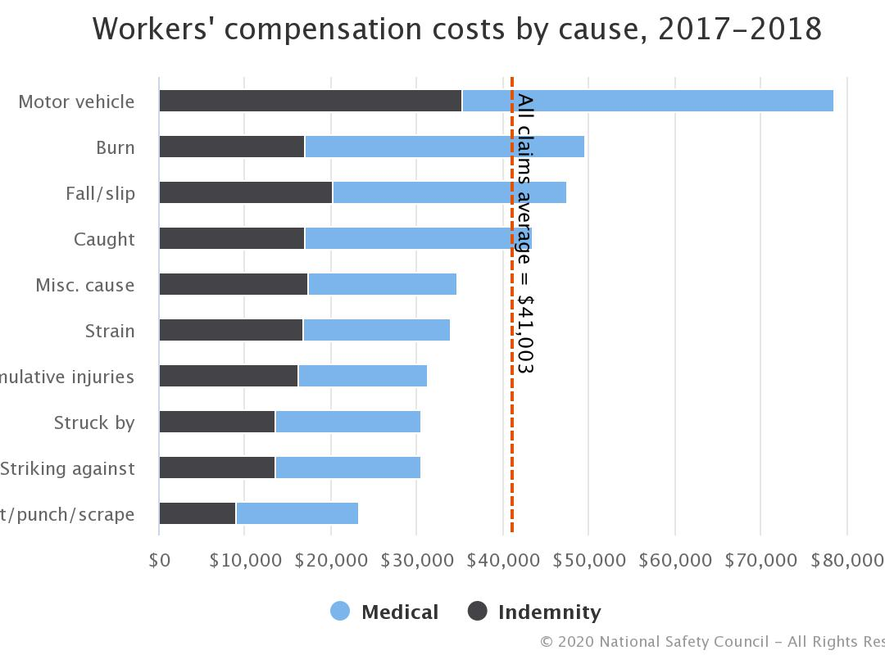
Statistics on Sprains & Strains
According to the U.S. Bureau of Labor Statistics the nonfatal injury with the highest incident rate to occur in the workplace Sprains, Strains, and Tears. (Type of Injury or Illness and Body Parts Affected by Nonfatal Injuries and Illnesses in 2014 : The Economics Daily: U.S. Bureau of Labor Statistics, 2015)
With sprains and strains being as common as they are over $30,000 is spent on workers compensation with sprain and strain as both the cause of injury and the nature of.
Notes:
Citation for Statistic:
Type of injury or illness and body parts affected by nonfatal injuries and illnesses in 2014 : The Economics Daily: U.S. Bureau of Labor Statistics. (2015, December 2). Https://Www.Bls.Gov/. https://www.bls.gov/opub/ted/2015/type-of-injury-or-illness-and-body-parts-affected-by-nonfatal-injuries-and-illnesses-in-2014.htm
In-text citation
Graph:
Workers’ compensation costs by cause, 2017 - 2018. (n.d.). [Graph]. Injury Facts. https://injuryfacts.nsc.org/work/costs/workers-compensation-costs/

Slide 5
Construction (195,600 workplace injuries and 3,600 workplace illnesses)
Overexertion and bodily reaction (approximately 33 incidents per 10,000 full-time workers)
Sprains, strains, and tears (approximately 35 incidents per 10,000 full-time workers)
Sprains, strains, and tears (median of 11 days)
6th most common Non-fatal workplace injury is sprains and strains (Workplace injury statistics-2019)
Notes:
J fabian. (2020, September 26). Workplace Injury Statistics - 2019. Retrieved October 25, 2020, from https://workinjurysource.com/workplace-injury-statistics-2019/

Slide 6
How do these injuries occur?
Habits to avoid:
Sprains and strains are not just something that occurs in the workplace. Personal health is an important consideration when considering the reasons for an injury.
“Strains and sprains related to lifting and material handling are some of the most frequent types of injuries, both on and off the job. While some factors that contribute to the potential for injury cannot be controlled, others can be reduced or minimized. Poor physical fitness, obesity, smoking, poor posture, and medical/physical deficiencies are personal factors that may contribute to strains and sprains” (Strain & Sprain Prevention, n.d.)
Use of excessive force.
Excessive repetitions of a task.
Working in an awkward position.
Working in poor environmental conditions.
Working while fatigued or with lack of rest.
Poor health habits such as smoking or being overweight.
Ignoring early signs and symptoms.
Notes:
J fabian. (2020, September 26). Workplace Injury Statistics - 2019. Retrieved October 25, 2020, from https://workinjurysource.com/workplace-injury-statistics-2019/
Habits to avoid.
Middlesworth, M. (2019, August 16). How to Prevent Sprains and Strains in the Workplace. SHRM. https://www.shrm.org/resourcesandtools/hr-topics/risk-management/pages/prevent-sprains-strains-workplace.aspx

Slide 7
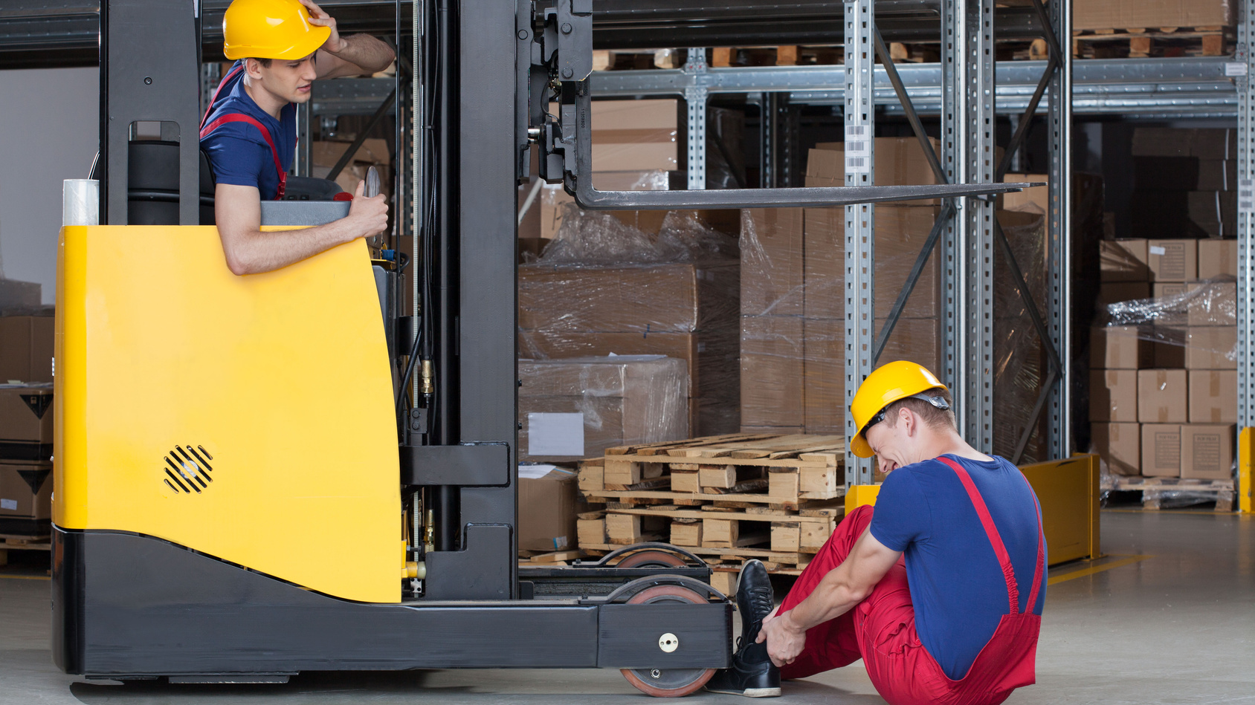
What causes sprains and strains in the workplace?
Excessive force on muscle that would lead to fatigue
Excessive repetition
Working in awkward positions puts stress on the joints and muscles
Trying to recover from a trip or slip(https://ergo-plus.com/prevent-sprains-strains-workplace)
This Photo by Unknown Author is licensed under CC BY-NC
Notes:
Middlesworth, M. (2014, February 05). How to Prevent Sprains and Strains in the Workplace. Retrieved October 26, 2020, from https://ergo-plus.com/prevent-sprains-strains-workplace/

Slide 8
What measure can we take to prevent sprains and strains?
Keeping oneself in shape overall
Good dietary habits
Stretching prior to work and during the shift
Company sponsored per-work exercise program(https://www.wcf.com/strains-and-sprains-prevention)
Notes:
Strains and Sprains Prevention. (n.d.). Retrieved October 27, 2020, from https://www.wcf.com/strains-and-sprains-prevention

Slide 9
S.M.A.R.T. Lifting Technique
Size up the load
Assess the size, weight, and shape. Remove obstacles from the load (such as loose wrapping materials).
Assess whether the load actually needs to be moved
Where is the load going to be placed? Remove obstacles from your path.
Determine whether mechanical or assistance from a co-worker is required
Move the load as close to your body as possible
Stay close throughout the lift
The whole hand should be used to ensure a firm grip
Always bend your knees
Maintain balance
Keep feet apart and in a comfortable position
Minimize bending at the waist
Bend your knees to a semi squat
Raise the load with your legs
Lift smoothly, without jerking
Maintain the normal curve of your spine throughout the lift
Tighten the abdominal muscles and exhale while lifting
Turn your feet in the direction that you want to move the load
Avoid unnecessary bending, twisting, and reaching
Change direction by turning your feet and not your back(http://hfairall.weebly.com/smart-lifting.html)
Notes:
SMART lifting. (n.d.). Retrieved October 28, 2020, from http://hfairall.weebly.com/smart-lifting.html

Slide 10

Team Lifting
Team lifts are appropriate if:
The load is too heavy for one person
The load is large, bulky, or oddly-shaped
You feel uncomfortable lifting the load by yourself (and do not have the proper equipment)
Plan the lift
Lift and lower in the same manner
Move slowly and evenly
Keep the load level and the weight evenly distributed.
Team Lifting No-No’s
Twist their bodies when lifting or carrying,
Lift from one knee,
Change their grip while holding the load, or
Step over objects when moving the load.(https://ehsdailyadvisor.blr.com/2009/12/team-lifting-a-special-case-with-special-rules/)
Notes:
Kilbourne, C. (2009, December 29). Team Lifting: A Special Case with Special Rules. Retrieved October 28, 2020, from https://ehsdailyadvisor.blr.com/2009/12/team-lifting-a-special-case-with-special-rules/

Slide 11
Sprains and Strains Symptoms You Should Know
A strain is defined as an injury to a tendon (tissues that connect your muscles and bones) or muscle. Strains can range from mild to extreme; and may mean your tendon or muscle has a partial or complete tear.
A sprain is a stretching or tearing of ligaments — the tough bands of fibrous tissue that connect two bones together in your joints. The most common location for a sprain is in your ankle.
Common symptoms of sprains | Common symptoms of strains
• bruising • pain around the affected joint • swelling • limited flexibility • difficulty using the joint’s full range of motion | • muscle spasm • pain around the affected joint • swelling • limited flexibility • difficulty using the joint’s full range of motion
Notes:
Sprains. (2020, September 25). Retrieved October 25, 2020, from https://www.mayoclinic.org/diseases-conditions/sprains/symptoms-causes/syc-20377938
17th, P. (2019, June 27). What is a Strain Injury?: Orthopedics Doctor Fairfield. Retrieved October 25, 2020, from https://www.osgpc.com/what-is-a-strain-injury/
Holland, K. (2017, March 20). Sprain vs. Strain: What's the Difference? Retrieved October 25, 2020, from https://www.healthline.com/health/sprain-vs-strain

Slide 12
References
Sprains. (2020, September 25). Retrieved November 06, 2020, from https://www.mayoclinic.org/diseases-conditions/sprains/symptoms-causes/syc-20377938
Muscle strains. (2020, September 01). Retrieved November 06, 2020, from https://www.mayoclinic.org/diseases-conditions/muscle-strains/symptoms-causes/syc-20450507
VIDEO - Muscle strains - Symptoms and causes. (2020, September 1). Mayo Clinic. https://www.mayoclinic.org/diseases-conditions/muscle-strains/symptoms-causes/syc-20450507
Type of injury or illness and body parts affected by nonfatal injuries and illnesses in 2014 : The Economics Daily: U.S. Bureau of Labor Statistics. (2015, December 2). Https://Www.Bls.Gov/. https://www.bls.gov/opub/ted/2015/type-of-injury-or-illness-and-body-parts-affected-by-nonfatal-injuries-and-illnesses-in-2014.htm
Workers’ compensation costs by cause, 2017 - 2018. (n.d.). [Graph]. Injury Facts. https://injuryfacts.nsc.org/work/costs/workers-compensation-costs/

Slide 13
References Cont’d
J fabian. (2020, September 26). Workplace Injury Statistics - 2019. Retrieved October 25, 2020, from https://workinjurysource.com/workplace-injury-statistics-2019/
J fabian. (2020, September 26). Workplace Injury Statistics - 2019. Retrieved October 25, 2020, from https://workinjurysource.com/workplace-injury-statistics-2019/
Middlesworth, M. (2019, August 16). How to Prevent Sprains and Strains in the Workplace. SHRM. https://www.shrm.org/resourcesandtools/hr-topics/risk-management/pages/prevent-sprains-strains-workplace.aspx
Middlesworth, M. (2014, February 05). How to Prevent Sprains and Strains in the Workplace. Retrieved October 26, 2020, from https://ergo-plus.com/prevent-sprains-strains-workplace/
Strains and Sprains Prevention. (n.d.). Retrieved October 27, 2020, from https://www.wcf.com/strains-and-sprains-prevention

Slide 14
References Cont’d
SMART lifting. (n.d.). Retrieved October 28, 2020, from http://hfairall.weebly.com/smart-lifting.html
Kilbourne, C. (2009, December 29). Team Lifting: A Special Case with Special Rules. Retrieved October 28, 2020, from https://ehsdailyadvisor.blr.com/2009/12/team-lifting-a-special-case-with-special-rules/
Sprains. (2020, September 25). Retrieved October 25, 2020, from https://www.mayoclinic.org/diseases-conditions/sprains/symptoms-causes/syc-20377938
(2019, June 27). What is a Strain Injury?: Orthopedics Doctor Fairfield. Retrieved October 25, 2020, from https://www.osgpc.com/what-is-a-strain-injury/
Holland, K. (2017, March 20). Sprain vs. Strain: What's the Difference? Retrieved October 25, 2020, from https://www.healthline.com/health/sprain-vs-strain

