Slide 1
Cold Illness Prevention
OLS 30000
Notes:
This is not meant to be either a substitute for or a legal interpretation of the occupational safety and health regulations.

Slide 2
Objectives of Training
OSHA Standards
Common cold-related illnesses
Fundamentals of Wind Chill
Symptoms of cold-related illnesses
Proper first aid actions
How cold-related illnesses can be prevented

Slide 3
Standards
OSHA’s general duty clause (Section 5(a)(1) of the Occupational Safety and Health Act of 1970) requires each employer to provide its employees a workplace that is free from recognized hazards that are causing or likely to cause death or serious physical harm.
There is a lack of OSHA standards towards cold illnesses, instead OSHA recommends methods of prevention and first aid.
This is due to the highly variable nature of when a person will experience cold illness
i.e. a person from a desert region will succumb to cold illness well before a person from an arctic region will

Slide 4
Common Cold-related Illnesses
It is necessary that supervisors and workers know the most common cold-related illnesses and injuries
Most common cold-related illnesses:
Hypothermia - When normal body temperature (98.6°F) drops to 95°F or less.
Frostbite - When body tissue freezes
Trench Foot - Non-Freezing injury to the foot, caused by lengthy exposure to wet and cold environment
Notes:
Knowledge of these common cold-related illnesses could save lives and allow those affected to receive medical attention faster.
Slide References:
https://www.osha.gov/Publications/OSHA3156.pdf
https://www.osha.gov/SLTC/emergencypreparedness/guides/cold.html

Slide 5
Symptoms - Hypothermia
Mild symptoms:
Fatigue
Shivering
Stomping of feet
Moderate to Severe symptoms:
The person stops shivering
Slowed heartbeat and breathing
Confusion or disorientation
Rigid muscles
Loss of consciousness

Slide 6
First Aid - Hypothermia
Seek warm shelter
If unable, protect exposed individual from wind
Remove wet clothing and replace with warm dry items
Warm gradually
Starting warming the core body
Do not start with extremities (can cause shock)
Do not immerse in warm water
Alcohol hinders the rewarming process
Tobacco products slow circulation needed for rewarming

Slide 7
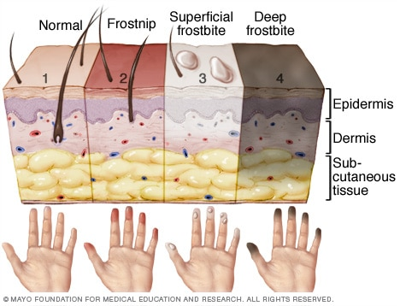
Symptoms - Frostbite
Frostnip:
Mild form of frostbite
When warming may feel prickling or tingling
Does not permanently damage skin
Superficial Frostbite:
Skin turns white or pale
Skin may feel warm
Stinging, burning, and swelling
Blisters 12 to 36 hours after rewarming
Deep Frostbite:
Skin turns bluish gray
Lose all sensation of cold
Pain in affected areas
Muscles stop working
Large blisters 24 to 48 hours after rewarming
Area turns black as tissue dies
Image retrieved from: https://www.mayoclinic.org/diseases-conditions/frostbite/multimedia/img-20114490
Notes:
Image retrieved from: https://www.mayoclinic.org/diseases-conditions/frostbite/multimedia/img-20114490

Slide 8
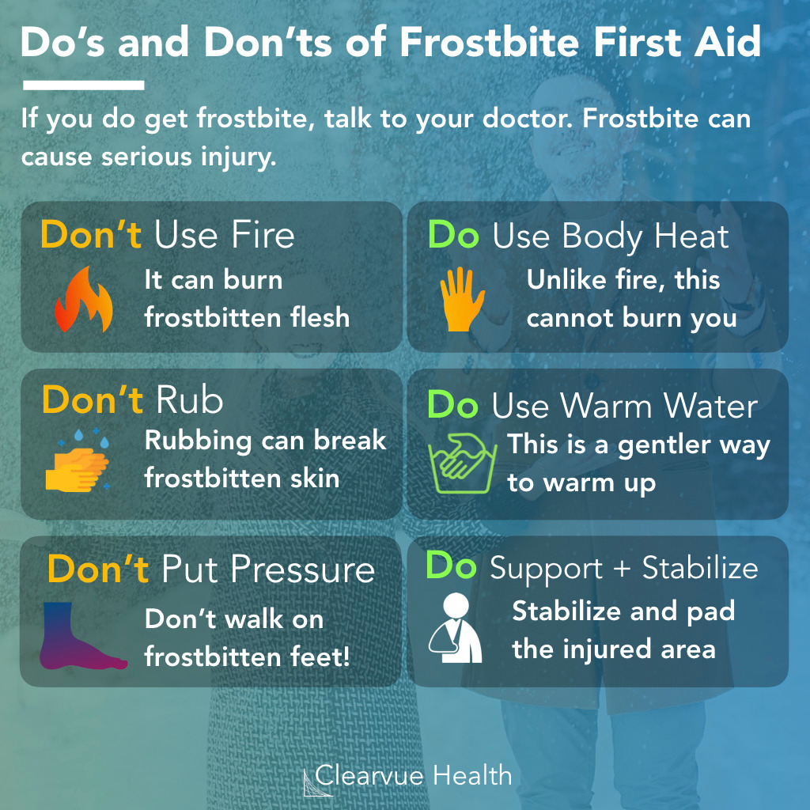
First Aid - Frostbite
Check for hypothermia
Protect the skin from further damage
Get out of the cold
Remove wet or damp clothing
Gently rewarm the affected areas
Drink warm liquids
Seek emergency help if numbness or pain continues after thawing the skin or if blisters form
Image retrieved from: https://www.clearvuehealth.com/frostbiteaid/
Notes:
If you are suffering from frostbite, you may be affected by hypothermia
Protect the skin from further damage: If the skin is at risk of being frozen again, do not thaw it. If they are already thawed, then cover them to protect them from being refrozen. Do not rub the affected skin or walk on frostbitten feet.
Get out of the cold: Once you are somewhere warm (indoors), remove any wet clothes.
Gently rewarm affected areas: Soak the affected areas in warm water - not hot. Rewarming will take around 30 minutes. Do not directly (i.e. fire, heat lamp, heat pad) warm frostbitten skin, it will be numb and you may not notice being burned.
Drink warm liquids to help warm you up.
Image retrieved from: https://www.clearvuehealth.com/frostbiteaid/

Slide 9
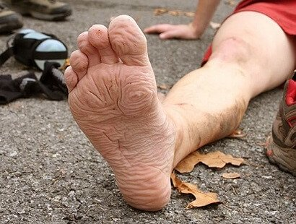
Symptoms - Trench Foot
Reddening of the skin
Leg Cramps
Tingling pain
Blisters
Feet swelling
Bleeding under the skin
Feet may turn dark purple or gray (Gangrene)
Moderate Case of Trench Foot
Image retrieved from: https://www.foot-pain-explored.com/trench-foot.html
Notes:
Image retrieved from: https://www.foot-pain-explored.com/trench-foot.html

Slide 10
First Aid - Trench Foot
Remove the shoes and wet socks
Clean and dry the feet
Put on clean dry socks every day
Warm the affected area using warm packs or soaking them in warm water for five minutes
Do not wear socks while sleeping or resting
Seek medical assistance as soon as possible
Notes:
Trench foot shares many of the same
Protect the skin from further damage: If the skin is at risk of being frozen again, do not thaw it. If they are already thawed, then cover them to protect them from being refrozen. Do not rub the affected skin or walk on frostbitten feet.
Get out of the cold: Once you are somewhere warm (indoors), remove any wet clothes.
Gently rewarm affected areas: Soak the affected areas in warm water - not hot. Rewarming will take around 30 minutes. Do not directly (i.e. fire, heat lamp, heat pad) warm frostbitten skin, it will be numb and you may not notice being burned.
Drink warm liquids to help warm you up.

Slide 11
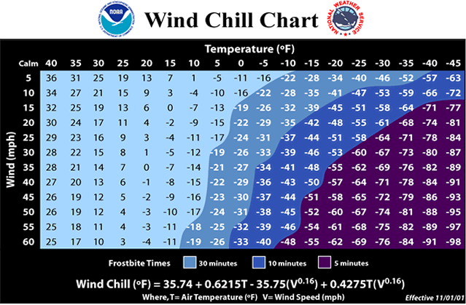
Wind Chill
Wind Chill is a factor of temperature and wind speed. The lower the windchill the sooner a cold-related illness can set in.
image retrieved from: https://www.weather.gov/safety/cold-wind-chill-chart
Notes:
Wind chill chart image retrieved from: https://www.weather.gov/safety/cold-wind-chill-chart
As an exercise calculate the wind chill. Choose a temperature, then choose a wind speed and see what the wind chill would be and note the colored region to determine how fast frostbite can set in

Slide 12
Calculating Wind Chill
Choose a Temperature: 15 °F
Choose a Wind Speed: 20mph
Trace the columns and rows until they intersect.
This gives a Wind Chill of -2 °F
Unprotected skin would have frostbite in 30 minutes with a Wind Chill of -2 °F
image retrieved from: https://www.weather.gov/safety/cold-wind-chill-chart

Slide 13
Prevention - Education
Must know Knowledge:
Near freezing temperatures are still considered hazardous
Cold stress can occur when the temperature is as high as 40 degrees outside
Moisture or dampness from sweating can increase the rate of heat loss from the body
Risk factors that contribute to cold stress are:
Wetness/dampness, dressing improperly, and exhaustion
Predisposing health conditions such as hypertension, hypothyroidism, and diabetes
Poor physical condition
Notes:
(Wetness/Dampness) -> makes it harder to maintain warmth
(Near freezing) -> different factors like precipitation and wind contribute to cold stress, not just temperature
Precipitation and wind should be considered when deciding if the weather outside is hazardous
(Improper outfitting) -> employees must wear warm clothing to protect skin and maintain proper temperature
(Predisposing health conditions) -> these may allow the worker to be more susceptible to cold-related illness
Slide Reference:
https://www.osha.gov/SLTC/emergencypreparedness/guides/cold.html

Slide 14
Prevention - Health Tips & Practices
Exercise
Drink warm beverages
Rest in warm environments
Wear layers/dress appropriately
Bring extra/spare clothes
Wear waterproof boots and gloves
Use distributed Personal Protective Equipment (PPE)
Notes:
(Exercise) -> helps avoid health conditions
(Drink warm beverages) -> maintain body temp.
(Rest in warm environments) -> regain warm, healthy body temperature
(Bring extra/spare clothes) -> incase clothing gets damaged, wet, or is not enough to keep warm
(Wear waterproof boots and gloves) keep dry and warm
Slide Reference:
https://www.osha.gov/SLTC/emergencypreparedness/guides/cold.html

Slide 15
Prevention - Control Measures
Safe practices and procedures
Examples:
Buddy system
Wear appropriate PPE
Wear appropriate clothing layers
Don’t resume work in hazardous temperatures
Appropriate break areas
Notes:
(Buddy system) -> ensure crew health
(Temperature) -> don’t resume work in unhealthy environments
(Uniform) -> make sure workers dressed appropriately
(Breaks) -> take in warm areas to regain warmth
Utilize breaks to ensure workers aren’t cold
Slide Reference:
https://www.osha.gov/SLTC/emergencypreparedness/guides/cold.html

Slide 16
Recommended PPE - How to Dress Warm
Inner Layer: Moisture wicking fabric helps keep skin dry and warm
Synthetic fabrics (polypropylene)
Wool
Cotton is a anti-moisture wicking fabric
Mid Layer: Provides warmth and insulation from cold
Wool
Fleece
Down
Outer Layer: Breathable while still blocking wind, rain, and snow
Gore-Tex
Synthetic fabrics
May need to meet or exceed: FRC NFPA 2112
Clothing does not insulate after it is wet
Being too warm can cause heat stresses
Notes:
Be aware of all potential hazards.
Hats help keep heat contained
Consider activity level when dressing for cold weather
Be comfortable and be safe

Slide 17
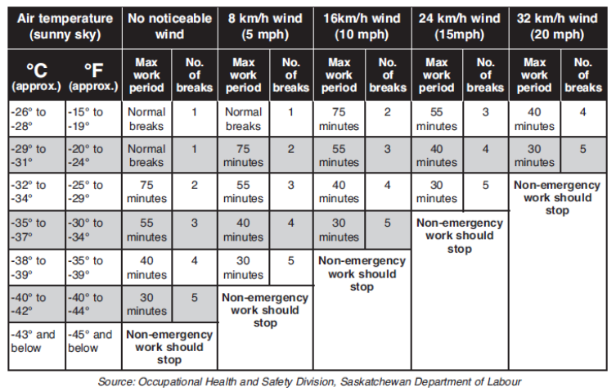
Prevention - Control Measures
Company policy
Strict uniform policies
Required breaks
Warm up schedule
Company distributed equipment
Nomex hoods and hats
Cleats
Insulated and waterproof boots
Insulated and waterproof gloves
Moisture wicking socks (wool)
Notes:
(Buddy system) -> ensure crew health
(Temperature) -> don’t resume work in unhealthy environments
(Uniform) -> make sure workers dressed appropriately
(Breaks) -> take in warm areas to regain warmth
Utilize breaks to ensure workers aren’t cold
Slide Reference:
https://www.osha.gov/SLTC/emergencypreparedness/guides/cold.html

Slide 18
Questions?

Slide 19
References
CDC - NIOSH Workplace Safety and Health Topic - Cold Stress - Cold Related Illnesses. (2018, June 6). Retrieved from https://www.cdc.gov/niosh/topics/coldstress/coldrelatedillnesses.html.
OSHA (2019). 1904.7- General recording Criteria. United States Department of Labor. Retrieved from https://www.osha.gov/laws-regs/regulations/standardnumber/1904/1904.7
OSHA (n.d.). Cold stress guide. United States Department of Labor. Retrieved from https://www.osha.gov/SLTC/emergencypreparedness/guides/cold.html
UNITED STATES DEPARTMENT OF LABOR. (n.d.). Protecting Workers from Cold Stress [PDF file]. Retrieved from https://www.osha.gov/Publications/OSHA3156.pdf
UNITED STATES DEPARTMENT OF LABOR. (n.d.). Retrieved from https://www.osha.gov/SLTC/emergencypreparedness/guides/cold.html.

Slide 20
Heat Illness Prevention
OLS 30000
Notes:
This is not meant to be either a substitute for or a legal interpretation of the occupational safety and health regulations.

Slide 21
Objectives of Training
OSHA Standards
Understanding Humidity and the Heat Index
Common heat-related illnesses
Symptoms of heat-related illnesses
First aid actions
Heat-related illness prevention

Slide 22
What Does the Standard Require?
OSHA’s general duty clause (Section 5(a)(1) of the Occupational Safety and Health Act of 1970) requires each employer to provide its employees a workplace that is free from recognized hazards that are causing or likely to cause death or serious physical harm.
There is a lack of OSHA standards towards heat illnesses, instead OSHA refers to NIOSH for a list of Recommended Standards
This is due to the highly variable nature of when a person will experience heat illness
i.e. a person from an arctic region will succumb to heat illness well before a person from a desert region will

Slide 23
OSHA Recommendations
NIOSH gives recommendations regarding:
Workplace Limits and Surveillance
Medical Monitoring
Surveillance of Heat-related Sentinel Health Events
Protective Clothing and Equipment
Worker information and Training
Control of Heat Stress
Notes:
A Sentinel Health Event (SHE) is a preventable disease, disability, or untimely death whose occurrence serves as a warning signal that the quality of preventive and/or therapeutic medical care may need to be improved.
A PDF of “Criteria for Recommended Standard Occupational Exposure to Heat and Hot Environments” https://www.cdc.gov/niosh/docs/2016-106/pdfs/2016-106.pdf?id=10.26616/NIOSHPUB2016106

Slide 24
Humid Conditions
Humidity plays a major role in heat illness in our area. As relative humidity increases how hot the temperature feels is increased. In addition to feeling hotter, humidity also slows down the evaporation rate of sweat which then in turn makes it harder for the body to get cool down.
Notes:
Reference:
https://www.osha.gov/SLTC/heatillness/heat_index/protective_high.html

Slide 25
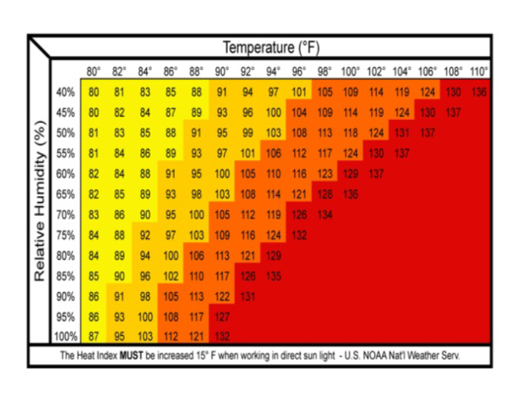
Heat Index
The heat index is a measure of how humidity impacts temperature
Use the heat index table to figure out which protective measures to enact
Image retrieved from Google
Notes:
A good exercise would be to instruct how to use the heat index table. Choose a temperature and a relative humidity to generate a heat index and use the Protective Measures table to choose the appropriate action
Image retrieved from Google

Slide 26
Using the Heat Index
Choose a Temperature (90 °F)
Choose a Humidity (85%)
Trace columns and rows until they intersect
This gives a Heat Index of 117 °F
While working in direct sunlight, 15 °F must be added to the Heat Index
This gives a Heat Index of 132 °F

Slide 27
Common Types of Heat-related Illnesses
Heat Rash
Heat Syncope
Heat Cramps
Heat Exhaustion
Heat Stroke

Slide 28
Symptoms - Heat Rash
Heat Rash
Occurs when sweat ducts become clogged
Sweat cannot get to surface of the skin
Symptoms include:
Red bumps on skin
Prickly or itchy feeling

Slide 29
First Aid - Heat Rash
When possible, a cooler, less humid work environment is best first aid.
Keep rash area dry.
Powder may be applied to increase comfort.
Ointments and creams should not be used. They cause the skin to stay warm and moist.

Slide 30
Symptoms - Heat Syncope
Heat Syncope
Occurs when blood vessels dilate and blood flow to the brain is reduced
Symptoms include:
Faintness
Dizziness
Headache
Nausea
Increased pulse rate

Slide 31
First Aid - Heat Syncope
Sit or lie down in a cool place
Slowly drink water, clear juice, or a sports drink
Seek medical attention for recurrent fainting episodes

Slide 32
Symptoms - Heat Cramps
Heat Cramps
Occurs when performing hard physical labor in hot environments
Due to the lack of water replenishment
Symptoms include:
Thirst
Sweating
Involuntary muscle cramps (Usually occurring in the legs)
Fatigue

Slide 33
First Aid - Heat Cramps
Drink water and have a snack every 15 to 20 minutes.
Avoid salt tablets.
Get medical help if the worker has heart problems, is on a low sodium diet, or if cramps do not subside within 1 hour.

Slide 34
Symptoms - Heat Exhaustion
Heat Exhaustion
Occurs when body temperature starts to rises to a critical level
May lead to heat stroke
Symptoms include:
Headache
Excessive sweating
Cool Skin
Nausea
Muscle cramps
Weakness
Thirst

Slide 35
First Aid - Heat Exhaustion
Bring the worker to a cool area that has shade or air conditioning
Remove any unnecessary clothing
Cool the worker with cold compresses on the armpits, groin, neck, back, and head.
Encourage frequent sips of cool water.
Notes:
First take the affected worker to receive medical care or call 911. If 911 is contacted someone should stay with the worker until help arrives. Bring the worker to a cool area and have them. Cold compresses or wet cloths should be placed on the affected person’s armpits, groin, neck, and back. These areas have many blood vessels close to the surface of the skin, reducing body temperature faster. Encourage them to sip at cool liquid.

Slide 36
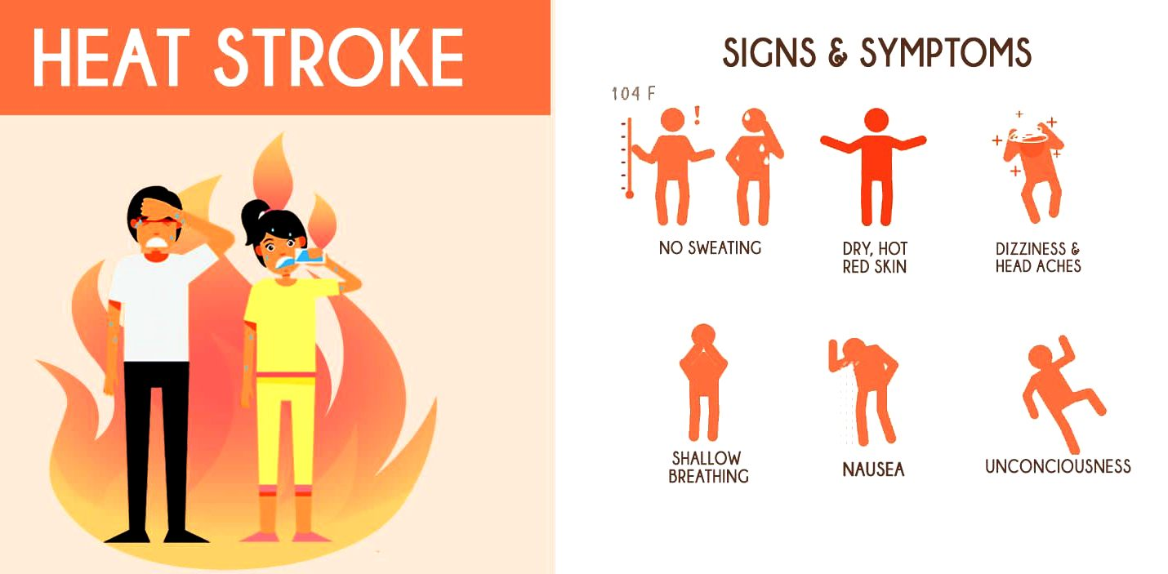
Symptoms - Heat Stroke
Heat Stroke
Occurs when the body’s temperature regulation fails
Body temperature rises to critical level
Symptoms include:
Confusion
Irrational behavior
Loss of consciousness
Convulsions
Hot, dry skin
Not sweating
Image retrieved from: https://zionnationalpark.net/recognizing-preventing-heat-stroke-hiking/
Notes:
Image retrieved from: https://zionnationalpark.net/recognizing-preventing-heat-stroke-hiking/

Slide 37
First Aid - Heat Stroke
Call 911 for emergency medical care
Bring the worker to a cool area with shade and remove any unnecessary clothing
Place cold wet cloths or ice on their head, neck, armpits, and groin; or soak the clothing with cool water.
Fan the worker to cool the air around them.
Stay with the worker until the emergency medical services have arrived
Notes:
Heat stroke can lead to death. Immediately contact emergency medical services if a worker is thought to be affected. Someone should stay with the worker until help arrives. Bring the worker to a cool area and remove any unnecessary clothes. Then place cold compresses or wet cloths on the affected person’s armpits, groin, neck, and back. These areas have many blood vessels close to the surface of the skin, reducing body temperature faster. Fan the worker to help circulate air around them to assist with cooling them down. Encourage them to sip at cool liquid.

Slide 38
Prevention - Education
Train workers to control and recognize heat-related hazards by promoting education of the following:
Types of heat-related illnesses
Importance of immediate medical attention
Company policies and procedures for contacting first responders
Protecting new “unacclimatized” workers
Job-related and personal risk factors
Appropriate work/rest cycles
Significance of taking rest breaks in cooler areas
Notes:
(Common heat-related illnesses) -> heat stroke, heat exhaustion, heat cramps, heat syncope,
Heat rash, Rhabdomyolysis (rab·dow·mai·aa·luh·suhs)
(Immediate attention) -> could be difference between life or death
(Policies) -> if company has a policy in place, its for good reason
(New workers) -> new workers are never fully educated as workers with seniority, it is important to help out your crew members
(Job related) -> certain work areas may prove to be more dangerous and require more cautious practice
(Breaks) -> breaks are important for overall wellbeing and must be utilized in high temperature work environments to avoid incidents.
Also workers must take breaks in cool, shaded, safe areas
Slide Reference:
https://www.osha.gov/SLTC/heatstress/training.html

Slide 39
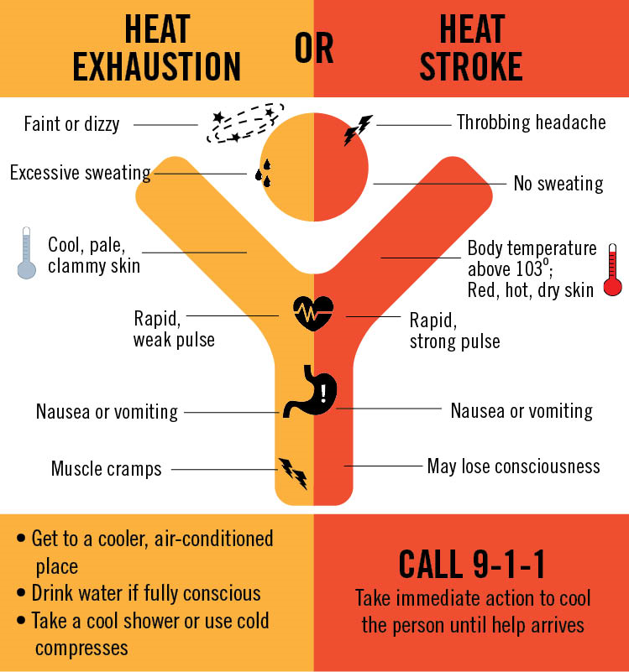
Prevention - Heat Illness
Determine whether total heat stress is too great and may have carryover effects on workers:
Heat advisories and Air Quality Alerts may compound on workers and prove for unsafe conditions
High level of physical activity leads to an increase of body heat production
Clothing and protective gear may not allow the body to shed excess heat
Image retrieved from Google
Notes:
(Carryover effects) -> May increase risk of heat related illness from overall exhaustion
(Environmental conditions) -> May create a more unsafe work environment due to more heat
(Physical activity) -> Body heat may lead to higher risk of heat related illness
(Gear) Clothing and gear may also lead to a higher risk of heat related illness
Slide Reference:
https://www.osha.gov/SLTC/heatstress/heat_hazardrecognition.html
Image retrieved from Google

Slide 40
Prevention - Acclimation
Acclimatization is a physical change that allows the body to build tolerance to working in the heat. Full acclimatization for workers may take up to 14 days.
To help avoid heat related illness workers can do the following:
Gradually increase workloads until at target workload
Take frequent breaks to hydrate
Rest in shaded areas
Notes:
If acclimatization is not properly addressed, workers will have an increased risk to heat-related illnesses.
It is absolutely crucial that workers slowly become accustomed to their work environment.
Slide Reference:
https://www.osha.gov/OshDoc/data_Hurricane_Facts/heat_stress.pdf

Slide 41
Prevention - Importance of Hydration
The following are tips and good habits to avoid dehydration:
Drink 8 oz. of cool water every 15-20 minutes
Do not depend on thirst
Avoid caffeinated beverages or alcohol, they dehydrate
Drink hydrating fluids before and during physical labor
Anticipate for conditions that will require increased need of water
Utilize hydration logs to ensure proper hydration
Notes:
These tips will help workers avoid dehydration which can help prevent heat-related illnesses. Water is crucial for our bodies to operate. Checking to see if a worker properly hydrated is one of the most common things checked after a heat-related incident.
Slide Reference:
https://hrs.uni.edu/sites/default/files/mybenefits/hydration_poster.pdf

Slide 42
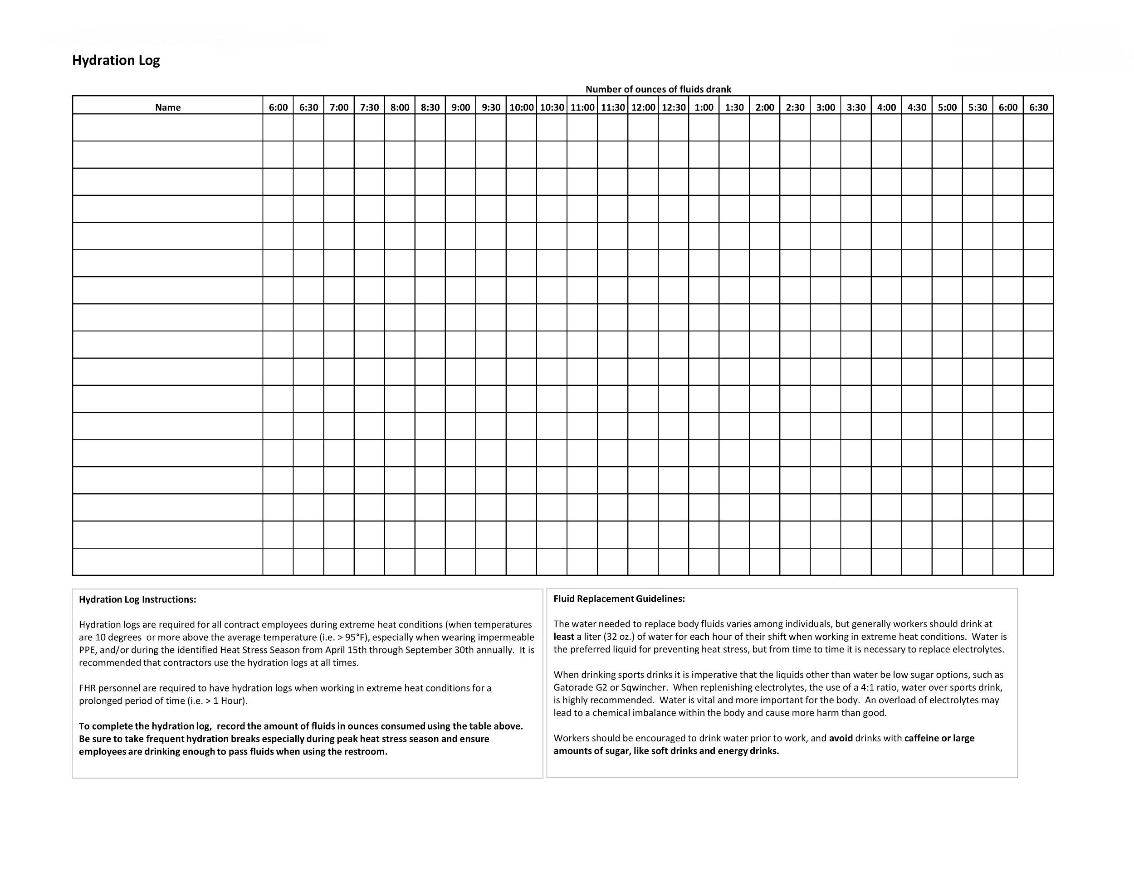
Prevention - Hydration Log Example
(Hydration logs are not generally used in this part of the country)
Notes:
They hydration log provided suggest that a liter (≈ 32 oz.) of water be consumed each hour of the workers shift when working in high heat environments. Therefore a half liter (500ml ≈ 16 oz.) should be consumed every half hour.
Slide Reference: (Figure of Hydration Log Example)

Slide 43
Prevention - Control Measures
Company implemented engineering and administrative control measures to reduce heat stress can provide for a safe work environment.
Engineered Control Measure Examples:
Air conditioning
Exhaust ventilation
Cooling/Misting Fans
Mechanical equipment to lessen manual labor
Cooled seating
Insulate heat sources
Notes:
(Engineering control measures) -> Using technology to lessen the creation of heat
(All examples) -> Each of the following engineered examples are implementations to keep the worker from getting hot
Slide Reference:
https://www.osha.gov/SLTC/heatstress/controls.html

Slide 44
Prevention - Control Measures
Administrative Control Measure Examples:
Modified work schedule
Rotate Job functions
Ensure water is being consumed
Implementation of buddy system
Avoid warm beverages
Provide shaded/cool areas
Require multiple breaks
Notes:
(Administrative control measures) -> Management needs to mitigate heat exposure
(Modified work schedule) -> Avoid working during the heat of the day
(Rotate job functions) -> If a certain role has high stress, rotate the worker to distribute workload
(Buddy system) -> Lookout for wellbeing of others
(Fluids) -> Drink lots of water and avoid warm beverages to keep body temp. low
(Areas) -> Designate areas specifically for breaks
(Breaks) -> Make sure workers take their breaks
Slide Reference:
https://www.osha.gov/SLTC/heatstress/controls.html

Slide 45
Questions?

Slide 46
References
CDC - Heat Stress - Heat Related Illness - NIOSH Workplace Safety and Health Topic. (2018, June 6). Retrieved from https://www.cdc.gov/niosh/topics/heatstress/heatrelillness.html.
UNITED STATES DEPARTMENT OF LABOR. (n.d.). Protecting Workers from the Effects of Heat [PDF file]. Retrieved from https://www.osha.gov/OshDoc/data_Hurricane_Facts/heat_stress.pdf
UNITED STATES DEPARTMENT OF LABOR. (n.d.). Retrieved from https://www.osha.gov/SLTC/heatillness/osha_heattraining_guide_0411.pdf
UNITED STATES DEPARTMENT OF LABOR. (n.d.). Retrieved from https://www.osha.gov/SLTC/heatstress/controls.html.
UNITED STATES DEPARTMENT OF LABOR. (n.d.). Retrieved from https://www.osha.gov/SLTC/heatstress/heat_hazardrecognition.html.
UNITED STATES DEPARTMENT OF LABOR. (n.d.). Retrieved from https://www.osha.gov/SLTC/heatstress/standards.html.
UNITED STATES DEPARTMENT OF LABOR. (n.d.). Retrieved from https://www.osha.gov/SLTC/heatstress/training.html.
Wheaton Franciscan Healthcare. Occupational Medicine & Wellness [PDF file]. Retrieved from https://hrs.uni.edu/sites/default/files/mybenefits/hydration_poster.pdf

