Slide 1
How to Mitigate Falls in the Work Establishment by Henry Crafer, Elijah Repke, Brian Long & Hassan Almaskeen OLS 30000-001 Safety and Health for Engineering Technologies Purdue University Northwest
(Figure 1. https://nationalsafetyinc.org)
Notes:
(Props as well as demonstrations regarding PPE and other company utilities is highly recommended)

Slide 2
Objective
1. Learn to identify fall hazards in the workplace. 2. Learn how to mitigate fall by the use of control measures such as personal protective equipment (PPE). 3. Know employers obligations and laws pertaining to fall protection.
Figure 2. (11/22/2019, https://papundits.files.wordpress.com)

Slide 3
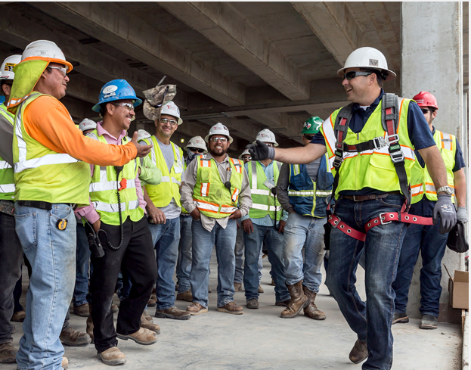
Introduction
According to OSHA, in the year 2017 there were 4,674 worker fatalities. 971 of those fatalities came from the construction industry and 39 percent of those fatalities were due to falls.
OSHA also states that in fiscal year 2018 the number one cited violation was fall protection
Figure 3. (11/22/2019 https://www.safetyandhealthmagazine.com)
Notes:
https://www.safetyandhealthmagazine.com/articles/print/16646-percent-of-construction-worker-deaths-involve-falls-new-database-shows

Slide 4
Introduction
Working at height accounts for more fatalities than any other activity.
Various factors such as vertical distance, roof types, support types, access equipment and weather conditions are responsible for the fall.
Unless working on a ladder, scissor lift or scaffold, OSHA requires the worker to have fall protection if height is 6 feet or greater.

Slide 5
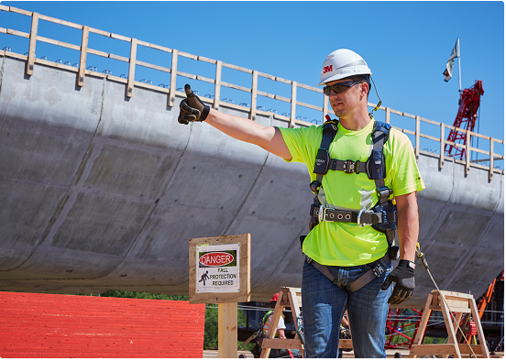
Introduction
What could be the problem?
It is uncomfortable
Takes extra time to put on
Gets in the way
(Figure 4. 11/22/2019 https://www.3m.com)
Notes:
Interact with the audience and ask them what they think the top 3 reasons workers do not wear fall protection then click the slide.

Slide 6
What are Control Measures?
Control Measures - are the actions we take to eliminate or reduce the hazard to an acceptable risk level.
Ideally the hazard is to be designed out when the part is made.
If the hazards can not be designed out then control measures are taken.
Common control measure include, personal protective equipment (PPE), guardrails, proper training etc...

Slide 7
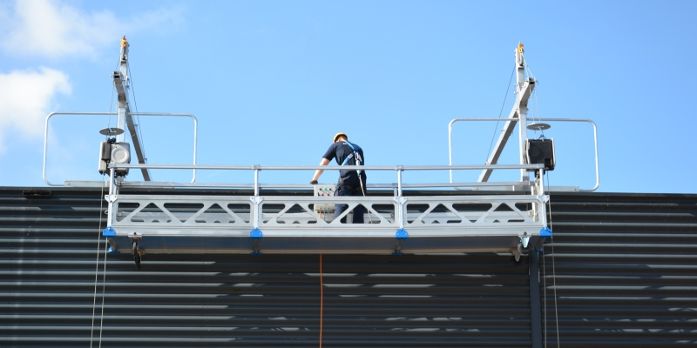
Common Hazards
Suspended platforms
Ladders
Leading edges
Floor openings
Wall openings
Scaffolding
Excavations
Unprotected sides and edges
(Figure 5. 11/22/2019 https://www.istockphoto.com)
Notes:
*Unprotected sides and edges: These are the sides and edges of walking and working surfaces that do not have walls, guardrail systems or other means of protection. "Guardrail system" means a vertical barrier, consisting of, but not limited to, top rails, mid rails, and posts, erected to prevent employees from falling off a scaffold platform or walkway to lower levels.
*Leading edges: These are the edges of a floor, a roof, the formwork for a floor or other walking surface that changes locations as additional floor, roofing, decking, or formwork sections are placed.
*Excavations: Excavations are any man-made cut, cavity, trench or depression in the surface of the earth. Excavations have their own hazards associated with them.
*Walking/working surfaces: These are any surfaces, whether vertical or horizontal, where employees work. Depending on the heights of these surfaces, you may be exposed to falls.
All of the conditions listed will increase your risk of falling. However, these are not the only areas where you may be exposed to falls. Regardless of height, fall protection must be used when working above:
* Dangerous equipment
* Sharp objects
* Piercing objects
https://fallprotectionxs.com/wp-content/uploads/2017/08/Header-FP.jpg

Slide 8
Control Hierarchy
Eliminate the hazard - This pertains to the first line of defense. This can be done by designing out.
Mitigate the fall - This is the second line of defense and can be done by using engineering control systems such as fences or guardrails.
Control the fall - This can be done by using Personal Fall Arrest Systems (PFAS).
Notes:
If hazard is eliminated, then the rest 2 steps are not required.
If it cannot be eliminated, then the fall has to be prevented or controlled.
Eliminating the hazard would be: avoiding working where hazard is present
Preventing the fall would be using Rails to prevent falls
To control the fall would be using a harness or net to catch the worker if they would fall.

Slide 9
Elimination of Fall hazards
Work from the ground whenever possible
Fill in any holes when done
Cover floor openings
Notes:
Cover the floor openings with material or components that are capable of withstanding the maximum load that is transferred under full service.
All floor opening coverings should be securely bolted or latched. They should be opened or removed with the permission and presence of an authorized person only.

Slide 10
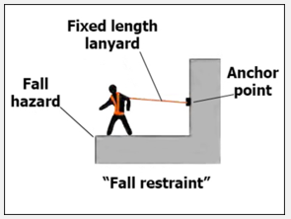
Fall Hazard Control: Mitigate
Install guard rails
Install toe boards
Prevent unauthorized entry or exit
Provide anchor points with fixed lanyard length (Personal Fall Arrest system).
(Figure 6. 11/22/2019 https://www.osha.gov)
Notes:
Guard rails are excellent to prevent falls. They carry the whole body weight incase the person slips
Toe boards give the perception of the fall. Thereby causing the worker to grip onto anything nearby.
Lanyard length is the length of the string that connects the worker and the anchor point as shown in the figure. Source: OSHA.
OSHA recommends fall restraint systems that have capacity to withstand 3000 pounds of force or twice the maximum expected force needed to restrain the worker from exposure to the fall.

Slide 11
Fall Hazard Control: Mitigate (Cont…)
1926.502(b) Guardrail systems and their use shall comply with the following provisions:
1926.502(b)(1) Top edge height of top rails, or equivalent guardrail system members, shall be 42 inches (1.1 m) plus or minus 3 inches (8 cm) above the walking/working level. When conditions warrant, the height of the top edge may exceed the 45-inch height, provided the guardrail system meets all other criteria of this paragraph.
1926.502(b)(4) When the 200 pound (890 N) test load specified in paragraph (b)(3) of this section is applied in a downward direction, the top edge of the guardrail shall not deflect to a height less than 39 inches (1.0 m) above the walking/working level. Guardrail system components selected and constructed in accordance with the Appendix B to subpart M of this part will be deemed to meet this requirement.
1926.502(b)(3) Guardrail systems shall be capable of withstanding, without failure, a force of at least 200 pounds (890 N) applied within 2 inches (5.1 cm) of the top edge, in any outward or downward direction, at any point along the top edge.
Notes:
FIXED

Slide 12
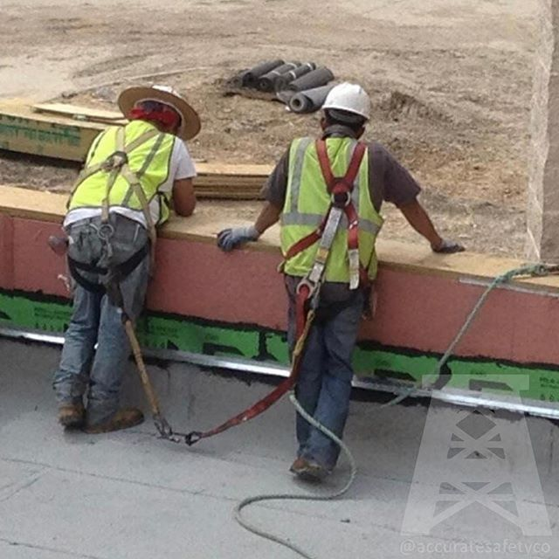
Personal Fall Arrest System (PFAS) A,B,C of PFAS
A- Anchorage
B- Body harness
C- Components (hooks, dee-rings, connection points, lanyards, deceleration devices etc.,)
(Figure 7. 11/22/2019 https://www.osha.gov)
Notes:
Anchorages can be temporary or permanent.
Body harnesses are full body coverage harnesses. They should be properly sized for the worker and inspected before being used. When not in use, they should be maintained regularly.
What not to do: Anchorage is to another person
https://i.pinimg.com/736x/cf/5c/f7/cf5cf7e5a47f89268107204cb268ffa3.jpg

Slide 13
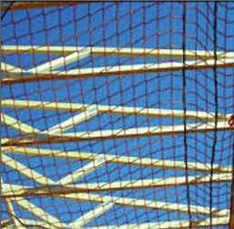
Fall Hazard Control Measures
Consists of a personal fall arrest system that straps the worker
Keeps workers from falling and decelerates slowly once released.
Safety nets can be used to catch a falling worker.
Must be designed, installed and maintained properly.
(Figure 8. 11/22/2019 https://blink.ucsd.edu)
Notes:
Safety net systems consist of mesh net, panels and connecting components. They are used as fall protection for heights 25 feet or above.
Source: OSHA
https://blink.ucsd.edu/safety/general/fall-protection/fall-protection-systems.html

Slide 14
OSHA Standard 1926.501
1926.501(a)(1) This section sets forth requirements for employers to provide fall protection systems. All fall protection required by this section shall conform to the criteria set forth in 1926.502 of this subpart.
1926.501(b)(2) The employer must ensure:
Each employee in a hoist area is protected from falling 6 feet or more to a lower level by:
A guardrail system;
A personal fall arrest system; or
A travel restraint system.
1926.501(b)(2)(ii) Each employee less than 6 feet above dangerous equipment is protected from falling into or onto the dangerous equipment by a guardrail system or a travel restraint system, unless the equipment is covered or guarded to eliminate the hazard.
Notes:
FIXED

Slide 15
OSHA Standard 1926.502
1926.502(a)General requirements. The employer must: Provide and install all fall protection systems and falling object protection this subpart requires, and comply with the other requirements in this subpart before any employee begins work that necessitates fall or falling object protection.
The employer must ensure guardrail systems meet the following requirements: The top edge height of top rails, or equivalent guardrail system members, are 42 inches (107 cm), plus or minus 3 inches (8 cm), above the walking-working surface.
When the employer uses a designated area, the employer must ensure: Employees remain within the designated area while work operations are underway; and the perimeter of the designated area is delineated with a warning line consisting of a rope, wire, tape, or chain.

Slide 16
OSHA Standard 1926.502
1926.502(a)(2) The employer must ensure that personal fall protection systems meet the following requirements.
Connectors must be drop forged, pressed or formed steel, or made of equivalent materials.
Connectors must have a corrosion resistant finish, and all surfaces and edges must be smooth to prevent damage to interfacing parts of the system.
When vertical lifelines are used, each employee must be attached to a separate lifeline.
Lanyards and vertical lifelines must have a minimum breaking strength of 5,000 pounds (22.2 kN).
Self-retracting lifelines and lanyards that automatically limit free fall distance to 2 feet (0.61 m) or less must have components capable of sustaining a minimum tensile load of 3,600 pounds (16 kN) applied to the device with the lifeline or lanyard in the fully extended position.
A competent person or qualified person must inspect each knot in a lanyard or vertical lifeline to ensure that it meets the requirements. Snap-hooks and carabiners must be the automatic locking type that require at least two separate, consecutive movements to open.
Snap-hooks and carabiners must not be connected to any of the following unless they are designed for such connections

Slide 17
Employer Requirements: Training and Certification
Training Program
Providing necessary training to all employees
Educate employees on fall hazards I.E. recognizing them
Utilizing work accessories that allow user to prevent Risk
Proper use of personal fall arrest, restraint systems, and platforms
Additional specified training may be required by customer
OSHA standards
Rescue program
Certification
Written certification forms
competency test
Retraining
To keep vigilance in the work environment
For those who need continual training
out of date training
lack of understanding or skill
Notes:
https://oshatraining.com/osha-training-requirements-fall-protection-construction.php
The focus of the program should
The program shall enable each employee to recognize the hazards of falling and shall train each employee in the procedures to be followed in order to minimize these hazards.

Slide 18
Employer requirements: Inspection
Employer area inspection
Mandatory regular grounds check for potential hazards
Fall hazard control systems: guard rails, personal fall arrest systems etc.
Employee must inspect
Personal fall arrest system/restraint systems ensuring they are up to standards and function properly.

Slide 19
Review Key Components
Identifying Hazards
Know when/how to use PPE
Understand Company laws/regulations concerning Fall protection
Become proficient in the Control Measures for the job
Familiarize yourself with OSHA Standards pertaining to Fall Hazards in construction
Become knowledgeable of employer requirements and how they can and do supersede less stringent regulations
Notes:
Give note that OSHA Standards given are only the bare minimum requirement.
Make sure to give emphasis on how your company's policies may include different/more precise regulations then general construction industry.

Slide 20
Comprehension Check
What are the main reasons employees do not wear fall protection?
It’s uncomfortable
Takes too much time to put on
Gets in the way
All of the above
Answer: All of the above
Notes:
Answer appears on click.

Slide 21
Comprehension Check
Working at a height accounts for more fatalities than any other activity in the workplace. True or False?
Answer: True

Slide 22
Comprehension Check
What does PFAS stand for?
Personal Float Advanced System
Personal Fall Arrest System
Personal Flying Apparatus System
All of the above
Answer: Personal Fall Arrest System

Slide 23
Comprehension Check
What are the A, B, and C of personal fall arrest systems?
Anchorage point, body harness and components
Hardhat, lanyard and whistle
Pray, wish upon a star and hope for the best
All of the above
Answer: Anchorage point, body harness and components

Slide 24
Comprehension Check
What is the minimum height that requires the use of a personal fall arrest system?
100 Feet
20 Feet
10 Feet
6 Feet
Answer: 6 Feet
Notes:
FIXED

Slide 25
Comprehension Check
In the fiscal year 2018, what was the number one OSHA cited violation?
Safety Glasses
Hard hat
Tripping hazards
Fall Protection
Answer: Fall Protection

Slide 26
Comprehension Check
What is the second process of required employee training?
Retrain
Certification
Inform
Identify
Answer: Certification

Slide 27
Comprehension Check
Control Measures are the actions we take to eliminate or reduce the hazard to an acceptable risk level. True or False?
Answer: True

Slide 28
Comprehension Check
Employees are required to purchase their own personal fall arrest system. True or False?
Answer: False

Slide 29
Comprehension Check
What does OSHA Standard 1926.501 cover?
Agricultural Standards/regulations
General Industry Standards/regulations
Construction Fall Protection Standards/regulations
Recordkeeping Standards/regulations
Answer: Construction Fall Protection Standards/Regulations

Slide 30
References
OSHA training requirements: Construction: Fall protection. (2011). Retrieved November 22, 2019, from https://oshatraining.com/osha-training-requirements-fall-protection-construction.php.
Safety and Health Magazine. (n.d.). 42 percent of construction worker deaths involve falls, new database shows. Retrieved November 22, 2019,from https://www.safetyandhealthmagazine.com/articles/print/16646-percent-of-construction-worker-deaths-involve-falls-new-database-shows.
OSHA. (n.d.). Department of Labor logo UNITED STATES DEPARTMENT OF LABOR. Retrieved from https://www.osha.gov/laws-regs/regulations/standardnumber/1926/1926.502.
OSHA. (n.d.). UNITED STATES DEPARTMENT OF LABOR. Retrieved November 22, 2019, from https://www.osha.gov/pls/oshaweb/owadisp.show_document?p_id=10757&p_table=STANDARDS .

Slide 31
Reference Images
Figure 1.- https://nationalsafetyinc.org/2013/08/08/fall-protection-training-videos-by-capital-safety/
Figure 2.- https://papundits.files.wordpress.com/2011/03/oshashowedup_2011-03-08-humor-history.jpg?w=594
Figure 3.- https://www.safetyandhealthmagazine.com/articles/16646-percent-of-construction-worker-deaths-involve-falls-new-database-shows
Figure 4.- https://www.3m.com/3M/en_US/worker-health-safety-us/solutions/fall-protection/
Figure 5.- https://www.istockphoto.com/photos/scaffolding?sort=best&mediatype=photography&phrase=Scaffolding
Figure 6.- https://www.osha.gov/Publications/fallprotectionsafety-commercialfishing-factsheet.html
Figure 7.- https://safety.honeywell.com/en-us/products/by-category/fall-protection/fall-protection-kits
Figure 8.- https://blink.ucsd.edu/safety/general/fall-protection/fall-protection-systems.html

