Slide 1
Ergonomics
Training Module
OLS 30000
Notes:
Three versions of this power point depending on time permitted.
Slide numbers do not include question portion.
1)Manual material handling only. (15 slides) SHORT VERSION
Use bottom right blue buttons to follow this version.
2)Manual material handling and Vibration. (21 slides) MEDIUM VERSION
Follow light blue rectangles in bottom left.
3) Manual material handling, awkward positions and Vibration. (24 slides) LONG VERSION
Click through slides normally.
If there is no button on the left or right for the version you would like to follow click through normally until the boxes are shown.

Slide 2
Objectives
What is ergonomics? (Section 1)
What is the standard for ergonomics? (Section 1)
Learn how to diminish common ergonomic risks.
Manual Material Handling and Lifting (Section 2)
Awkward Posture (Section 3)
Vibration (Section 4)

Slide 3
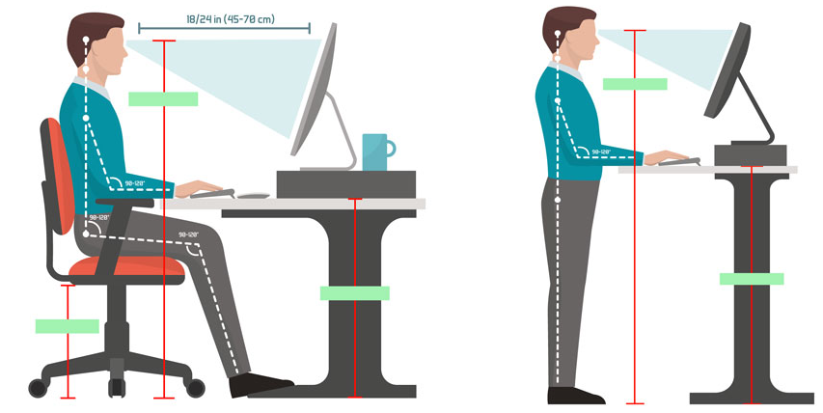
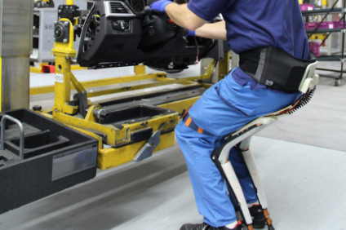
Ergonomics Defined
Section 1
Ergonomics is the process of fitting a job to a person.
Increases productivity
Comfort of worker
Decreased muscle fatigue
(Retrieved from: https://www.just-auto.com/comment/the-week-that-was-bmws-clever-production-tricks_id168074.aspx)
(Retrieved from https://www.dreamstime.com/ergonomics-correct-posture-to-lift-heavy-object-ergonomics-correct-posture-to-lift-heavy-object-man-lifting-object-image131579005)
Notes:
Ergonomics is the process of fitting a job to a person. It is relevent in any work enviroment, from working at a computer to working on a farm.
The benefits of learning how to account for ergonomics in your everyday work life are that it increases productivity, overall comfort when doing your job, and decreased muscle fatigue when doing repetative work.
Exo skeleton-Worker assist inovation https://www.just-auto.com/comment/the-week-that-was-bmws-clever-production-tricks_id168074.aspx
Lifting diagram-https://www.dreamstime.com/ergonomics-correct-posture-to-lift-heavy-object-ergonomics-correct-posture-to-lift-heavy-object-man-lifting-object-image131579005

Slide 4
Why is this important?
Section 1
OSHA’s General Duty Clause (Section 5(a)(1)) states:
Employers must create a work environment that is free of obvious and known hazards that can cause death or physical harm.
This clause indirectly states companies must take into account the ergonomic factors that are in their workplace.
When a job is not fit to the person, it is likely to cause Musculoskeletal Disorders (MSD) along with other disorders.
“MSD cases accounted for 33% of all worker injury and illness cases.”
Causes a loss in productivity in the workplace
Notes:
OSHA standard is stated to show there is no real rule stating ergonomis is to be follow but this standard in directly states it.

Slide 5
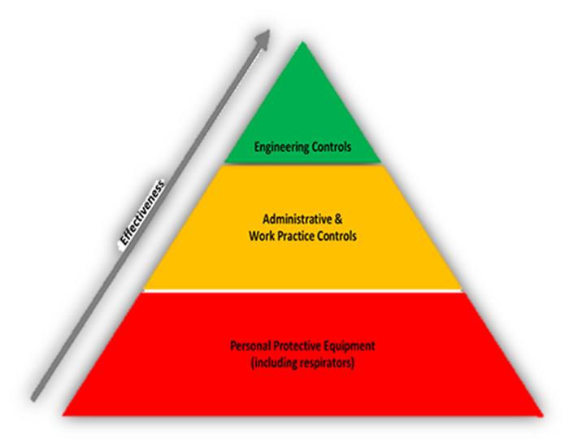
Process of controlling ergonomic risks
Section 1

Slide 6
Manual Material Handling and Lifting
Section 2

Slide 7
MSD
Section 2
MSD targets a certain part of the body or group of muscles, joints, and bones.
It encompasses a wide range of diseases and problems.
Musculoskeletal Disorders (2018)
Notes:
Musculoskeletal Disease or MSD cover a wide range of disease and related problem pertaining to body’s muscles, joint, and/or bones. These disease are from displacement from the natural or neutral position and preforming work or strain in that position. The affect of MSD are long lasting and typically are irreversible. These disease are the main focus of ergonomics and prevention is the goal.

Slide 8
Manual Material Handling and Lifting
Section 2
National Institute of Occupational Safety and health (NIOSH) states the most common nonfatal injury for lost time.
Lower Back Pain (LBP) is a common injury in material handling
#1 Musculoskeletal Disorder (MSD)
Affects all workers regardless of gender, age, or weight
Back brace does not aid in lifting
Decreased muscle tone
Does not align the spine or trunk muscles
Notes:
Niosh lists lower back pain as the most common non fatal injury for lost time at a company or service. It is the also the number one MSD injury. The MSD does not affect a certain gender, age or weight. Along with material handling, the misconception is that a back brace help the individual to lift more and maintain good posture. Transversely it does none of these. The back brace decreases muscle tone with repetitive use. The back brace also does not aid in spinal alignment or holding in on trunk muscles.

Slide 9
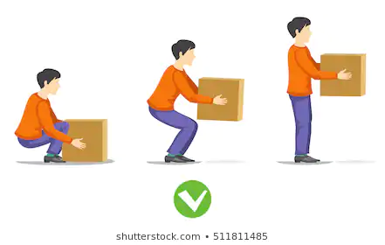
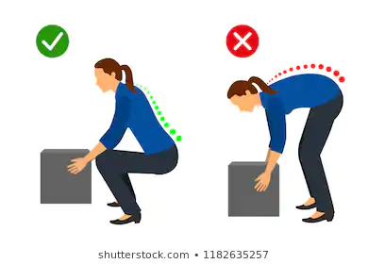
Correct Posture for LIfting
Section 2
Both Images found: Shutterstock.com (n.d.)
Notes:
Individuals should lift from a starting position of bent knees and straight back, grip the item firmly, and straighten out the knee and maintain a straight spinal alignment

Slide 10
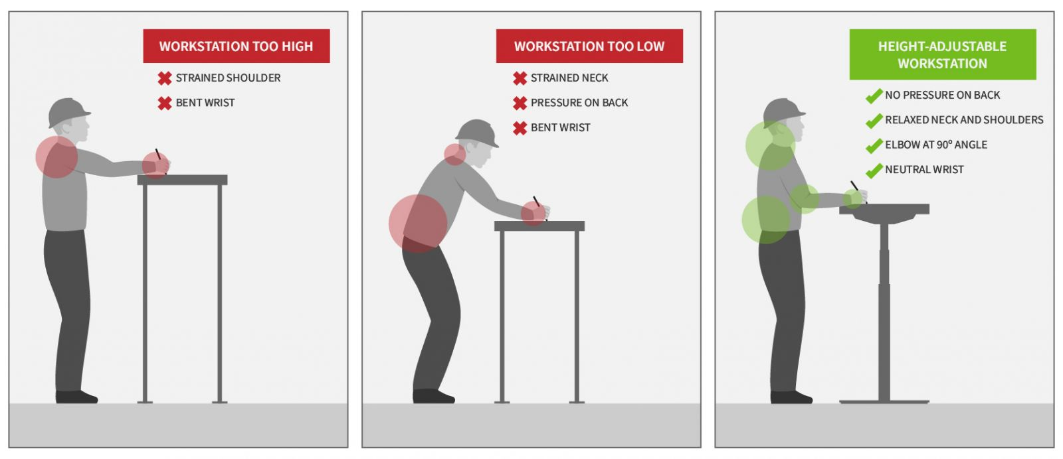
Work Station Ergonomics
Section 2
Reinventing the Production Line: Ergonomics in the Factory. (2018)
Notes:
Work stations are very important in ergonomics. These stations should help the worker do their job quickly, effectively, and with out injury. Each workstation should be job specific and site specific. What worked in on place might not work in another due to new surroundings or other hazards not present before. The posture should maintain straight up and down as well as the arm be bent at a 90 degree angle. The wrists should not have to be bent but instead be neutral and relaxed for easy writing.

Slide 11
Training Videos
Section 2
(10:02)
(2:25)
(16:09)
Notes:
Different training video lengths for time permitted.
Follow the dark blue rectangles in bottom right to continue short version of Ergonomics ppt.

Slide 12
Awkward Posture
Section 3

Slide 13
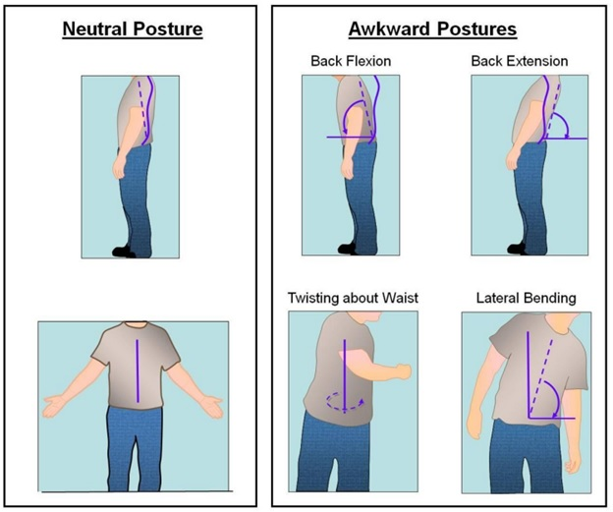
Awkward Posture
Section 3
Awkward posture refers to positions of the body that deviate significantly from the neutral position while performing work activities.
Examples:
Working overhead
Back bent
Reaching
Kneeling
Squatting
Bent Neck
Source: Practical Demonstrations of Ergonomic Principles (NIOSH RI 9684)

Slide 14
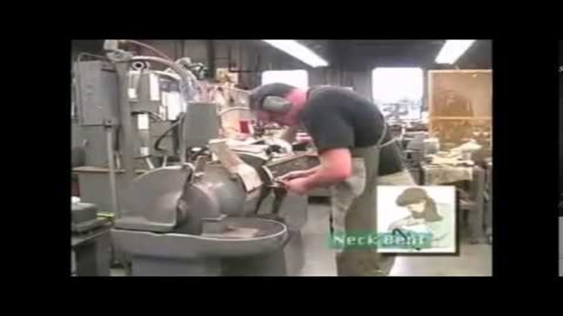
Signs and Symptoms
Section 3
Pain which may be dull and aching, sharp and stabbing or a burning sensation.
Tingling or numbness; swelling, inflammation, stiffness.
Muscle weakness or discomfort; extremities turning white or cold.
Muscle tightness, cramping or discomfort; clumsiness or loss of coordination.
Decreased range of motion; or discomfort when making certain movements.

Slide 15
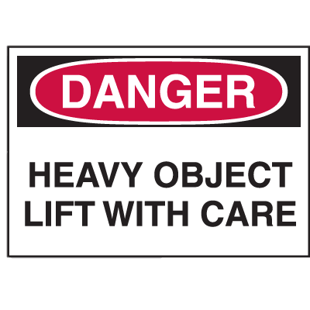
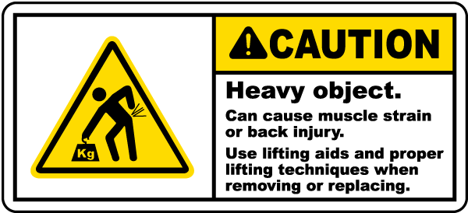
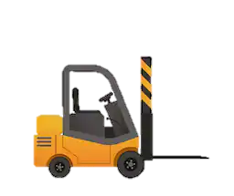
Control Measures
Section 2 & 3
(For lifting/handling and awkward postures)
Engineering Controls
Allow for easy pick up points
Work Practice
Make room for a mechanical device to assist in heavy objects
Training
Ability to lift properly
Warning labels for objects over 40 pound for team pickup
Ability to recognize the weight lift threshold
Operate Forklift/Crane
Setup of an ergonomic workstation
Take regular breaks
Avoid twisting and bending motions
All images from: Shutterstock.com

Slide 16
Vibration
Section 4

Slide 17
Vibration
Section 4
Vibrations are caused from running hand tools and machinery
Vibrations cause health risks due to regular and frequent exposure to vibration.
Hand-arm-vibration-syndrome(HAVS)
Carpal Tunnel Syndrome(CTS)
Notes:
“What is hand-arm vibration? Hand-arm vibration is vibration transmitted into workers’ hands and arms. This can come from use of hand-held power tools (such as grinders or road breakers), handguided equipment (such as powered lawnmowers or pedestrian controlled floor saws) or by holding materials being worked by hand-fed machines (such as pedestal grinders or forge hammers).
Why is hand-arm vibration an issue? Regular and frequent exposure to hand-arm vibration can lead to two forms of permanent ill health known as:
■ hand-arm vibration syndrome (HAVS); and
■ carpal tunnel syndrome (CTS). Symptoms and effects of HAVS include:
■ tingling and numbness in the fingers which can result in an inability to do fine work (for example, assembling small components) or everyday tasks (for example, fastening buttons);
■ loss of strength in the hands which might affect the ability to do work safely;
■ the fingers going white (blanching) and becoming red and painful on recovery, reducing ability to work in cold or damp conditions, eg outdoors. Symptoms and effects of CTS can also occur and include:
■ tingling, numbness, pain and weakness in the hand which can interfere with work and everyday tasks and might affect the ability to do work safely. Symptoms of both may come and go, but with continued exposure to vibration they may become prolonged or permanent and cause pain, distress and sleep disturbance. This can happen after only a few months of exposure, but in most cases it will happen over a few years.” (Health and Safety executive,2012)
http://www.hse.gov.uk/pubns/indg175.pdf

Slide 18
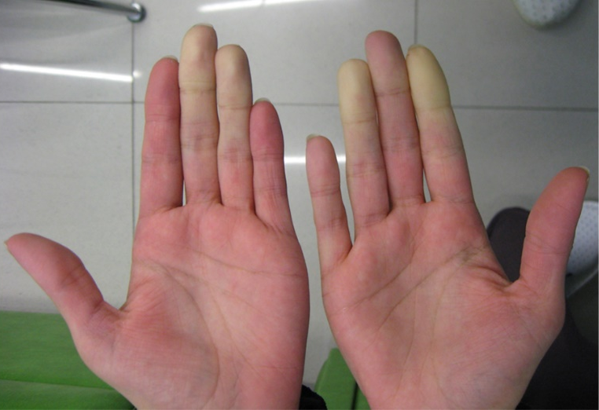
Symptoms
Section 4
Symptoms of HAVS include:
Tingling and numbness in the fingers
Loss of strength in the hands
The fingers going white (blanching) and becoming red and painful on recovery,
Symptoms of CTS:
Tingling or numbness
Weakness
Image source: https://hmohs.com/health/protecting-workers-health-vibration-exposure
Notes:
Hand Image: Image source: https://hmohs.com/health/protecting-workers-health-vibration-exposure
Carpal tunnel syndrome symptoms usually start gradually. The first symptoms often include numbness or tingling in your thumb, index and middle fingers that comes and goes.
Carpal tunnel syndrome may also cause discomfort in your wrist and the palm of your hand. Common carpal tunnel syndrome symptoms include:
“Tingling or numbness. You may experience tingling and numbness in your fingers or hand. Usually the thumb and index, middle or ring fingers are affected, but not your little finger. Sometimes there is a sensation like an electric shock in these fingers. The sensation may travel from your wrist up your arm. These symptoms often occur while holding a steering wheel, phone or newspaper. The sensation may wake you from sleep. Many people "shake out" their hands to try to relieve their symptoms. The numb feeling may become constant over time.
Weakness. You may experience weakness in your hand and a tendency to drop objects. This may be due to the numbness in your hand or weakness of the thumb's pinching muscles, which are also controlled by the median nerve.”(Mayo Clinic, 2017)
https://www.mayoclinic.org/diseases-conditions/carpal-tunnel-syndrome/symptoms-causes/syc-20355603

Slide 19
Hazard Identification
Section 4
Identifying sources of vibration
Chainsaws
Grinders (all types and sizes, ex: angle, die, straight, vertical etc.)
Impact drills; sanders and polishers
Scaling hammers including needle scalers
Powered hammers for chipping, demolition, road breaking etc.
Hand-held saws for concrete, metal, ground clearance etc.

Slide 20
Control Measures
Section 4
Engineering Controls
Use power tools that minimize vibration
Use manual tools where practical
Work Practice
Know and report symptoms
Take breaks and let the tools do the work
Personal Protective Equipment
Vibration dampening gloves
Maintain tools
Notes:
“Engineering controls:implement physical change to the workplace, which eliminates/reduces the hazard on the job/task)
purchasers are encouraged to select tools that minimize vibration. Such information can be obtained from manufacturers’ product or technical brochures.
Eliminate the need for vibrating tool if possible
Administrative & work practice controls:(establish efficient processes or procedures)
Workers using vibrating tools and their employers should be informed of the symptoms of vibration syndrome.
Vibrating tools should be carefully maintained according to manufacturers’ recommendations.
Work schedules with a 10-minute break after each hour of continuous exposure may help reduce the severity of vibration syndrome.
Let the tool do the work, grasping it as lightly as possible while working safely and maintaining tool control. The tool should rest on the workpiece or support as much as possible. The tighter the tool is held, the greater the vibration transmitted to the worker.
Wear adequate clothing to keep the body temperature stable and normal, since a low body temperature reduces blood flow to the extremities and therefore may trigger an attack of vibration syndrome. Workers are also advised to keep hands warm and dry while on the job.
Personal Protective Equipment: (wearable protection to reduce exposure to ergonomics-related risk factors)
some designs may attenuate vibration; however, this may be limited to only some of the higher frequencies found in vibrating handtools. Although gloves alone are not recommended as a method of reducing vibration transferred to the hands” (Donald Millar,2014)
Triangle Chart: Image source: https://www.osha.gov/SLTC/ergonomics/controlhazards.html

Slide 21
Thank you for your time
Section 5
Please review and fill out the Module Assessment that has been given to you.
Click boxes below for answers
Manual Material Handling and Lifting
Basic Ergonomics
Awkward Postures
Vibration

Slide 22
Basic Ergonomics Section 1
Answer c. process of fitting a job to a person
OSHA’s General Duty Clause (Section 5(a)(1))
Return to answer selection slide

Slide 23
Manual Material handling and lifting Section 2
Answer a. Musculoskeletal disease
Answer c. lower back pain
Answer b. False
Answer b. False
Return to answer selection slide

Slide 24
Awkward Postures Section 3
Answer: b. False
Answer: b. False
Answer: c.
Answer: a. Yes, my co-worker safety is important.
Return to answer selection slide

Slide 25
Vibration Section 4
Answer a. false, Frequent and regular exposure to Hand Arm Vibration causes Hand Arm Vibration Syndrome
Answer d. all of the above
Answer d. While HAVS and CTS have therapies to manage symptoms, neither condition is curable.
Answer b. PPE is the least effective control measure for hazard exposure.
Return to answer selection slide

Slide 26
References (Awkward Posture)
Colby.edu. (2019). [online] Available at: http://www.colby.edu/humanresources/wp-content/uploads/sites/170/2015/05/Ergo-Safety-03-Talk.pdf [Accessed 13 Nov. 2019].
ehs.yale.edu. (2018). ERGONOMICS: AWKWARD POSTURE. [online] Available at: https://ehs.yale.edu/sites/default/files/files/ergo-awkward-posture.pdf. [Accessed 13 Nov. 2019].
Cdc.gov. (2017). Step 1: Identify Risk Factors | NIOSH | CDC. [online] Available at: https://www.cdc.gov/niosh/topics/ergonomics/ergoprimer/step1.html [Accessed 13 Nov. 2019].
Osha.gov. (2019). Ergonomics eTool: Solutions for Electrical Contractors - Supplemental Information: Hazard Index. [online] Available at: https://www.osha.gov/SLTC/etools/electricalcontractors/supplemental/hazardindex.html#awkward [Accessed 13 Nov. 2019].
Moore, S. and Torma-Krajewski, J. (2011). Figure 4. Neutral and awkward back postures.. [image] Available at: https://www.cdc.gov/niosh/mining/UserFiles/works/pdfs/2011-191.pdf [Accessed 13 Nov. 2019].
Ehs.virginia.edu. (n.d.). Signs & Symptoms of Physical Distress, UVA-EHS. [online] Available at: http://ehs.virginia.edu/Ergonomics-Distress.html [Accessed 13 Nov. 2019].
Lounge-tek team (2017). back-pain-using-laptop. [image] Available at: https://lounge-tek.com/chair-back-pain-ergonomics/ [Accessed 13 Nov. 2019].

Slide 27
References (Vibration)
Carpal tunnel syndrome. (2017, March 30). Retrieved November 19, 2019, from https://www.mayoclinic.org/diseases-conditions/carpal-tunnel-syndrome/symptoms-causes/syc-20355603.
Donald Millar, J. (2014, June 6). CDC - NIOSH Publications and Products - Vibration Syndrome (83-110). Retrieved November 19, 2019, from https://www.cdc.gov/niosh/docs/83-110/.
Health and Safety Executive. (2012). Hand-arm vibration at work [leaflet]. Crown. Retrieved from http://www.hse.gov.uk/pubns/indg175.pdf
[Membership HCLG]. (2017, May 10). Hand Arm Vibration [Video file]. Retrieved from https://www.youtube.com/watch?v=f1e_XiD3W1s
UNITED STATES DEPARTMENT OF LABOR. (n.d.). Retrieved from https://www.osha.gov/SLTC/ergonomics/controlhazards.html.

Slide 28
References (Work handling and Lifing)
CDC - Mining Topic - Manual Materials Handling - NIOSH. (2018, March 9). Retrieved November 10, 2019, from https://www.cdc.gov/niosh/mining/topics/manualmaterialshandling.html.
Ergonomics and Musculoskeletal Disorders. (2018, February 28). Retrieved November 10, 2019, from https://www.cdc.gov/niosh/topics/ergonomics/.
Images of manual lifting. (n.d.). Retrieved November 15, 2019, from https://www.shutterstock.com/es/search/manual lifting.
Musculoskeletal Disorders. (2018, March 9). Retrieved November 18, 2019, from https://books.hse.gov.uk/Musculoskeletal/.NIOSHTIC-2 Publications Search - 00221251 - Workplace use of back belts. Review and recommendations. (2019, April 12). Retrieved November 10, 2019, from https://www.cdc.gov/niosh/nioshtic-2/00221251.html.
NIOSHTIC-2 Search Results - Full View. (2019, January 30). Retrieved November 10, 2019, from https://www2a.cdc.gov/nioshtic-2/BuildQyr.asp?s1=Ferguson+Marras&f1=*&Startyear=&Adv=0&terms=1&D1=10&EndYear=&Limit=10000&sort=&PageNo=1&RecNo=1&View=f&.
Reinventing the Production Line: Ergonomics in the Factory. (2018, January 26). Retrieved November 15, 2019, from https://www.timotionergo.com/en/news/detail/blog-articles/reinventing-the-production-line:-ergonomics-in-the-factory?guid=1516999939.
Stevenson, S. (2017, August 16). Musculoskeletal system diseases. Retrieved November 10, 2019, from https://www.dmu.edu/medterms/musculoskeletal-system/musculoskeletal-system-diseases/.
UNITED STATES DEPARTMENT OF LABOR. (2013). Retrieved November 10, 2019, from https://www.osha.gov/SLTC/ergonomics/.

