Slide 1
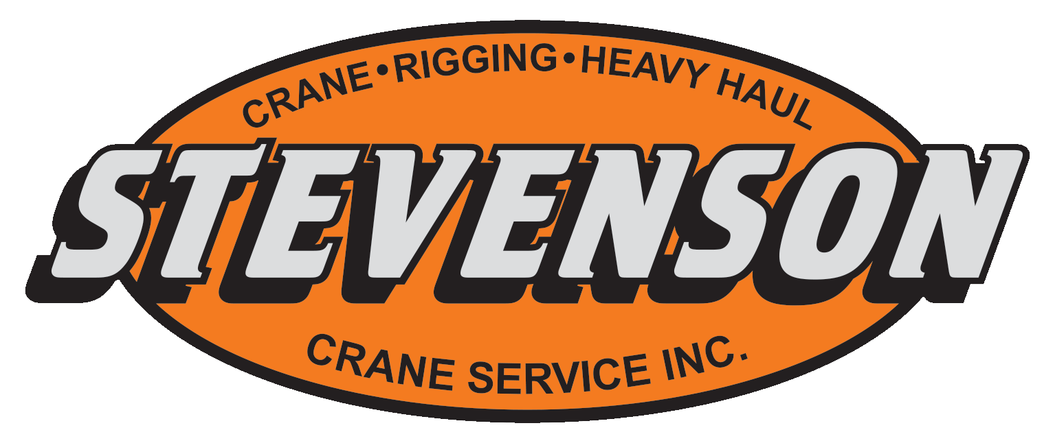
Crane Safety:
Notes:
Title Page.

Slide 2
Objectives of Training:
1. To inform operators of the various hazards associated with crane use.
2. To inform operators of the OSHA standards associated with safely operating equipment.
3. To inform operators about the proper times to conduct inspections, and the associated hazards they are based on.
Notes:
Objectives for the Training.

Slide 3
Common Issues and Hazards with Cranes:
[Workplace Lifting Safety
Training] Retrieved from:
https://youtu.be/LviUp94t65Q
Notes:
Youtube video on Crane Safety.

Slide 4
Common Issues and Hazards with Cranes:
Hazards:
Electrical hazards, power lines.
Overloading, poor weight distribution.
Materials slipping or falling from the crane.
Improper ground conditions.
Notes:
List of most common hazards.

Slide 5
Power line example:
Hazards cont.
This is a crane accident involving power lines that the crane or load did not come into contact with. Many Crane accidents result from improper clearance with overhead power lines.
[Crane and powerline hazard] retrieved from https://www.youtube.com/watch?v=pwftUYkOX0Y
Notes:
Hazard associated with a crane combusting near a powerline.

Slide 6
Common Issues: Overloading:
[Overloading, Sims Crane Minute] Retrieved from:
https://www.forconstructionpros.com/rental/lifting-equipment/crane/video/11148502/video-crane-overloading-is-not-safe
Notes:
Video explains hazards involved with overloading and explains how it can be prevented.

Slide 7
Damage to people and property:
Materials slipping and falling from the crane is a serious hazard because people underneath the crane or around the worksite can be crushed by these objects, and damage to property as well as people getting hurt are also serious hazards.
It is also a hazard to the environment around the crane.
Steam lines, underground vaults, voids, and utilities are all Improper ground conditions.
Notes:
A Slide that address the potential hazards to people and property.

Slide 8
Common Maintenance Hazards with Cranes:
Issues:
Damage and degradation to the wire rope.
Alignment issues.
Wear and tear on end truck wheels.
Issues with electrification system.
Bent or damaged hooks.
Notes:
Hazards associated with the maintenance of equipment.

Slide 9
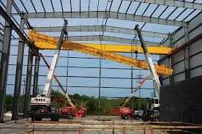
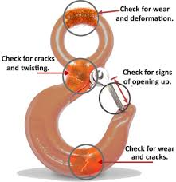
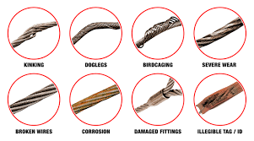
Common Maintenance Hazards with Cranes:
[Poor alignment] retrieved from: https://www.mazzellacompanies.com/resources/blog/5-common-problems-with-overhead-cranes-and-how-to-avoid-them
[Bent and damaged hook] retrieved from: https://www.hoistandcranedepot.com/about-rigging-hook-safety-types-and-uses/
[Wear and tear on wire] retrieved from: https://www.mazzellacompanies.com/Resources/Blog/how-to-inspect-wire-rope-slings-to-asme-b309-standards
Notes:
From left to right: Wear and tear on wire, incorrect crane alignment, bent and damaged hook

Slide 10
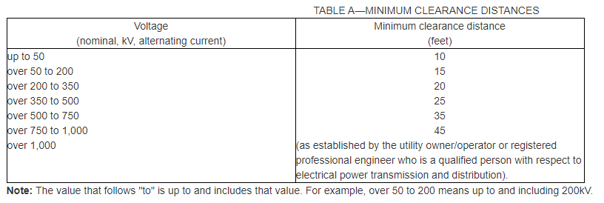
Corrective Measures:
Overhead Power Lines
Insure there is a 20 foot clearance from the maximum work zone.
If the work zone is closer than 20 feet to the load lines, then options 1, 2, or 3 are to be met.
De-energize the lines and ensure they are grounded;
Employer must ensure that the equipment, load lines, or load never get closer than the 20 foot clearance when operating;
When maximum work zone is closer than 20 feet to power lines, Table A clearances are to be used.
[Table A from OSHA Power Line Safety] retrieved from: https://www.osha.gov/laws-regs/regulations/standardnumber/1926/1926.1408
Notes:
How to compensate for overhead power lines.

Slide 11
Corrective Measures involving power lines:
Overhead Power Lines Cont.
When using Options 2 or 3, special encroachment precautions are to be met:
A meeting with the operator and other workers in the area to review the location of the power lines.
Steps to be implemented to prevent encroachment/electrocution.
If tag lines are used, they must be non-conductive.
High-visibility markers are to be placed at the 20 foot line (or otherwise specified in Table A) and if the operator can not see the markers, a dedicated spotter must be used.
Either a proximity alarm or a dedicated spotter in constant contact with the operator must be implemented.
No part of the equipment, load line, or load is to be under the power line unless employer has confirmed that the lines are deenergized.
Notes:
Additional information about overhead lines.

Slide 12
Corrective Measures:
Overloading / Poor Weight Distribution / Load Slipping or Falling
Most modern cranes have overload protection systems.
Earlier models may have 4 types of switches that when a load exceeds a certain limit, the crane will only be able to be lowered. The 4 types are the following:
Mechanical.
Electric.
Mechanical/Electrical Hybrid.
Chain Hoist.
When first rigging a load, the load should only be hoisted a few inches above the ground then checked for proper balance and insurance that the load is completely secured.
Verifying the rigging should insure that the load will not slip or fall.
Notes:
Mechanical Switch- when excessive force occurs, a spring collapses, causing the switch to flip, and disabling the hoist
Electric- Monitors the current the motor is drawing. When exceeded, disables the hoist
Mechanical/Electric- adjust voltage to compensate for deflection to an extent then the mechanical switch disables the hoist
Chain Hoist- Uses a slip clutch. The slip clutch will continue to spin when overload occurs but will not lift the load, disabling the hoist.

Slide 13
Weather:
When setting up the crane to pick up the desired load, it is crucial to investigate the weather conditions for the area, are right for safe crane operation.
The most important weather conditions to keep in mind are the wind speed, and lightning.
Just remember that high winds = uncontrollable load which makes the job unsafe for everyone. The crane arm also acts like a lightning rod.
Notes:
In this section, emphasize on how important the wind speed factor is with regards to picking up loads.
For the manufacturer’s maximum amount of wind speed allowed, see the owners/operators manual for more information
It should also be mentioned that the size of the load will have an effect on what makes the load uncontrollable when there are high winds.

Slide 14
Crane Setup Hazards:
When setting up the crane prior to operating, the following must be ensured:
The ground is level, and free from any obstructions.
All outriggers are properly extended and the correct outrigger pads are used.
When checking the outriggers, there should be no float.
The crane’s area is large enough to satisfy the crane’s radii when rotated.
Notes:
Hazards to look for when setting up the cranes

Slide 15
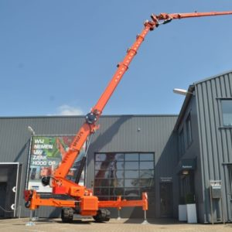
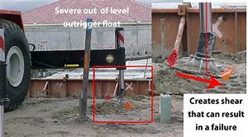
Crane Outrigger Setup:
[Proper outrigger utilization] retrieved from:
https://stevensoncrane.com/product/maeda-mc-405-c/
[Improper outrigger utilization] retrieved from:
https://www.cranetech.com/blog/leveling-the-field/
Notes:
Proper vs improper outrigger setup. Links lead to further information on the subject.

Slide 16
Crane Outrigger Hazards:
When extending the outriggers of the crane and also when placing the pads in the desired area, be sure to follow all safety rules. Hazards that are associated with this are as follows:
Extending the outriggers into a person or piece of equipment.
Pinch points when setting up the outriggers pads.
Ensure proper pads are used to reduce the risk of an outrigger leg slipping off the pad.
Note: Proper pad placement and proper type of pad will greatly reduce the risk of the crane tipping over.
Notes:
Hazards associated with an Outrigger.

Slide 17
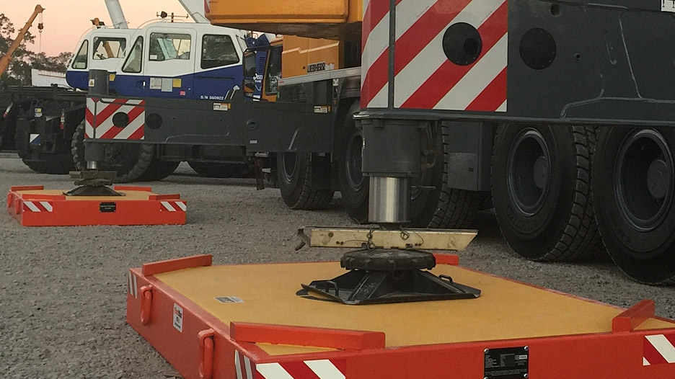
Crane Outrigger Pads - Correct Use:
The image shown is the correct utilization of the outrigger pads. Note that the outrigger legs are centered directly in the middle of the pad.
Image retrieved from https://dicausa.com/fibermax-crane-pads/
Notes:
Proper use of Outrigger Pads.

Slide 18
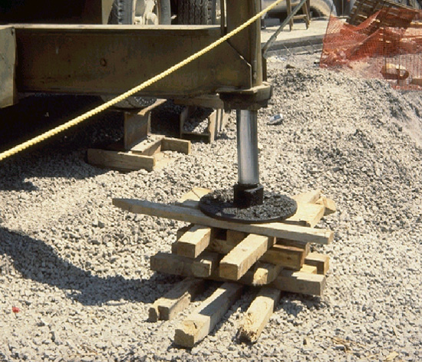
Crane Outrigger Pads - Incorrect Use:
The image shown here is the incorrect use of wood blocks. There should be no gaps between the blocks and the ground should be level.
Image retrieved from http://www.elcosh.org/document/1488/748/d000104/selection.html
Notes:
Improper use of Outrigger pads.

Slide 19
OSHA Standard for Outrigger Use:
OSHA Standard 1910.180(h)(3)(ix) states:
“Outriggers shall be used when the load to be handled at that particular radius exceeds the rated load without outriggers as given by the manufacturer for that crane. Where floats are used they shall be securely attached to the outriggers.”
Notes:
OSHA’s take on Outrigger Use.

Slide 20
Crane Inspections and Associated Hazards:
To reduce the risk of crane failure, inspections on each component of the crane is required.
Periodic or frequent are two crane usage classifications that determine the inspection intervals.
OSHA defines the intervals as:
Frequent inspection - daily to monthly intervals.
Periodic inspection - 1 to 12 month intervals or as specified by manufacturer.
Notes:
Crane inspections and their importance.

Slide 21
Post Assembly inspection:
OSHA 1926.1412 (c)
After completion of assembly, the equipment must be inspected by a qualified person to ensure it meets manufacture criteria.
(2)(i) Determine is a registered professional engineer (RPE) is familiar with the specific type of equipment needs to develop criteria for the equipment configuration. If the RPE is not needed, employer must ensure it is developed by a qualified person.
(c)(3) Equipment must not be used until an inspection under this paragraph demonstrates equipment is configured in accordance with criteria.
Notes:
Inspection standards used after equipment is assembled

Slide 22
Severe Service Environment Inspections:
1926.1412(g) - 1926.1412(g)(3)
Under conditions where significant damage via overloading, shock loading, or continuous usage in a corrosive environment, the crane must be brought down for mandatory inspection.
A qualified person must determine if the equipment is still safe to use, and make sure it satisfies the criteria listed under 1926.1412(f).
If an issue is discovered, the employer is required to satisfy the requirements found under 1926.1412(f)(4)-1926.1412(f)(6).
Notes:
This slide is about the environments that make maintenance more difficult and common

Slide 23
Crane Inspections and Associated Hazards:
OSHA 1910.1809(d)(3) explains “frequent inspection” as:
“"Frequent inspection." Items such as the following shall be inspected for defects at intervals as defined in paragraph (d)(2)(i) of this section or as specifically indicated including observation during operation for any defects which might appear between regular inspections. Any deficiencies such as listed shall be carefully examined and determination made as to whether they constitute a safety hazard”
1926.1412 (2)- If there are any deficiencies in inspection are found, a determination by a competent person must be made to decide if it is a safety hazard. If it is a safety hazard then equipment must be taken out of service until it is corrected.
1926.1412 (3)- If any deficiencies are found then action must be taken prior to using equipment.
Notes:
How to isolate and correct safety hazards

Slide 24
Crane Inspections and Associated Hazards:
OSHA 1926.1412 (d) (i)-(d) (xiv)
(i) Control mechanisms interfering with operation.
(ii) Control and drive mechanics with excessive wear and contamination by lubricants and other foreign matter.
(iii) Air, Hydraulic and other pressurized systems for deterioration or leakage.
(iv) Hydraulic system for proper fluid levels.
(v) Hooks and latches for: deformation, cracks, excessive wear, or chemical damage.
(vi) Wire rope in compliance with manufacturer.
(vii) wire rope in accordance with 1926.1413 .
(viii) Electrical apparatus for: malfunctioning, deterioration, dirt, and moisture accumulation.
Notes:
Inspection Standards

Slide 25
Crane Inspections and Associated Hazards continued:
(ix) Tires for proper inflation and condition.
(x) Ground conditions around equipment for support: ground settling under and around outriggers/stabilizers, and foundations, groundwater accumulation, does not include railroad tracks.
(xi) equipment for level position specified by manufacturers recommendation, both before and after each shift.
(xii) Operator cab windows for: significant cracks, breaks or other deficiencies that can hinder operators view.
(xiii) When equipment is rail traveling: Rails, Rail stops, and Rail clamps.
(xiv) Safety devices and operational aids for proper operation.
Notes:
Information about Inspections of cranes.

Slide 26
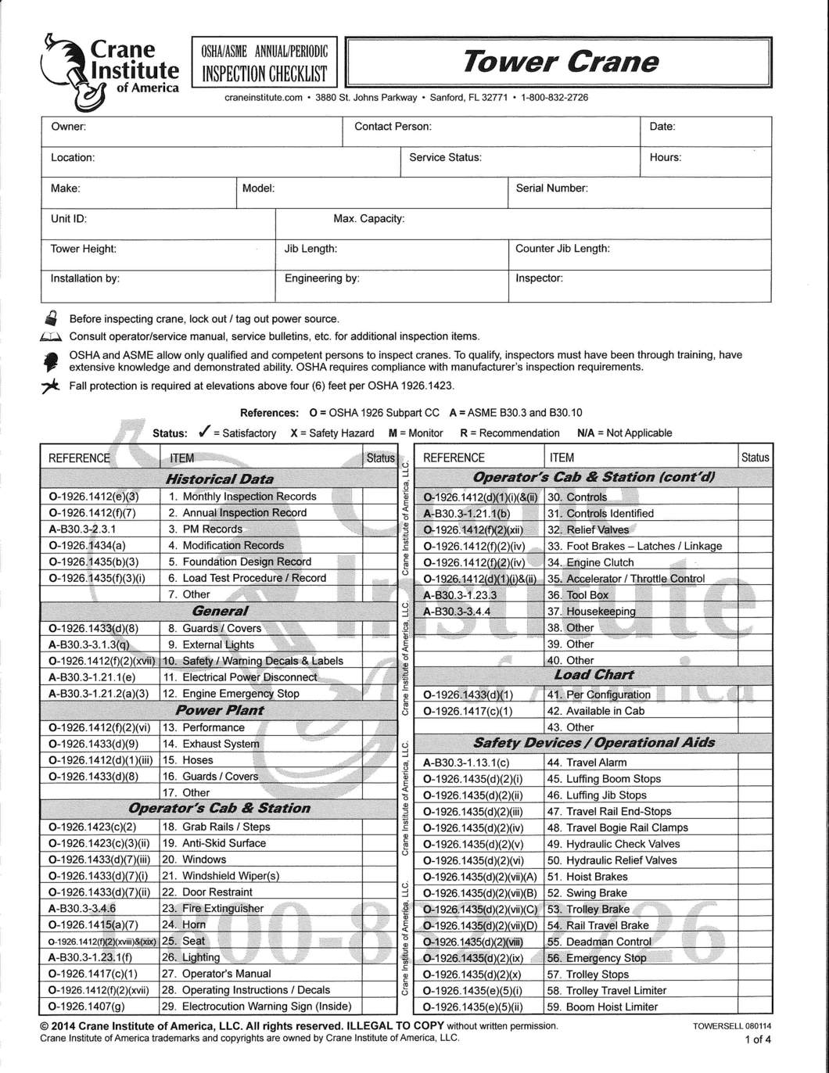
Crane Inspection Checklist:
A crane inspection must be performed prior to operating the crane. Any deficiencies located must be taken care of before the crane can be safely operated.
Refer to OSHA 1926.1412(d)(2) and (3).
Image retrieved from:
https://store.craneinstitute.com/products/inspection-checklist-tower-crane-annual-periodic
Notes:
Image of a crane inspection sheet.

Slide 27
Crane Operator Qualification:
Operators of derricks, sideboom cranes, or equipment with a maximum manufacturer-rated hoisting/lifting capacity of 2,000 lbs. or less are not required to be certified/licensed but still must complete training.
An employee that is not certified/licensed may work as an operator-in-training only under supervision.
An operator-in-training may not operator if any of the following circumstances;
If the work zone is closer than 20 feet of a power line up to 350kV, or within 50 feet of a power line over 350kV.
The equipment is being used to hoist personnel.
Multiple-equipment lifts.
If the equipment is used over a shaft, cofferdam, or in a tank farm.
Notes:
Information on Who is qualified to operate certain machines.

Slide 28
Crane Operator Qualification:
Audited Employer Program: The employer’s certification of its employee must meet the following requirements
Written and practical tests must be either;
Developed by an accredited crane operator organization.
Approved by an auditor.
The employer program must be audited within 3 months of the beginning of the program and at least every 3 years thereafter.
Certification is achieved when a written test is passed on all the knowledge as skills needed to operate equipment safely.
The employer must ensure that each operator is qualified through an evaluation of skills and knowledge necessary to operate the equipment safely.
Notes:
The Requirements necessary to qualify someone for operating a crane.

Slide 29
References:
CraneOperations.jpg. (n.d.). Retrieved November 26, 2019, from https://ehs.princeton.edu/workplace-construction/workplace-safety/construction- safety/crane-safety/crane-operations.
Department of Labor logo UNITED STATESDEPARTMENT OF LABOR. (n.d.). Retrieved November 26, 2019, from https://www.osha.gov/laws- regs/regulations/standardnumber/1926/1926.1412.
Lang, J. (n.d.). How do overload protective devices work? Retrieved from https://www.konecranesusa.com/resources/lifting-viewpoints/how-do-overload-protective- devices-work.
Managing Mobile Crane Hazards. (n.d.).Retrieved November 26, 2019, from http://www.elcosh.org/document/1488/745/d000104/hazards.html.
Notes:
References 1

Slide 30
References:
Operator training, certification, and evaluation. (2018, November 9). Retrieved from https://www.osha.gov/laws-regs/regulations/standardnumber/1926/1926.1427.
Power line safety (up to 350 kV)--equipment operations.(2010, August 9). Retrieved from https://www.osha.gov/laws-regs/regulations/standardnumber/1926/1926.1408
UNITED STATES DEPARTMENT OF LABOR. (n.d.). Retrieved November 26, 2019, from https://www.osha.gov/SLTC/cranehoistsafety/hazards.html.
Video: Crane Overloading is not Safe. (n.d.). Retrieved November 26, 2019, from https://www.forconstructionpros.com/rental/lifting-equipment/crane/video/11148502/video- crane-overloading-is-not-safe.
Notes:
Page 2 of references.

