Slide 1
Confined Space
Training
Notes:
Welcome trainees, the topic of today’s training is confined spaces.

Slide 2
Training Objectives
At the end of this training participants will be able to:
Identify Confined Spaces
Identify hazards of confined spaces
Control hazards with appropriate methods/equipment
How to apply standard.
Notes:
Introduce the training objectives. Listed are the concepts trainees should understand.
At the end of the training program, there will be a quiz to measure trainee comprehension.
Encourage trainees to share ideas, information, experiences from the field to help the learning experience.
All of this is per OSHA Standard 1910.146(g)(1)
The employer shall provide training so that all employees whose work is regulated by this section acquire the understanding, knowledge, and skills necessary for the safe performance of the duties assigned under this section.
Reference:
OSHA. (2012). Regulations (Standards- 29 CFR). Retrieved from United States Department of Labor: https://www.osha.gov/pls/oshaweb/owadisp.show_document?p_id=9797&p_table=STANDARDS

Slide 3
Topics Covered
Confined Space Regulation
Confined Space Hazards
Safety Equipment and Devices
Signages and Permits
Worker Training, Team Duties and Rescue Service Personnel
Safety Practices and Case Study
Notes:
Topics covered in the training include: Confined Space hazards, Types of Confined Spaces, Control Measures in Confined Spaces, and OSHA Confined Space Standards application.

Slide 4
What is a Confined Space?
A space not design for occupancy but large enough for a person to get inside to work
1910.146(b) - 3 Criteria
Is large enough to enter and perform assigned work
Has limited or restricted means for entry or exit
Is not designed for continuous employee occupancy
Notes:
According to the OSHA standard 1910.146(b):
All 3 criteria must be met.
Read 3 sections on powerpoint.
Explanations:
The whole body of an employee must be able to fit and work inside a given space
Does NOT mean only one way in or out… It means that the worker must exert unusual effort to enter or leave the space such as twisting, crawling, go through narrow openings, etc.
Examples: Hatchets, port holes, manholes, ladders, spiral stairway, crawl spaces, enclosed spaces with long distance to exit
For example space is not designed with any safeguards for workers such as lighting, ventilation, gas detector etc.
Reference:
OSHA. (2012). Regulations (Standards- 29 CFR). Retrieved from United States Department of Labor: https://www.osha.gov/pls/oshaweb/owadisp.show_document?p_id=9797&p_table=STANDARDS

Slide 5
Worker dies due to engulfment
use in the beginning to show why confined space is important, add more info about the incident to notes
Figure 1. Trench Death(Barab, 2017)
Notes:
The image above shows the body of Patrick Walters after dying due to working in sewage pipes. The autopsy report shows that walters died a slow death due to sludge filling his lungs after sludge caved in the sewage pipes he was working in.
This is an example of how tragic confined spaces can be if proper equipment and practices aren’t followed. Had Patrick been using proper equipment, and had the company in question been requiring the use of proper equipment, trenching accidents like this one wouldn’t happen.
References:
Barab, J. (2017, March 27). Retrieved from jordanbarab.com: http://jordanbarab.com/confinedspace/2017/03/27/trench/

Slide 6
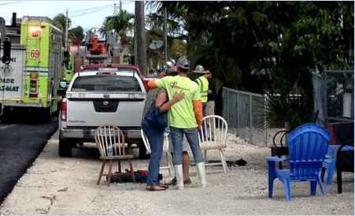
Families Mourn Death of Loved Ones
use in the beginning to show why confined space is important, add more info about the incident to notes
Figure 2. Confined Space Continues to Kill (Barab, 2017)
Notes:
In July of 2017, three employees died working in a manhole in Key Largo due to deadly amounts of hydrogen sulfide and carbon monoxide. This is one tragic example of accident that should not happen in the workplace. Accidents like this one are easily avoidable if proper equipment was used and procedures were followed. For example, if the atmosphere was tested prior to entry the workers would have been able to take proper precautions, such as using proper PPE. As we continue through this presentation we will learn about the possible procedures and precautions that need to be taken in order to avoid situations like this.
References:
Barab, J. (2017, March 27). Retrieved from jordanbarab.com: http://jordanbarab.com/confinedspace/2017/07/28/confined-spaces/

Slide 7
Permit-Required vs. Non-Permit Required
A Permit-Required confined space includes at least one of the following hazards:
Hazardous atmosphere
engulfment hazard
configuration hazard
any other recognized serious safety or health hazard
A Non-Permit Required confined space has all hazards controlled or eliminated.
ALL CONFINED SPACES MUST BE POSTED WITH A SIGN
Notes:
What is a Permit-required Confined Space?
A confined space that requires a permit that includes at least one of the following hazards:
hazardous atmosphere
engulfment hazards - trapped or buried
configuration hazards - shaped in a way that makes entry or exit difficult
any other recognized serious safety or health hazard
Any of these hazards would affect a workers ability to leave the area without assistance
A Non-Permit Required confined space has all hazards controlled or eliminated.
A great tool to use when determining whether a space is a permit-required space is the flowchart provided on the next slide
ALL CONFINED SPACES MUST BE POSTED WITH A SIGN.
Reference:
OSHA. (2012). Regulations (Standards- 29 CFR). Retrieved from United States Department of Labor: https://www.osha.gov/pls/oshaweb/owadisp.show_document?p_id=9797&p_table=STANDARDS

Slide 8
Confined Space Flowchart
Space large enough to enter and,
Limited or restricted enter or exit and,
Not designed for continuous worker occupancy.
NO
Not a confined space
YES
Confined Space
Hazardous Atmosphere
OR
Non
Permit
Required
Confined
Space
Permit
Required
Confined
Space
Engulfment Hazard
YES
OR
NO
Configuration Hazard
OR
Any other recognized serious hazard
Figure 3. Confined Space Flow Chart
Notes:
This flowchart will help you determine whether a space is considered a confined space. If a space is considered a confined space, this will also help you determine if it’s a Permit-Required Confined Space or a Non-permit Required Confined Space.
There are two types of confined spaces, “Non Permit Required” and “Permit Required”
A non-permit required confined space has no hazard present and have no potential for having a hazard present.
Permit Required Confined Spaces have hazards present and/or have the potential for a hazard to be present.
It is important to reevaluate non-permit required confined spaces whenever a change in use occurs that may introduce a hazard to workers and may have to changed into a permit required confined space.
“Permit-Required Confined Spaces” by definition has one or more of these hazard characteristics
Hazardous or potentially hazardous atmosphere
Material which can engulf an entrant
Area is configured in a way in which could trap or asphyxiate an entrant
Any other serious safety or health hazards
While a “Non-Permit Required Confined Spaces” do not include these hazard characteristics.
Reference:
OSHA. (2012). Regulations (Standards- 29 CFR). Retrieved from United States Department of Labor: https://www.osha.gov/pls/oshaweb/owadisp.show_document?p_id=9797&p_table=STANDARDS

Slide 9
Criteria for Non Permit
A confined space that does not have any hazards capable of causing death
A space that cannot cause any physical harm.
There is no potential for atmospheric hazards.
Notes:
Your employer must do a risk assessment to verify that the confined space does not pose any one of these three to be considered as a confined space for permit entry where a permit must be pulled to enter.

Slide 10
Types of Confined Space
Figure 4. Types of Confined Spaces (University, 2011)
Notes:
Here are some examples of confined spaces. As you can see confined spaces are all over the industry and come in all shapes and sizes. Different confined spaces have different hazards depending on the space and what you’re being exposed to for example, a pipeline may have several types of hazards inside of it depending on what is being piped through it. This is an example of a hazardous atmosphere. A silo can be a hazardous atmosphere and an engulfment hazard as the dust and particulate can be hazardous to your health, but the content being stored can also engulf a worker inside.
Examples include:
1. Storage tanks of water or gas for a building
2. Sewer systems basins to control water flow or excess rain water with manholes for inspections
3. Maintenance tunnels for accessing valves, meters, pipes, other equipment.
4. Inspection tunnels for checking for cracks, leaks, failures in structures.
5. Empty railroad tanks inspection for leaks, cracks or cleaning
6. Transportation of fuels or gas to a building
7. Communication cables for ATT or Comcast
8. Trenches or Access holes used for distribution systems such as power and energy grids
9. Elevator shafts and inspection openings
Reference:
University, T. S. (2011, May). Types of Confined Spaces. Retrieved from Texas State University: https://www.fss.txstate.edu/ehsrm/safetymanual/confined/typesconfin.html

Slide 11
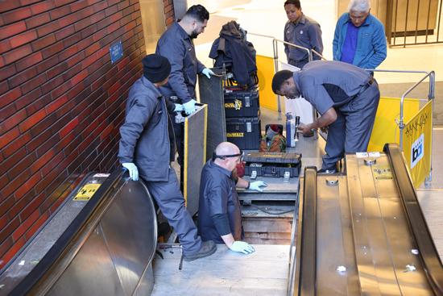
Examples of a Confined Space
Figure 6. Escalator Techs(Jordan, 2017)
Figure 5. Sewer System (Fracassa, 2017)
Notes:
Left image - Worker going down through manhole to sewer system. This is a confined space because worker’s whole body is able to fit inside work area, entrance and exit is very narrow and restrictive, and is not suitable for prolonged occupancy or worker.
Right image - Workers working inside an escalator pit. Workers must have access to components underneath escalator to do work.
References:
Fracassa, D. (2017, October 21). SF embarking on major projects to bolster sewer system. Retrieved from San Francisco Chronicle: https://www.sfchronicle.com/bayarea/article/SF-embarking-on-major-projects-to-bolster-sewer-12296228.php#photo-14392461
Jordan, M. (2017, February 8). BART build pipeline for escalator techs to keep system moving safely. Retrieved from Bay Area Rapid Transit: https://www.bart.gov/news/articles/2017/news20170206

Slide 12
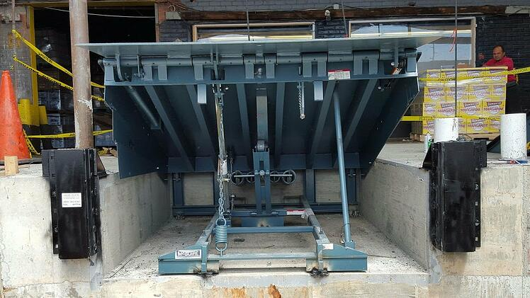
Examples of a Confined Space (cont.)
Figure 7. Elevator Mechanic(Campbell, 2017)
Figure 8. Dock Leveler(Cuchiara, 2016)
Notes:
Left image - Elevator inspector working inside elevator shaft. This is a confined space, elevator doors must be held open to enter and exit, inspector can be inside elevator shaft to perform work, and required lighting to perform work.
Right image - Image of a dock leveler . Employee must crawl into space to do work. Mobility is limited to crawling to enter and exit work area.
References:
Campbell, M. (2017, May 29). How Elevator Mechanic became Canada's hottest job, for better or worse. Retrieved from Canadian Business: https://www.canadianbusiness.com/lists-and-rankings/best-jobs/elevator-mechanic-canadas-hottest-job-2017/
Cuchiara, A. (2016, October 22). Recessed or Pit-style Dock Levelers in New Jersey and New York. Retrieved from Loading Dock: https://www.loadingdock.com/blog/recessed-or-pit-style-dock-levelers

Slide 13
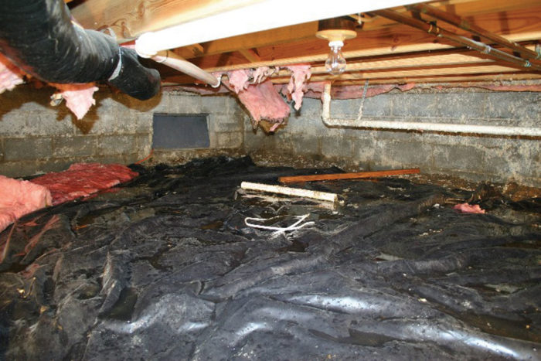
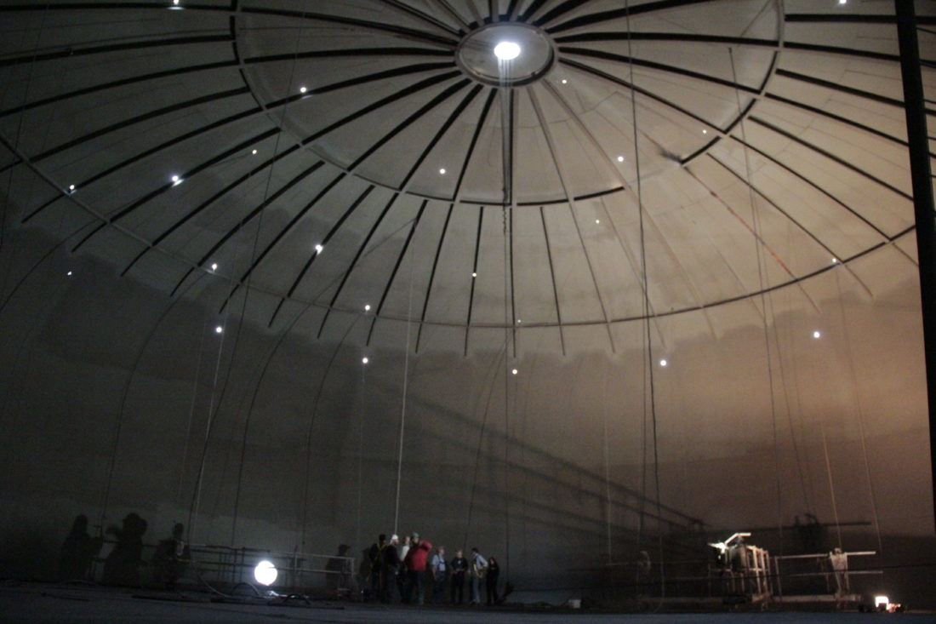
Examples of a Confined Space (cont.)
Figure 9. Crawlspace(Holladay, 2011)
Figure 10. Water Tank inspection(Patterson, 2017)
Notes:
Left image - Picture of a crawl space. This is a confined space because workers are able to do work while still being able to fit whole body in space but mobility is very limited to crawling in and out of space.
Right image - Workers inside of a water storage tank. Entry and exit port holes restrict entrants from exiting the tank without restriction in the case of an emergency.
References:
Holladay, M. (2011, May 13). Building an Unevented Crawlspace. Retrieved from Green Building Advisory: https://www.greenbuildingadvisor.com/article/building-an-unvented-crawl-space
Patterson, J. (2017, June 8). The Marietta Times. Retrieved from City council inspects water tank: https://www.mariettatimes.com/news/2017/06/city-council-inspects-water-tank/

Slide 14
Examples of a Confined Space (cont.)
Figure 11. Tunnel construction(Smith, 2018)
Notes:
Underground tunnels are confined spaces of work. Safeguards must be provided to allow entrants to work in these spaces such as lights, ventilation systems and gas detectors to maintain a safe temporary work environment.
Reference:
Smith, M. (2018, August 6). Purple Line neighbors told to expect 'intrusive' construction as crews build tunnel. Retrieved from WTOP: https://wtop.com/dc-transit/2018/08/purple-line-construction-cheek-to-jowl-with-neighbors-for-next-four-years/

Slide 15
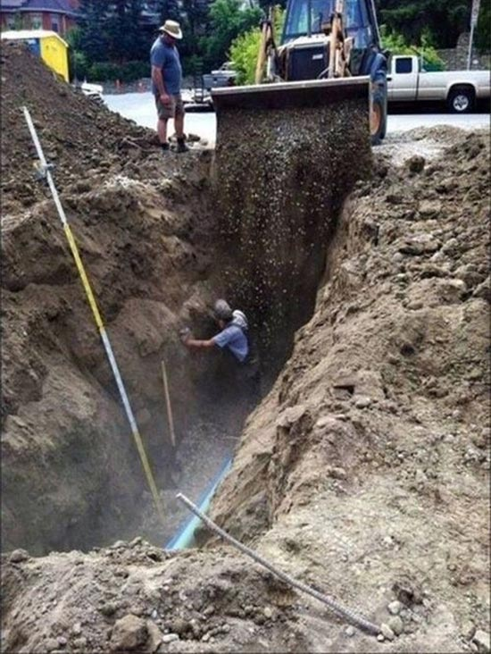
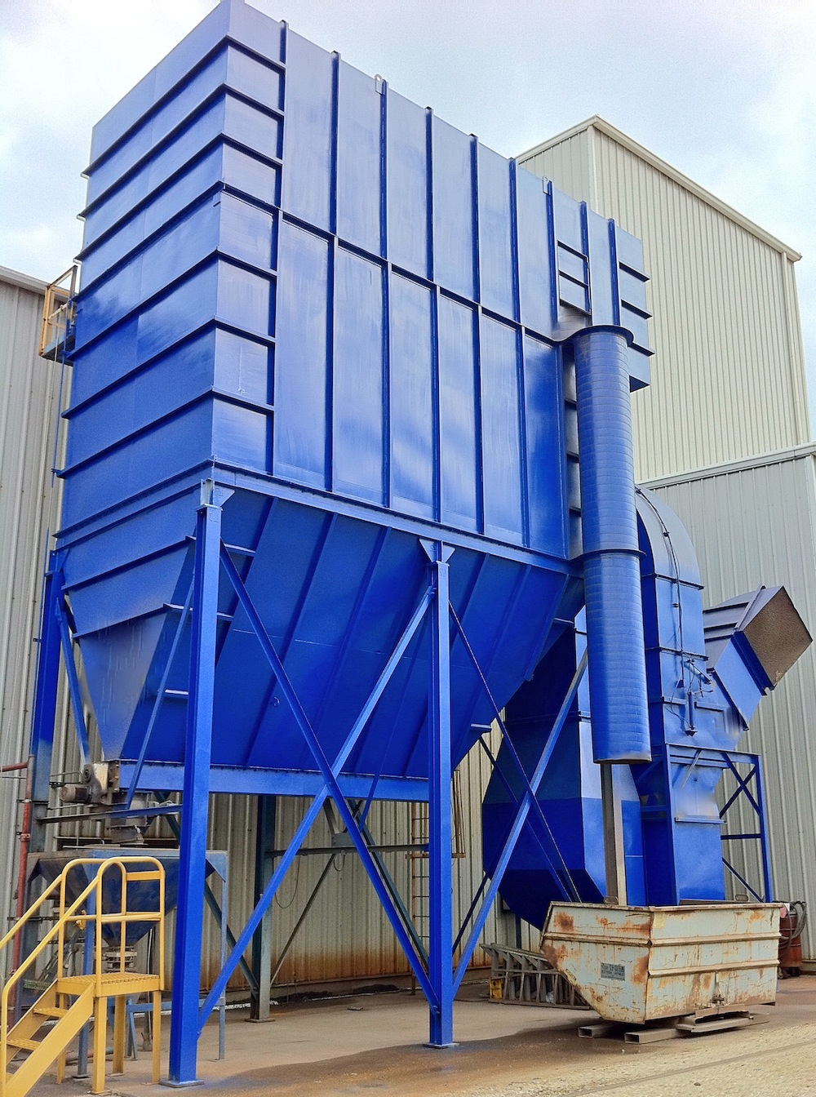
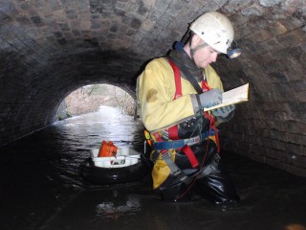
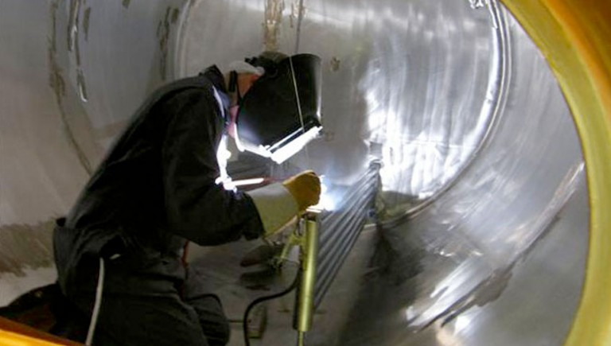
What are the Hazards?
Figure 12. Gravedigger Engulfment (Roco Rescue, 2016)
Figure 13. Baghouse Collector (Donaldson, 2019)
Figure 14. Confined space Identification (Trademark Safety & Rescue, 2016)
Figure 15. Confined Spaces (Up and Under, 2019)
Notes:
What makes a confined space permit-required is that one of following criteria are present:
Engulfment hazard (Figure 9)
Configuration hazard (Figure 10)
Hazardous atmosphere (Figure 11)
Other recognized hazards (Figure 12)
Ask the trainees: Explain the hazards depicted in the images above.
References:
Roco Rescue, Inc. (2016, January 4). Gravedigger Engulfmed In Cave-in of Unguarded Grave. Retrieved from Roco Rescue: https://blog.rocorescue.com/roco-rescue-blog/gravedigger-engulfed-in-cave-in-of-unguarded-grave
Donaldson. (2019). Baghouse Collectors. Retrieved from Donaldson Filtration Solutions: https://www.donaldson.com/en-us/industrial-dust-fume-mist/equipment/dust-collectors/baghouse/
Trademark Safety & Rescue. (2016, January 22). Confined Space Identification. Retrieved from Trademark Safety & Rescue: http://trademarksafetyandrescue.com/2016/01/22/confined-space-identification/
Up and Under. (2019). Confined Spaces. Retrieved from Up and Under: http://www.upandundergroup.com/access-solutions/confined-spaces/

Slide 16
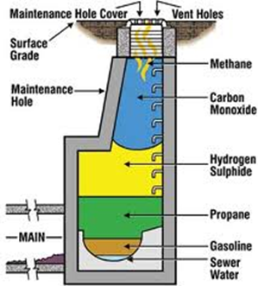
Two Types of Hazards
Physical Hazards
Atmospheric Hazards
Explosive hazards
Mechanical, electrical, hydraulic, pneumatic energy hazards
Extreme temperatures
Engulfment
Noise
Odd space configurations
Chemical hazards
Flammable gas
Airborne combustible dust
Oxygen concentration below 19.5% or above 23.5%
Gas concentration levels beyond Permissible Exposure Limit (PEL from OSHA)
Atmosphere that presents an immediate danger to life or health
Figure 16. Multigas Monitor in a Confined Space(Icon Safety, 2011)
Notes:
There are two types of hazards that can be present in a Permit-Required Confined Space.
A physical hazard is an existing or potential hazard that can cause death or serious physical harm
It includes but is not limited to…(Read info under Physical Hazards). We will mainly detail engulfment and configuration hazard in this section of the training.
A atmospheric hazard is an atmosphere that may expose employees to the risk of death, incapacitation, impairment of ability to self-rescue (that is, escape unaided from a permit space), injury, or acute illness (or the abrupt onset of a disease). This includes…(Read info under Atmospheric Hazards). In other words, any atmosphere that could result in death or serious injury to a worker caused by oxygen deficiency or enrichment, toxic and flammable materials. The image shows that different gases can settle at different elevations so it is important to test for different atmospheric hazards.
Reference:
OSHA. (2012). Regulations (Standards- 29 CFR). Retrieved from United States Department of Labor: https://www.osha.gov/pls/oshaweb/owadisp.show_document?p_id=9797&p_table=STANDARDS
OSHA. (2012). Permissible Exposure Limits - Annotated Tables. Retrieved from United States Department of Labor: https://www.osha.gov/dsg/annotated-pels/index.html
Icon Safety. (2011, December 14). Multigas Monitors in a Confined Space. Retrieved from ICON Safety's Gas Detection & Industrial Safety Blog: https://iconsafety.wordpress.com/2011/12/14/multigas-monitors-in-a-confined-space/

Slide 17
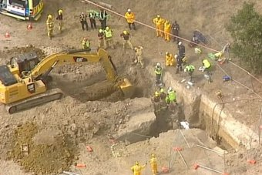
Physical Hazard - Engulfment
Figure 17. Gravedigger Engulfment (Roco Rescue, 2016)
Figure 18. Trench Collapse (Johnson, 2019)
Notes:
Engulfment means the surrounding and effective capture of a person by liquid or finely divided (flowable) solid substance that can be aspired to cause death by filling or plugging the respiratory system or that can exert enough force on the body to cause death by strangulation, constriction, or crushing.
References:
Roco Rescue, Inc. (2016, January 4). Gravedigger Engulfment In Cave-in of Unguarded Grave. Retrieved from Roco Rescue: https://blog.rocorescue.com/roco-rescue-blog/gravedigger-engulfed-in-cave-in-of-unguarded-grave
Johnson, S. (2019, January 8). Trench collapse deaths result in charges against construction company Pipecon. Retrieved from ABC: https://www.abc.net.au/news/2019-01-09/company-charged-over-ballarat-trench-collapse-deaths/10701784

Slide 18
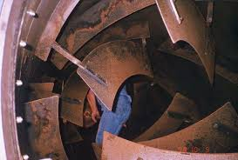
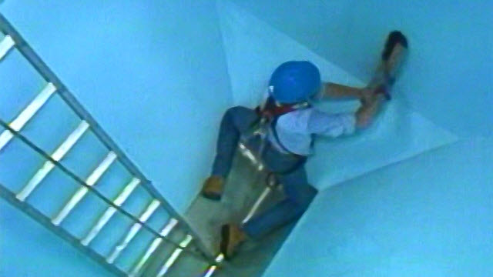
Physical Hazard - Configuration Hazard
Figure 19. Cement Drum Mixer (EHS Oregon State, 2019)
Figure 20. Inwardly Converging Wall (Media Partners, 2019)
Notes:
A configuration hazard is a confined space in which it may be difficult to enter, exit or maneuver around due to the way a confined space is shaped.
In the example pictures, the cement mixer drum is has a configuration hazard because the internal construction of the drum makes it difficult to maneuver around requiring workers to duck and climb over parts. The baghouse has converging walls at the bottom making exiting the space difficult.
References:
EHS Oregon State. (2019). The Oregon OSHA Confined Space Rule Applicable to General Industry and Construction. Retrieved from EHS Oregon State: https://ehs.oregonstate.edu/sites/ehs.oregonstate.edu/files/pdf/occsafety/confined_space/or-osha_confined_spaces_ig.pdf
Donaldson. (2019). Baghouse Collectors. Retrieved from Donaldson Filtration Solutions: https://www.donaldson.com/en-us/industrial-dust-fume-mist/equipment/dust-collectors/baghouse/
Media Partners. (2019). Confined Space Entry: Permit Required! Retrieved from Media Partners: https://www.media-partners.com/confined_spaces_safety_training/confined_space_entry_permit_required.htm

Slide 19
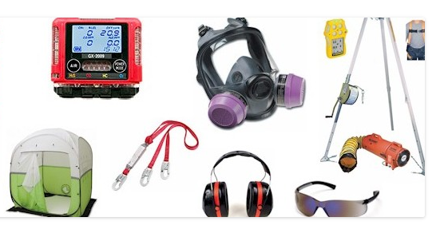
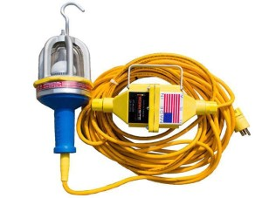
Necessary Safety Equipment
Permit
Gas monitors
ventilation system
communication devices
lighting system
PPE
retrieval system
communication system
self-contained breathing apparatus*
safety harness
Barriers or shields
Figure 22. Confined Space Kits (Amos, C., 2017)
Figure 23. Explosion proof handlamp (New Legend Media, 2018)
Notes:
When entering a permit-required confined space, it is important to have these safety equipment with you: (Read bullet points)
Have the permit on the work site
use gas monitors to ensure safe working atmospheric environment
ventilation systems keep the work space supplied with fresh air
communication devices should always be supplied to all workers involved
lighting system
personal protective equipment should be provided
retrieval system and safety harness for worker in case of an emergency such as a rescue hoist
if necessary, equip workers with a self-contained breathing apparatus.
place barriers or shield around the entrance and exit of the confined space with signages
References:
Amos, C. (2017, January 5). Confined Space Kits - A Primer. Retrieved from Safety Equipment FAQ: http://safetyequipmentfaq.com/
New Legend Media. (2018). 2600- LED Series Explosion Proof Handlamp With Inline Transformer. Retrieved from Worksite Lighting and Power Solutions, MFR.: http://www.worksitelighting.com/product/led-drop-light-with-transformer/

Slide 20
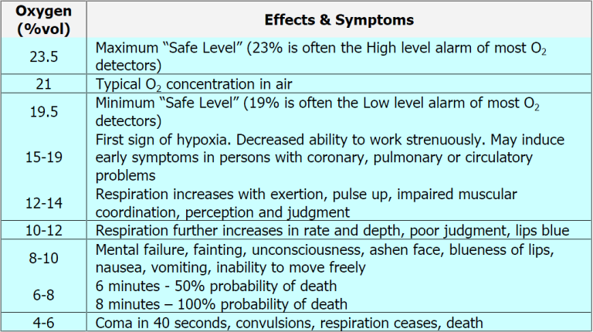
Atmospheric Hazard - Oxygen Concentration levels
Figure 21. Oxygen Levels and Oxygen Deprivation Effects (Gray, J.A., 2018)
Notes:
Something we don’t always think about is the amount of oxygen in the atmosphere and depending on the container that a worker is working in, different gases may be present in different amounts.
The typical level of Oxygen in the Atmosphere is 21%, too much or too little can be hazardous to your health. The maximum safe level that’s safe for someone to breathe is 23.5%, most detectors go off at 23%. As the percentage decreases, the negative effects on the person in the area become more severe.
*Read table*
Reference:
Gray, J.A. (2018). Indoor Air Quality Testing: Oxygen Levels and Oxygen Deprivation Effects. Retrieved from Environmental Indoor Air Quality Testing & Consulting: http://www.indoorairqualitytestingdallas.com/indoor-air-oxygen-levels-and-oxygen-deprivation-effects/

Slide 21
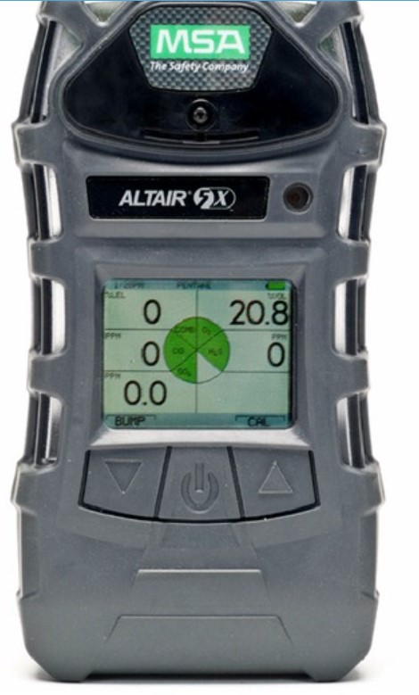
Standard safety equipment
Standard equipment used in the field is MSA Altair 5x and 4x
Constant monitoring air quality
Detects four gases at the same time with high level alarms CO,NO2,Oxygen, and H2S
Has wireless connectivity with interfacing with other modules and center control station
Display shows levels in parts per million (ppm)
LED status display green, yellow, and red for alarms
Figure 22. MSA Altair 5x Manuals 2012-2919
Notes:
This is a standard safety equipment used by companies in the field
*Read bullet points*
Reference:
MSA. (2019, November 25). MSA Altair 5X Operating Manual. Retrieved from https://www.manualslib.com/manual/1239599/Msa-Altair-5x.html?page=15#manual

Slide 22
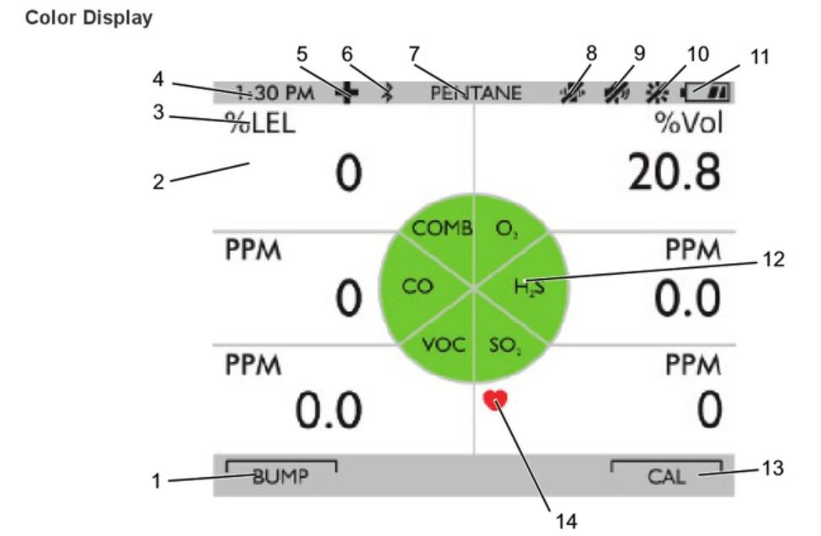
The MSA Altera 5x Display
Number 1 bump button to test the equipment before each use
Number 2 gas level
Number 3 gas detection
Number 7 combustible gas level
Number 12 gas type
Number 14 sensor life indicator
Meters must be calibrated every 30 days
Figure 23. MSA Altair 5x Manuals 2012-2019 page15
Notes:
There is a MSA manual book online with a pdf you can find more information on the meter
Reference:
MSA. (2019, November 25). MSA Altair 5X Operating Manual. Retrieved from https://www.manualslib.com/manual/1239599/Msa-Altair-5x.html?page=15#manual

Slide 23
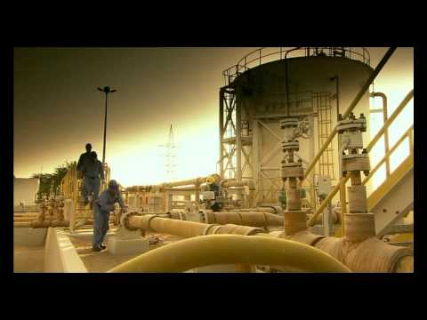
(ASIAWorkSAFE, 2015)
Notes:
This video is a great example of how atmospheric hazards can be deadly at the job site. Workers are easily injured by atmospheric hazards because most gases are invisible and sit at different levels due to different densities. It’s important to consider the fact that if a co-worker faints they might faint due to a hazard that is invisible.
*Play video from 1:50 - 4:50*
Below is a copy of the video’s hyperlink in case the embedded video doesn’t play.
https://www.youtube.com/watch?v=93j0J6DcQm0&feature=youtu.be
Reference:
ASIAWorkSAFE. (2015, September 1). Confine Space Fatality - Lessons Learned. Retrieved from https://www.youtube.com/watch?v=93j0J6DcQm0&feature=youtu.be

Slide 24
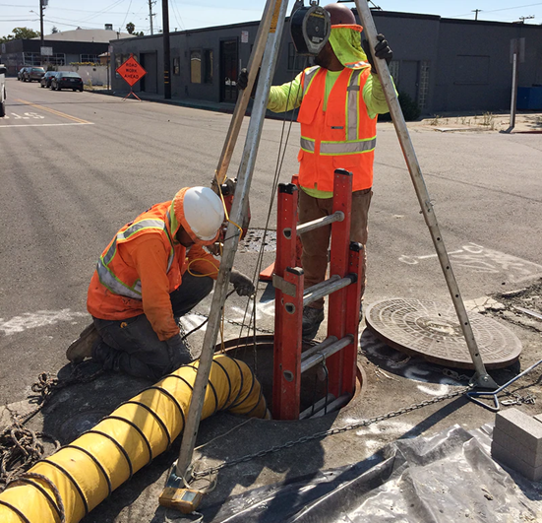
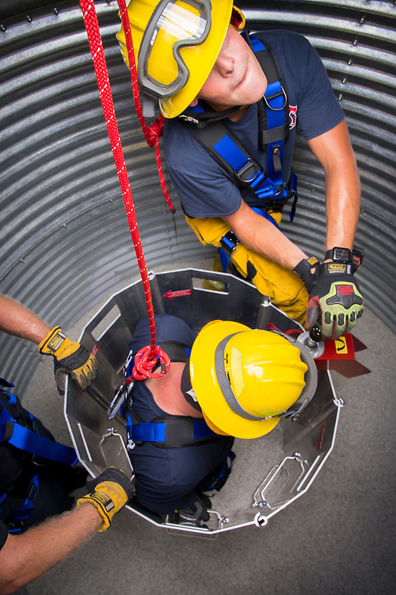
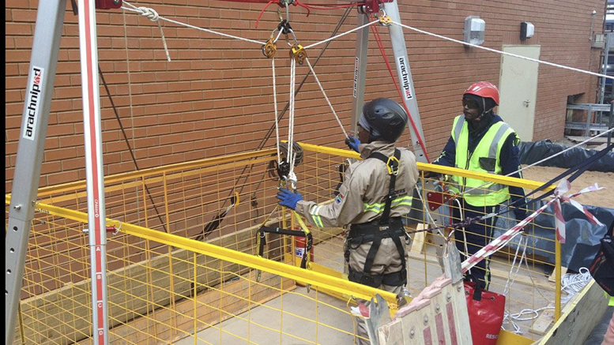
Right and Wrong Examples
Engulfment Hazard:
Barrier Hazard:
Figure 26. Confined Space Entry (Adamovica, 2017)
Figure 24. Grain Engulfment (OSHA, 2011)
🗹
Figure 27. Training Service (Bhowan, T., 2019)
Figure 25. Dangers of Engulfment and Suffocation in Grain Bins (OSU, 2017)
Notes:
Shown above are examples of good and bad uses of equipment.
The left shows an engulfment hazard. This example shows how harnesses can be used to avoid engulfment. In the event that the employee working in the silo starts to become engulfed, the harness is already attached and ready to free them.
The right shows a barrier hazard. The configuration of equipment significantly restricts the remaining movement and space of all workers in the already confined spaces. A configuration shown in the bottom right is much more beneficial for employees that are working in holes, as it helps to maximize the effectiveness of the limited space.
References:
Adamovica, M. (2017, March 16). Confined Space Entry — Top 3 Safety Tips. Retrieved from PK Safety - The Worker Safety Specialists: https://pksafety.com/blog/confined-space-entry-top-safety-tips
Bhowan, T. (2019, July 26). Training services expand in tight spaces. Retrieved from Creamer Media's Engineering News: http://m.engineeringnews.co.za/article/training-services-expand-in-tight-spaces-2019-07-26/rep_id:4433
OSU Ag Communications Services. (2017, September 15). GRAIN ENGULFMENT RESCUE SIMULATOR TRAILER FOR FIRE/RESCUE TRAINING. Retrieved from AG Photos: https://kitchensink.photoshelter.com/gallery-image/Grain-Entrapment-Training-Trailer/G0000nzFvHCvetNc/I000079P1ho0t7gQ/C0000oyLkvRhbyXQhttps://www.osha.gov/SLTC/grainhandling/hazard_alert.html
OSHA. (2011, October 19). Dangers of Engulfment and Suffocation in Grain Bins. Retrieved from US Department of Labor: https://www.osha.gov/SLTC/grainhandling/hazard_alert.html

Slide 25
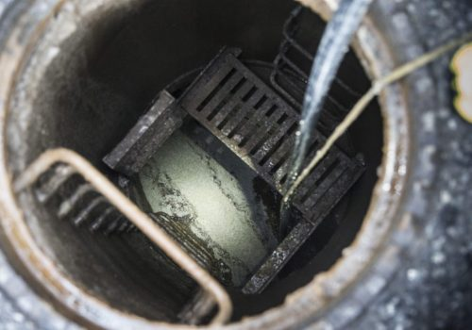
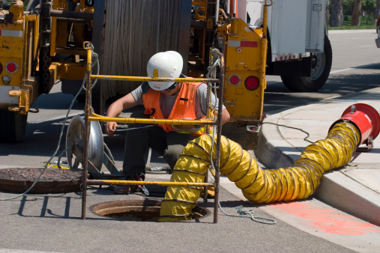
Ventilation
Figure 29. Workers descended into a manhole(Schmidt, 2017)
Figure 28. Purging and Ventilation (EHS Database, 2019)
Figure 30. Confined Space Awareness(Core Safety Group, 2017)
Notes:
Shown in these images are right and wrong procedures for ventilation.
It is very important to know and be aware of the surroundings when preparing ventilation equipment. There may be other hazardous contaminants in the air where you are trying to set up the intake of your ventilation equipment. As shown in the image on the left, the intake of the ventilation equipment is far too close to the exhaust of hazardous contaminants. And shown on the two images on the right are examples of no ventilation being used versus ventilation being used.
References:
Confined Space - Purging and Ventilation . (n.d.). Retrieved from Environmental, Health & Safety Database: http://www.ehsdb.com/confined-space-purging-and-ventilation.php
Core Safety Group. (2017, February 27). Tragedy highlights the importance of confined space awareness and safe work discipline. Retrieved from Core Safety Group: https://www.coresafety.com/industry_news/tragedy-highlights-the-importance-of-confined-space-awareness-and-safe-work-discipline/
Schmidt, S. (2017, January 18). One by one, 3 utility workers descended into a manhole. One by one, they died. Retrieved from The Star: https://www.thestar.com/news/world/2017/01/18/one-by-one-3-utility-workers-descended-into-a-manhole-one-by-one-they-died.html

Slide 26
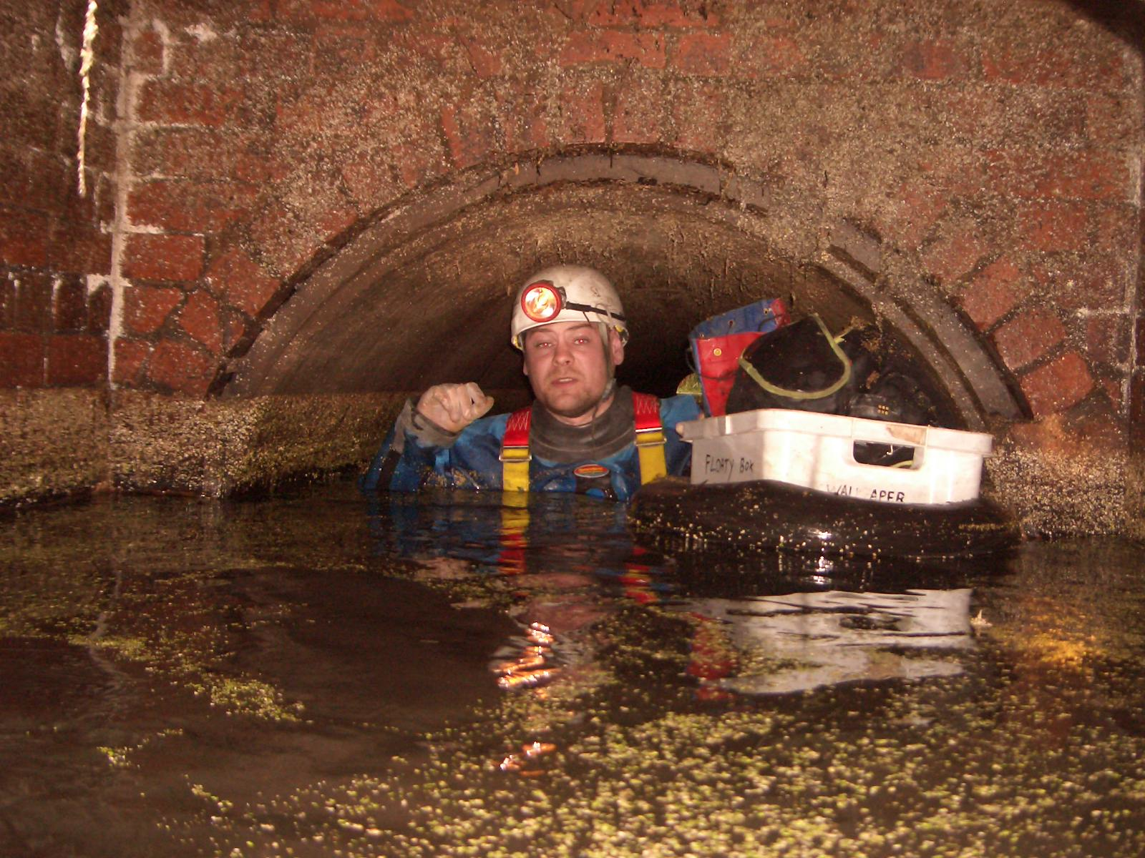
Depth of Water
Figure 31. Confined Spaces (Up and Under, 2014)
Figure 32. Avoid Confined Space Entry with QuickCal Measurement Tool(CC Lynch & Associates, 2012)
Notes:
As you can see in these two images, the depth of water is also very important to be considered in confined spaces. There is a properly measured amount of water shown in the image on the right while there was nothing done about the level of water in the image on the left.
References:
CC Lynch & Associates , Inc. (2012, May 15). Avoid Confined Space Entry With QuickCal Measurement Tool. Retrieved from CC Lynch & Associates, Inc. The Water Monitoring People: http://www.cclynch.com/avoid-confined-space-entry-with-quickcal-measurement-tool/
Up and Under Group . (2014). Confined Spaces. Retrieved from Up and Under Group: http://www.upandundergroup.com/access-solutions/confined-spaces/

Slide 27
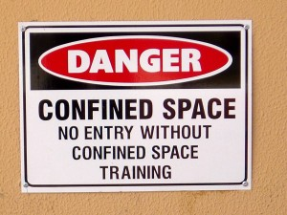
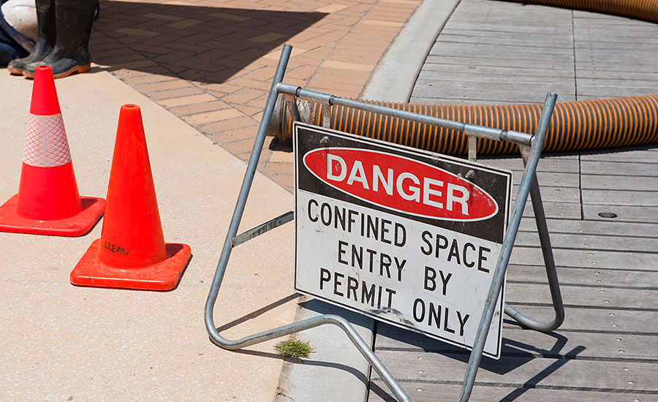
Confined Space Signage
Figure 33. OSHA confined space construction standard(Industrial Safety and Hygiene News, 2019
Figure 34. EHS Journal(Ruble, B.,2011)
Notes:
It is important to have signs posted around the permit space to warn unauthorized entrants. A sign alone can help save a life.
According to OSHA standard 1910.146(c)(2)...
If the workplace contains permit spaces, the employer shall inform exposed employees, by posting danger signs or by any other equally effective means, of the existence and location of and the danger posed by the permit spaces.
NOTE: A sign reading DANGER -- PERMIT-REQUIRED CONFINED SPACE, DO NOT ENTER or using other similar language would satisfy the requirement for a sign.
1910.146(e)(2)
Before entry begins, the entry supervisor identified on the permit shall sign the entry permit to authorize entry.
Reference:
Industrial Safety and Hygiene News. (2019, January 3). OSHA confined space construction standard. Retrieved from Industrial Safety and Hygiene News: https://www.ishn.com/articles/110025-osha-confined-space-construction-standard
OSHA. (2012). Regulations (Standards- 29 CFR). Retrieved from United States Department of Labor: https://www.osha.gov/pls/oshaweb/owadisp.show_document?p_id=9797&p_table=STANDARDS
Ruble, B. J. (2011, June 5). EHS Journal. Retrieved from Practical Solutions for Environmental, Health, and Safety Professionals : http://ehsjournal.org/http:/ehsjournal.org/barbara-jo-ruble/how-big-is-a-confined-space/2011/

Slide 28
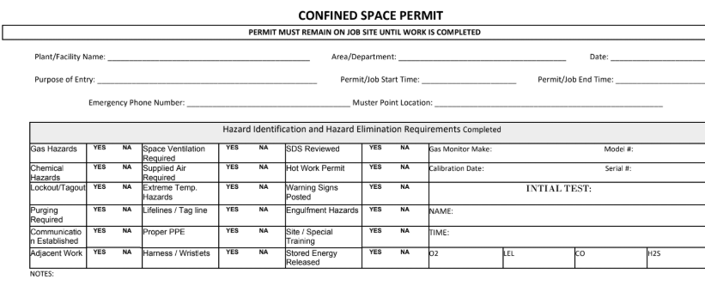
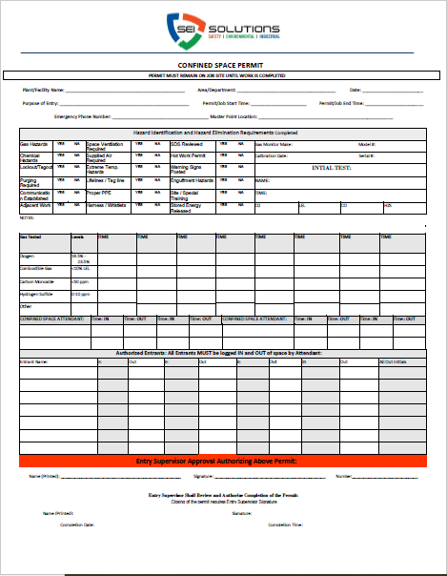
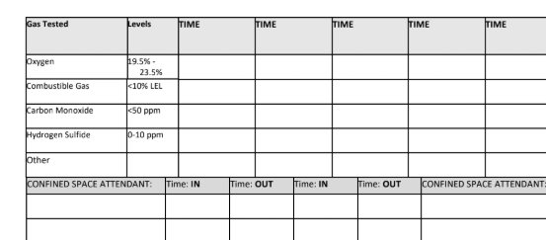
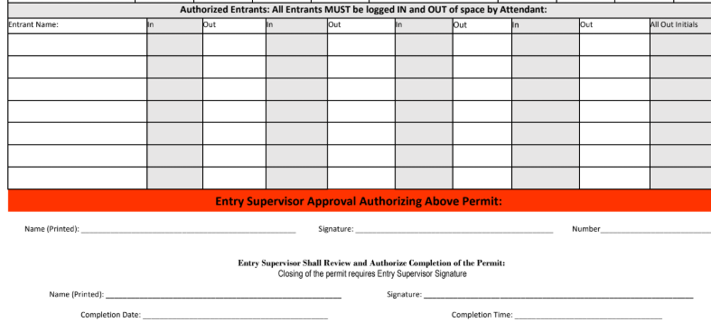
Confined Space Work Permit
Figure 35. Confined Space Permit (SEI Solutions, 2019)
Notes:
In the case of a required entry permit, the employer shall provide an entry permit for the entrants to fill out and provide a written program. The entry supervisor will need to sign the permit and make sure it is posted at all entrances for the confined space entrants.
Within an entry permit, the following must be included:
-The name of the permit space, name of the entrants, and the name of the authorized individuals that are entry supervisors as well as their signature
-The date, duration of entry, and acceptable entry conditions
-The purpose of entry and the known hazards within the space
-The atmospheric conditions in the confined space along with the test results and the tester’s initials or signature
-Measures to be taken to isolate permit spaces and to eliminate or control space hazards
-Names and contact information of rescue and emergency services
-Communication procedures and equipment to maintain contact during entry
-Additional permits, such as for hot work, that have been issued authorizing work in the permit space
-Special equipment and procedures, including personal protective equipment and alarm systems
-Any other information needed to ensure employee safety, such as a safety checklist
After work has been complete or new conditions exists, entry supervisor must cancel the entry permit. New conditions are to be noted on the canceled permit and used in a revised permit space program.
References:
SEI Solutions . (2019, November 24). Confined Space Entry Permit . SEI Solutions .
Occupational Safety and Health Administration. (2004). Permit-Required Confined Spaces. Retrieved from United States Department of Labor: https://www.osha.gov/Publications/osha3138.html

Slide 29
Confined Space Permit
Indicate the permit space to be entered
Purpose for entering the confined space
Date and duration of permit
Authorized entrants, and when necessary the attendant and entry supervisor name
Hazards present at the space
Measures taken to secure permit space and to eliminate or control hazards
Acceptable entry conditions
Documented initial and periodic air quality test
Rescue team and emergency services available and the means to summoning them
Communication devices for maintaining contact during entry(radio, air horns, verbal)
Safety equipment used such as personal protective equipment, testing devices, communication devices, alarm systems, and rescue equipment.
Any other information necessary to assure worker safety
Any additional permits that have been issued to authorize work in permit space.
Notes:
What is included in a permit?
Here are the important information that must be filled out with every permit required before entering a permit-required confined space.
Read the list*:
Indicate the permit space to be entered
Purpose for entering the confined space
Date and duration of permit
Authorized entrants, and when necessary the attendant and entry supervisor name
Hazards present at the space
Measures taken to secure permit space and to eliminate or control hazards
Acceptable entry conditions
Documented initial and periodic air quality test
Rescue team and emergency services available and the means to summoning them
Communication devices for maintaining contact during entry(radio, air horns, verbal)
Safety equipment used such as personal protective equipment, testing devices, communication devices, alarm systems, and rescue equipment.
Any other information necessary to assure worker safety
Any additional permits that have been issued to authorize work in permit space.

Slide 30
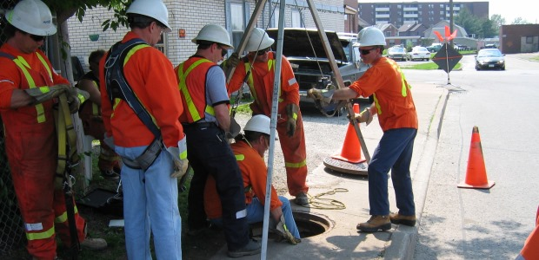
Attendant, Entrant and Supervisor Duties
Figure 36. Testing Knowledge of Confined Space(Argudin, R. 2014)
Notes:
There are 3 main duties of an entrant but is not limited to only 3 people.
According to OSHA standard 1910.146(b), these roles are defined as….
Supervisor - the person (such as the employer, foreman, or crew chief) responsible for determining if acceptable entry conditions are present at a permit space where entry is planned, for authorizing entry and overseeing entry operations, and for terminating entry as required by this section.
Entrant - means an employee who is authorized by the employer to enter a permit space
Attendant - an individual stationed outside of a permit spaces who monitors the authorized entrants and who performs all attendant's duties assigned in the employer's permit space program.
Reference:
Argudin, R. (2014 , August 1). Beware of These Five Common Confined Space Myths. Retrieved from Occupational Health and Safety: https://ohsonline.com/articles/2014/08/01/beware-of-these-five-common.aspx
OSHA. (2012). Regulations (Standards- 29 CFR). Retrieved from United States Department of Labor: https://www.osha.gov/pls/oshaweb/owadisp.show_document?p_id=9797&p_table=STANDARDS

Slide 31
Supervisor Duties
Be aware of the hazards in the confined space
Verify that permit is completed, all safety precautions listed are taken, tests and procedures are followed, and issues the permit
Verify safe entry conditions
Verify availability and effectiveness of rescue services
Ensures acceptable entry conditions are maintained
Removes any unauthorized personnel
Terminates entry and cancels permit when work is done or space becomes unsafe
Notes:
Site Supervisors are tasked with:
Be aware of the hazards in the confined space
Verifies that permit is completed, all safety precautions listed are taken, tests and procedures are followed, and issues the permit
Monitors work conditions before and continuously during working operation
Removes any unauthorized personnel
Terminates permit when work is done
Reference:
OSHA. (2012). Regulations (Standards- 29 CFR). Retrieved from United States Department of Labor: https://www.osha.gov/pls/oshaweb/owadisp.show_document?p_id=9797&p_table=STANDARDS

Slide 32
Entrant Duties
Be aware of the hazards and its behavioral effects
Maintains contact with attendant
Alert and ready to evacuate when needed
Informs attendant of any hazards
Know how to use required equipment for the job including personal protective equipment
Knows how to exit the space if necessary (self-rescue)
Notes:
The Entrant is tasked with:
Be aware of the hazards and its behavioral effects
Maintains contact with attendant
Alert and ready to evacuate when needed
Informs attendant of any hazards
Know how to use required equipment for the job including personal protective equipment
Knows how to exit the space if necessary (self-rescue)
Reference:
OSHA. (2012). Regulations (Standards- 29 CFR). Retrieved from United States Department of Labor: https://www.osha.gov/pls/oshaweb/owadisp.show_document?p_id=9797&p_table=STANDARDS

Slide 33
Attendant Duties
Be aware of the hazards and its behavioral effects
Maintains accurate account of all entrants in the confined space
Monitors the outside of the confined space until relieved
Monitors work conditions before and continuously during working operation
Continuous monitoring of oxygen levels, documenting levels every 10-15 min. At a minimum atmospheric levels are taken and documented every 2 hrs.
Keeps contact with entrant and supervisor
Order evacuation and calls in rescue when required
Non-entry rescues
Notes:
The Attendant is tasked with:
be aware of the hazards and its behavioral effects
maintains accurate account of all entrants in the confined space
monitors the outside of the permit-required confined space until relieved
monitors work conditions before and continuously during working operation
Continuous monitoring of oxygen levels
Keeps contact with entrant and supervisor
Calls in rescue when required
Non-entry rescues
Reference:
OSHA. (2012). Regulations (Standards- 29 CFR). Retrieved from United States Department of Labor: https://www.osha.gov/pls/oshaweb/owadisp.show_document?p_id=9797&p_table=STANDARDS

Slide 34
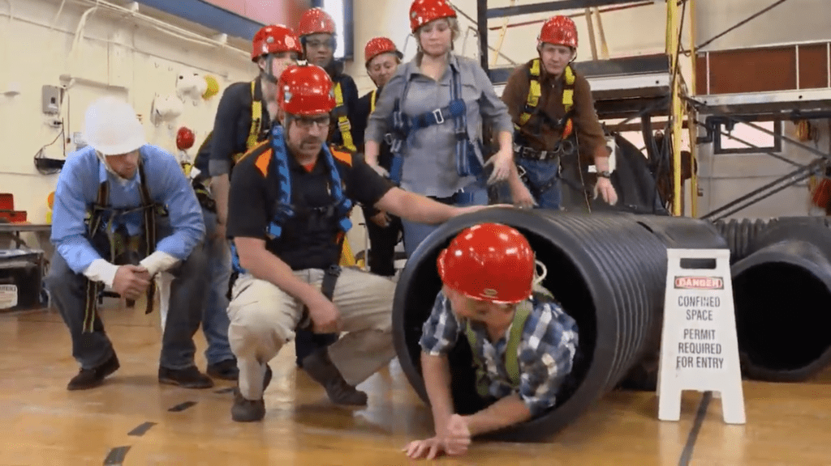
Worker Training
Employers are required to provide proper training to all workers who are required to work in a permit-required confined space.
CPR and first aid training
Additional training is required when
job duties change
change in permit space program or a new hazard arises
employee job performance shows deficiencies
Figure 37. Confined Space Training(ufadmin, 2019)
Notes:
All workers required to enter a permit-required confined space must receive proper training of the job prior to entering said space.
All workers must have CPR and first aid training
Additional training is required when
job duties change
new conditions arise
or employee job performance shows deficiencies
Reference:
Occupational Safety and Health Administration. (2004). Permit-Required Confined Spaces. Retrieved from United States Department of Labor: https://www.osha.gov/Publications/osha3138.html
OSHA. (2012). Regulations (Standards- 29 CFR). Retrieved from United States Department of Labor: https://www.osha.gov/pls/oshaweb/owadisp.show_document?p_id=9797&p_table=STANDARDS
ufadmin. (2019, March 29). The Canary in Your Pocket. Retrieved from All Hazards: https://www.findlayallhazards.com/blog/the-canary-in-your-pocket/

Slide 35
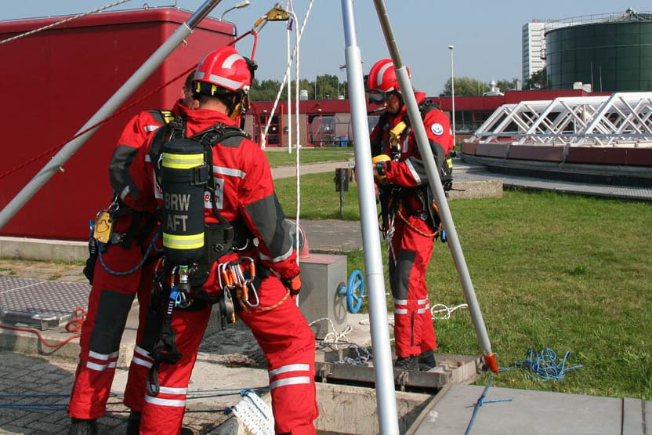
Rescue Service Personnel
Follow the NIOSH and NFPA standards
Required by OSHA standard under section 1910.146(d)(9) ,
Rescue Service Personnel:
be capable of responding to an emergency in a timely manner
must be provided with proper personal protective equipment and proper training
must receive the same authorized entrants training as well as rescue duties
CPR and first aid trained (one minimum certified)
practice rescues are performed yearly
aware of the hazards in a permit space and hazardous safety training
Every two year must be recertified for confined space entrant by NIOSH
Figure 38. Confined Space Rescue Service (Rescue 3 International, 2015)
Notes:
NIOSH( National Institute Of Occupational Safety and Health) and NFPA ( National Fire Protection Association)
Required by OSHA standards, employers must provide means of providing rescue service personnel in the event of an emergency
rescue personnel must
be capable of respond to an emergency quickly
have personal protective equipment including respirators and have training in proper usage
receive same authorized entrant training in addition to rescue training
CPR and first aid trained with at least one rescue personnel certified
practice rescues at a minimum once a year
aware of the hazards present at a permit space
Reference:
OSHA. (2012). Regulations (Standards- 29 CFR). Retrieved from United States Department of Labor: https://www.osha.gov/pls/oshaweb/owadisp.show_document?p_id=9797&p_table=STANDARDS
Rescue 3 International. (2015). Confined Space for Industry & Government. Retrieved from Rescue 3 International : https://rescue3.com/confined-space-for-industry-government/

Slide 36
Safety Practices
Display permit on the worksite
Monitor atmosphere content levels at all times!
Measure gas levels in multiple elevations
Have at least one attendant on standby outside in constant communication with entrant
Equip entrants with communication device
Lockout/Tagout equipment before entering
Secure the perimeter of a permit space
More eyes on site, the better.
Use safety equipment, ventilation equipment, and personal protective equipment
Ventilate properly
Notes:
Some safety practices to keep in mind when working on a permit space are:
Display the issued permit on the worksite at all times
Working conditions can change, always monitor atmosphere content AT ALL TIMES
Different gases settle at different elevations, measure gas levels at different elevations
Always have someone in communication with the entrant. New hazards may be introduced and needs to be reported. It also allows attendant to monitor entrant’s behavior and determine if the entrant is overexposed to a hazard.
Lockout/Tagout any equipment before entering to prevent accidental machine startups
Secure the perimeter of a permit space worksite with barriers or shields to prevent any unauthorized access
More eyes the better, having multiple attendants can make sure the worksite is being monitored at all times as well as prevent unauthorized entries.
Utilize safety equipments PPE’s and ventilation equipments to provide a safe working environment for the entrant.
Ventilate properly, being away of the placement of the fresh air intake and exhaust.
Ask the trainees what other safety practices they can do

Slide 37
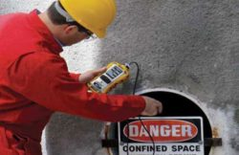
Case study of Confined Spaces
Case Study Link
In January 6, 2017 A 36 year old pipe layer entered a manhole and quickly died
Co-worker 49 years old entered the hole attempted rescue and also died
Both workers died, none survived.
Figure 39. OSHA finds employer at fault in confined space deaths (OSHA Training, 2017)
Notes:
Going back to one of the accidents that was shared earlier in the presentation, having learned about all of the proper procedures and equipment accidents like this can be prevented if you all take what you’ve learned here and apply it into your day to day life.
As a refresher, here’s what happened in the case above. In July of 2017, three employees died working in a manhole in Key Largo due to deadly amounts of hydrogen sulfide and carbon monoxide.
**Discuss with the class, ask attendee’s what went wrong and what actions could have been taken to avoid this incident. Try and get the class to bring up the following corrective actions**
Corrective Actions
Contains or has a potential to contain a hazardous atmosphere and oxygen deficient
Failure to use gas detection equipment to measure oxygen and gas content
Provide confined space entry permit and provide documentation
Workers need confined space permit training before entering, confined space
No guarding around manhole before workers enter the confined space
Safety equipment
The workers did not have safety equipment before entering the confined space such as tripod, safety harness, ventilation equipment, clothing, boots, respirator, special tools, communication equipment, entrant, and
The safety entrant should have a safety rope or line tied to the worker entering the confined space
Reference:
OSHA Training. (2017). Retrieved from OSHA finds employer at fault in confined space deaths: http://osha10hrtraining.com/blog/safety-violations/osha-finds-employer-at-fault-in-confined-space-deaths/

Slide 38
References
OSHA. (2012). Regulations (Standards- 29 CFR). Retrieved
from United States Department of Labor: https://www.osha.gov/pls/oshaweb/owadisp.show_document?p_id=9797&p_table=STANDARDS
Barab, J. (2017, March 27). Retrieved from jordanbarab.com: http://jordanbarab.com/confinedspace/2017/03/27/trench/
Barab, J. (2017, March 27). Retrieved from jordanbarab.com: http://jordanbarab.com/confinedspace/2017/07/28/confined-spaces/
University, T. S. (2011, May). Types of Confined Spaces. Retrieved from Texas State University: https://www.fss.txstate.edu/ehsrm/safetymanual/confined/typesconfin.html
Fracassa, D. (2017, October 21). SF embarking on major projects to bolster sewer system. Retrieved from San Francisco Chronicle: https://www.sfchronicle.com/bayarea/article/SF-embarking-on-major-projects-to-bolster-sewer-12296228.php#photo-14392461
Jordan, M. (2017, February 8). BART build pipeline for escalator techs to keep system moving safely. Retrieved from Bay Area Rapid Transit: https://www.bart.gov/news/articles/2017/news20170206
Campbell, M. (2017, May 29). How Elevator Mechanic became Canada's hottest job, for better or worse. Retrieved from Canadian Business: https://www.canadianbusiness.com/lists-and-rankings/best-jobs/elevator-mechanic-canadas-hottest-job-2017/
Cuchiara, A. (2016, October 22). Recessed or Pit-style Dock Levelers in New Jersey and New York. Retrieved from Loading Dock: https://www.loadingdock.com/blog/recessed-or-pit-style-dock-levelers
Holladay, M. (2011, May 13). Building an Unevented Crawlspace. Retrieved from Green Building Advisory: https://www.greenbuildingadvisor.com/article/building-an-unvented-crawl-space
Patterson, J. (2017, June 8). The Marietta Times. Retrieved from City council inspects water tank: https://www.mariettatimes.com/news/2017/06/city-council-inspects-water-tank/
Smith, M. (2018, August 6). Purple Line neighbors told to expect 'intrusive' construction as
crews build tunnel. Retrieved
from WTOP: https://wtop.com/dc-transit/2018/08/purple-line-construction-cheek-to-jowl-with-neighbors-for-next-four-years/
Roco Rescue, Inc. (2016, January 4). Gravedigger Engulfmed In Cave-in of Unguarded
Grave. Retrieved from Roco
Rescue: https://blog.rocorescue.com/roco-rescue-blog/gravedigger-engulfed-in-cave-in-of-unguarded-grave
SEI Solutions . (2019, November 24). Confined Space Entry Permit . SEI Solutions .
Media Partners. (2019). Confined Space Entry: Permit Required! Retrieved from Media Partners: https://www.media-partners.com/confined_spaces_safety_training/confined_space_entry_permit_required.htm

Slide 39
References
Donaldson. (2019). Baghouse Collectors. Retrieved from Donaldson Filtration Solutions: https://www.donaldson.com/en-us/industrial-dust-fume-mist/equipment/dust-collectors/baghouse/
Trademark Safety & Rescue. (2016, January 22). Confined Space Identification. Retrieved from Trademark Safety & Rescue: http://trademarksafetyandrescue.com/2016/01/22/confined-space-identification/
Up and Under. (2019). Confined Spaces. Retrieved from Up and
Under: http://www.upandundergroup.com/access-solutions/confined-spaces/
Amos, C. (2017, January 5). Confined Space Kits - A Primer. Retrieved from Safety Equipment FAQ: http://safetyequipmentfaq.com/
New Legend Media. (2018). 2600- LED Series Explosion Proof Handlamp With Inline Transformer. Retrieved
from Worksite Lighting and Power Solutions, MFR.: http://www.worksitelighting.com/product/led-drop-light-with-transformer/
Adamovica, M. (2017, March 16). Confined Space Entry — Top 3 Safety Tips. Retrieved from PK Safety - The Worker Safety Specialists: https://pksafety.com/blog/confined-space-entry-top-safety-tips
Bhowan, T. (2019, July 26). Training services expand in tight spaces. Retrieved from Creamer Media's Engineering News: http://m.engineeringnews.co.za/article/training-services-expand-in-tight-spaces-2019-07-26/rep_id:4433
OSU Ag Communications Services. (2017, September 15). GRAIN ENGULFMENT RESCUE SIMULATOR TRAILER FOR FIRE/RESCUE TRAINING. Retrieved from AG Photos: https://kitchensink.photoshelter.com/gallery-image/Grain-Entrapment-Training-Trailer/G0000nzFvHCvetNc/I000079P1ho0t7gQ/C0000oyLkvRhbyXQhttps://www.osha.gov/SLTC/grainhandling/hazard_alert.html
OSHA. (2011, October 19). Dangers of Engulfment and Suffocation in Grain Bins. Retrieved from US Department of Labor: https://www.osha.gov/SLTC/grainhandling/hazard_alert.html
Confined Space - Purging and Ventilation . (n.d.). Retrieved from Environmental, Health & Safety Database: http://www.ehsdb.com/confined-space-purging-and-ventilation.php

Slide 40
References
Core Safety Group. (2017, February 27). Tragedy
highlights the importance of confined space awareness and safe work discipline. Retrieved from Core Safety Group: https://www.coresafety.com/industry_news/tragedy-highlights-the-importance-of-confined-space-awareness-and-safe-work-discipline/
Schmidt, S. (2017, January 18). One by one, 3 utility workers descended into a manhole. One by one, they died. Retrieved from The Star: https://www.thestar.com/news/world/2017/01/18/one-by-one-3-utility-workers-descended-into-a-manhole-one-by-one-they-died.html
CC Lynch & Associates , Inc. (2012, May 15). Avoid Confined Space Entry With QuickCal Measurement Tool. Retrieved from
CC Lynch & Associates, Inc. The Water Monitoring People: http://www.cclynch.com/avoid-confined-space-entry-with-quickcal-measurement-tool/
Up and Under Group . (2014). Confined Spaces. Retrieved from Up and Under Group: http://www.upandundergroup.com/access-solutions/confined-spaces/
Industrial Safety and Hygiene News. (2019, January 3). OSHA confined space construction standard. Retrieved from Industrial Safety and Hygiene News: https://www.ishn.com/articles/110025-osha-confined-space-construction-standard
OSHA. (2012). Regulations (Standards- 29 CFR). Retrieved from United States Department of Labor: https://www.osha.gov/pls/oshaweb/owadisp.show_document?p_id=9797&p_table=STANDARDS
Ruble, B. J. (2011, June 5). EHS Journal. Retrieved from Practical Solutions for Environmental, Health, and Safety Professionals : http://ehsjournal.org/http:/ehsjournal.org/barbara-jo-ruble/how-big-is-a-confined-space/2011/
HD Supply Facilities Maintenance . (2019). USA Bluebook. Retrieved from https://www.usabluebook.com/p-362503-confined-space-permit-forms-ncr-paper-permitssbquo-25packsbquo-ep1.aspx
Occupational Safety and Health Administration. (2004). Permit-Required Confined Spaces. Retrieved from United States Department of Labor.https://www.osha.gov/Publications/osha3138.html
ufadmin. (2019, March 29). The Canary in Your Pocket. Retrieved from All Hazards: https://www.findlayallhazards.com/blog/the-canary-in-your-pocket/
Argudin, R. (2014 , August 1). Beware of These Five Common Confined Space Myths. Retrieved from Occupational Health and Safety: https://ohsonline.com/articles/2014/08/01/beware-of-these-five-common.aspx
Rescue 3 International. (2015). Confined Space for Industry & Government. Retrieved from Rescue 3 International : https://rescue3.com/confined-space-for-industry-government/
ASIAWorkSAFE. (2015, September 1). Confine Space Fatality - Lessons Learned. Retrieved from https://www.youtube.com/watch?v=93j0J6DcQm0&feature=youtu.be
MSA. (2019, November 25). MSA Altair 5X Operating Manual. Retrieved from https://www.manualslib.com/manual/1239599/Msa-Altair-5x.html?page=15#manual

Slide 41
THANKS FOR WATCHING

